Slide 1


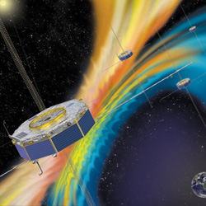
Test of Polynomial Reconstruction of the Magnetic Field
R. E. Denton, R. B. Torbert, Y.-H. Liu, I. Dors, H. Hasegawa, B. U. O. Sonnerup, C. T. Russell, R. J. Strangeway, B. L. Giles, and J. L. Burch, and the MMS SWT

Slide 2
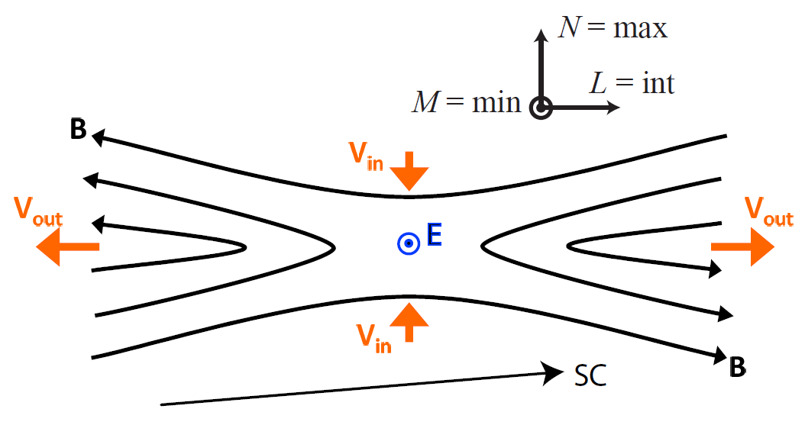
Notation
L,M,N = fixed directions for event
n = local maximum gradient direction from MDDB = local normal
m = local minimum gradient direction from MDDB = local "invariant" direction
l = local intermediate gradient direction from MDDB = local reconnection direction

Slide 3
The idea
Find quadratic B_{model} from fits to B_{sc} and Jp_{sc} (assuming Jp = ∇×B_{model})
Conditions to keep ∇⋅B_{model} = 0
Exact fit for full set of equations (Roy’s method) or least squares fit for reduced set of equations

Slide 4
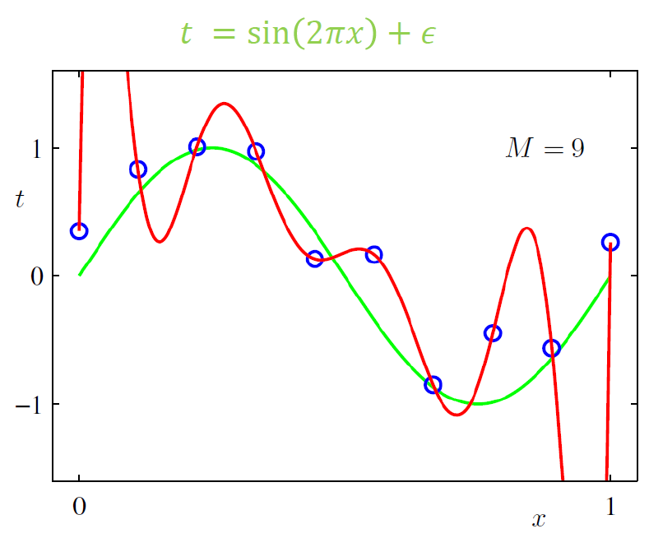
Overfitting
From “Machine Learning and Pattern Recognition”, Bishop

Slide 5
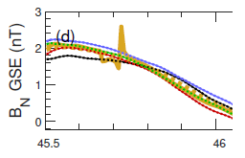
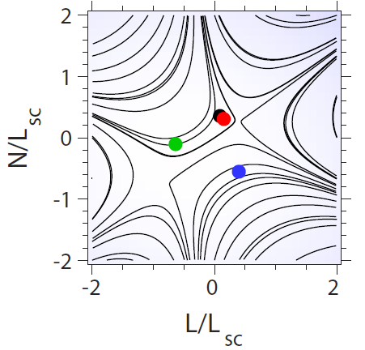
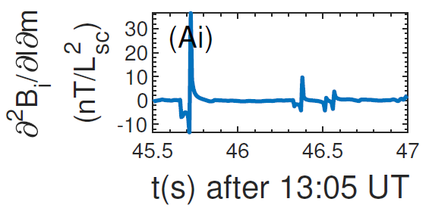
Signs of Overfitting

Slide 6
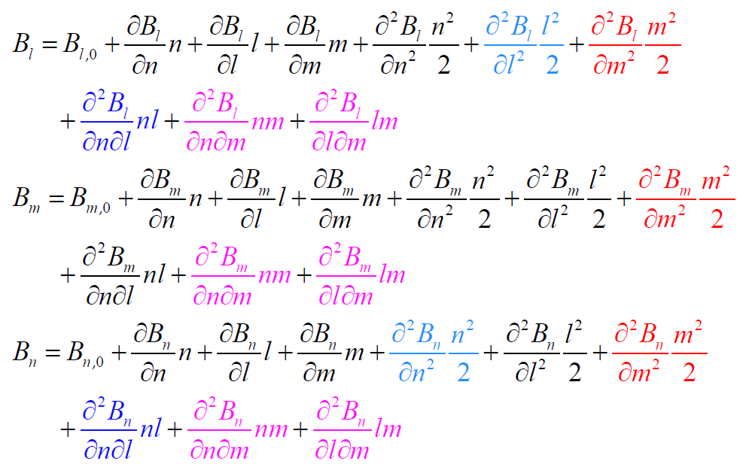
Polynomial Expansion of B

Slide 7
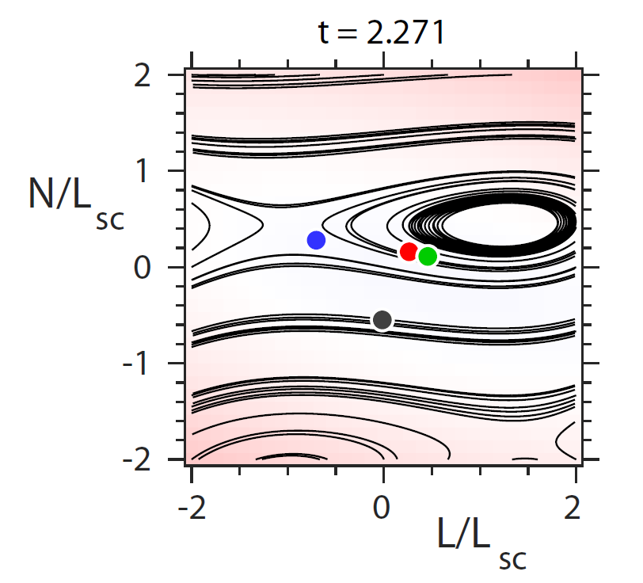
Artificial Features

Slide 8
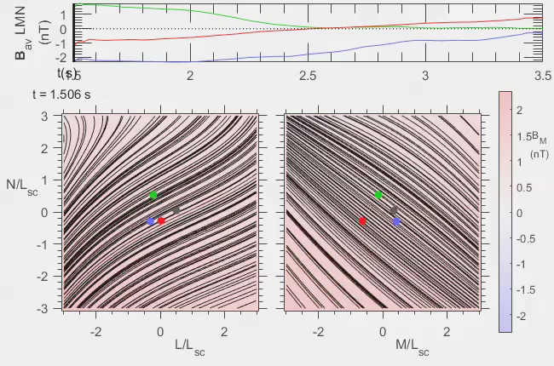
11 Jul 17 Mgtail Event (Torbert et al., Science, 2018)

Slide 9
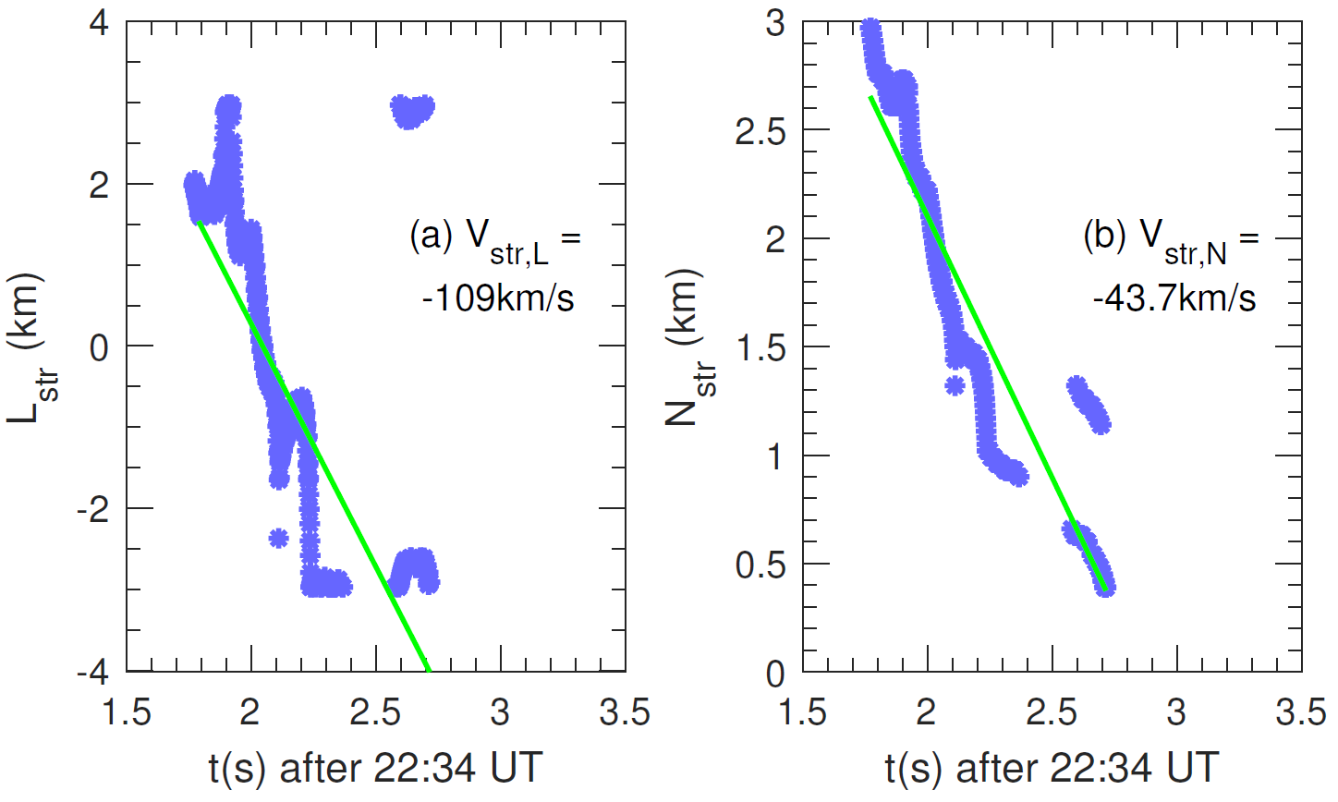
Tracking X Point

Slide 10
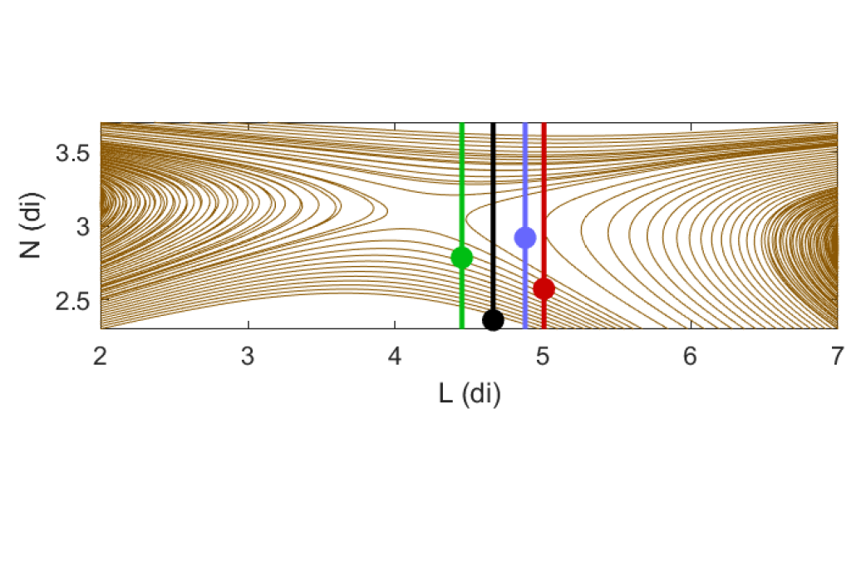
Virtual spacecraft flying through large-scale 3D PIC simulation (Yi-Hsin Liu et al., JGR, 2018)
*Magnetosphere*

Slide 11
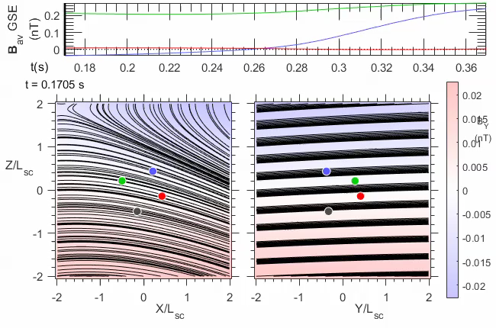
Video of structure moving past virtual spacecraft

Slide 12
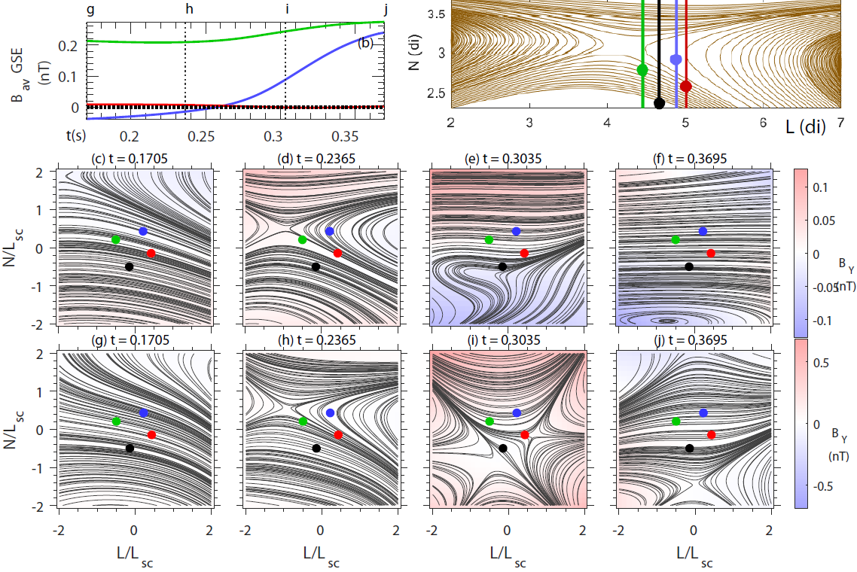
Reduced-Full Eqs Comparison

Slide 13
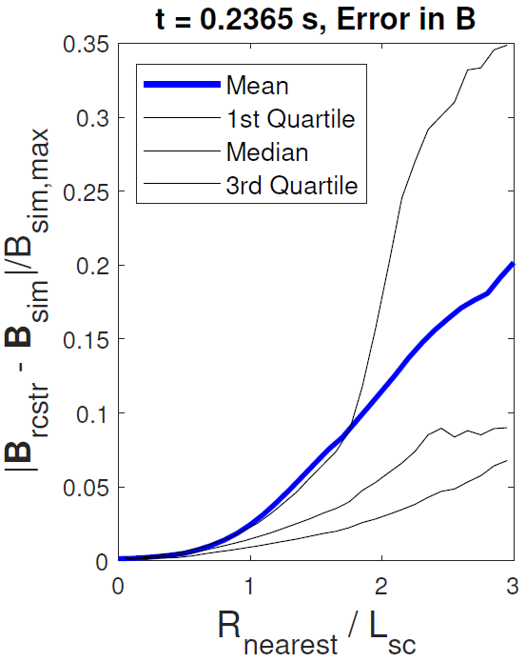
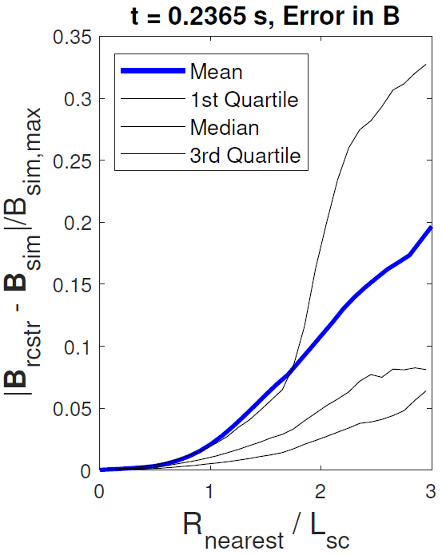
Reduced and full eqs Error 2nd column

Slide 14
3D dB

Slide 15
Reduced-Full Eqs Comparison

Slide 16
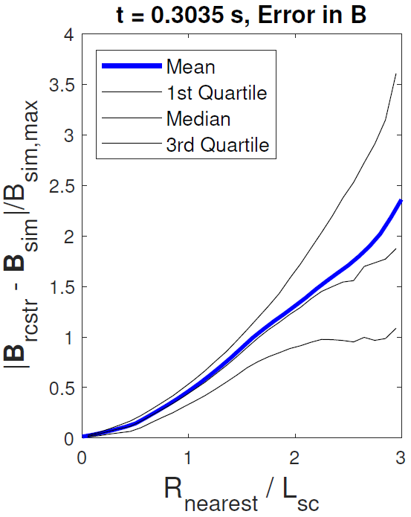
Reduced and full eqs Error 3nd column

Slide 17
Reduced-Full Eqs Comparison

Slide 18
Conclusions
A polynomial expansion of the magnetic field and particle current density can be useful for visualizing the reconnection geometry
Overfitting can be limited by using a reduced expansion
Method works better where there is significant variation of the magnetic field, better on the magnetosheath side than the magnetosphere side, and probably better for antiparallel reconnection without a guide field
Ivan Dors will be speaking more about this tomorrow

Slide 19
Spacecraft separation
Mass ratio in simulation = 25
Burch et al. 2016 Science paper event:
  Lsc = 0.19 di = 8.0 de
Here:
  Lsc = 0.6 di = 3 de
Averaging
  B, n_{e} and J_{e} (not J_{p}) averaged over Ω_{cp}⁻¹
  Then B and J averaged over path

Slide 20
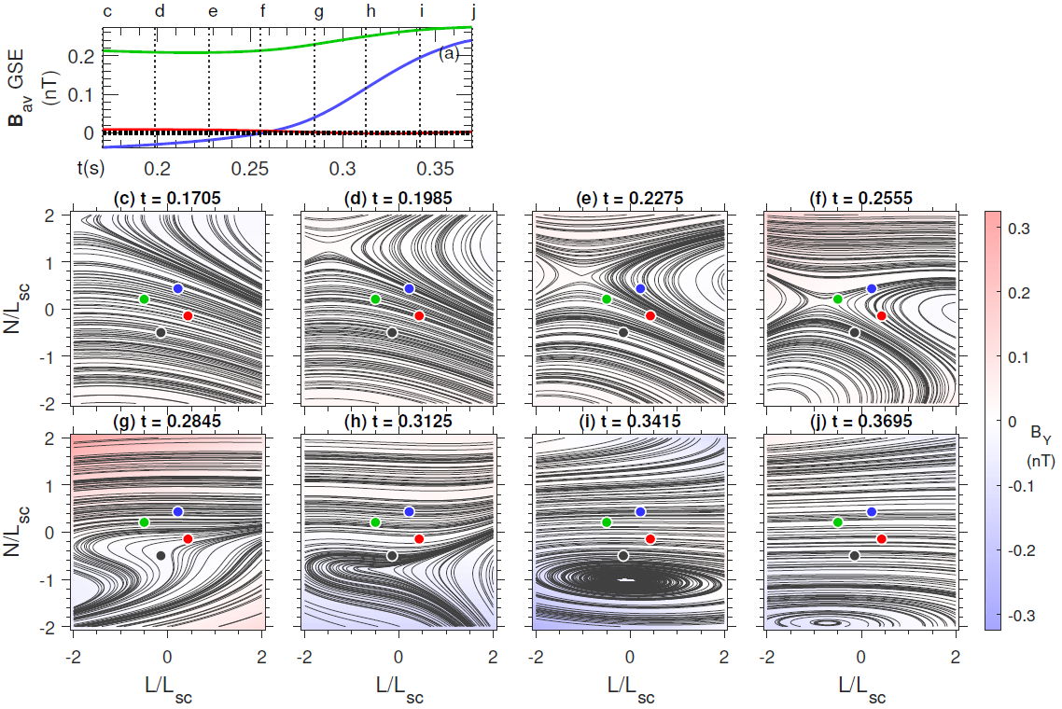
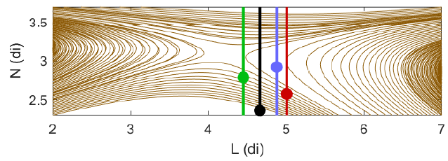
Reduced Eq Reconstruction

Slide 21
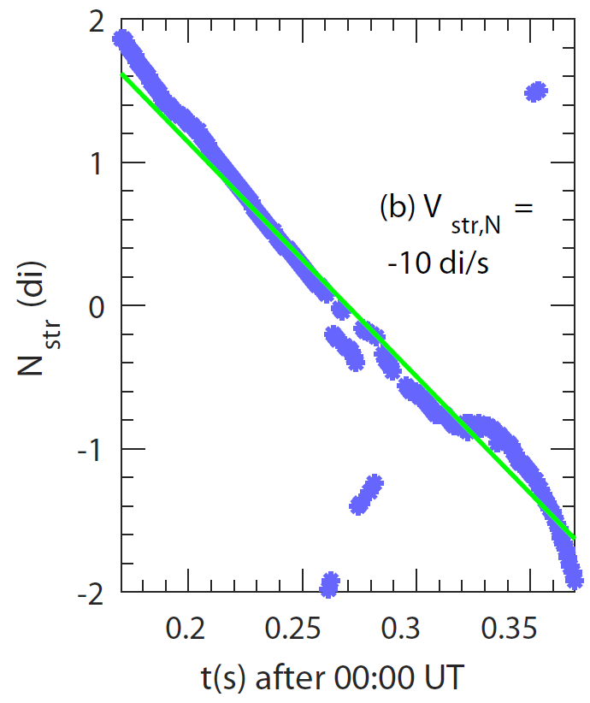
Velocity

Slide 22
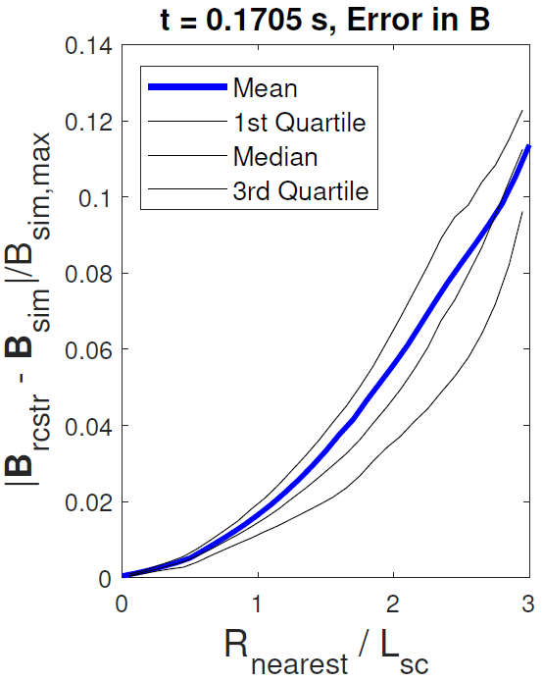
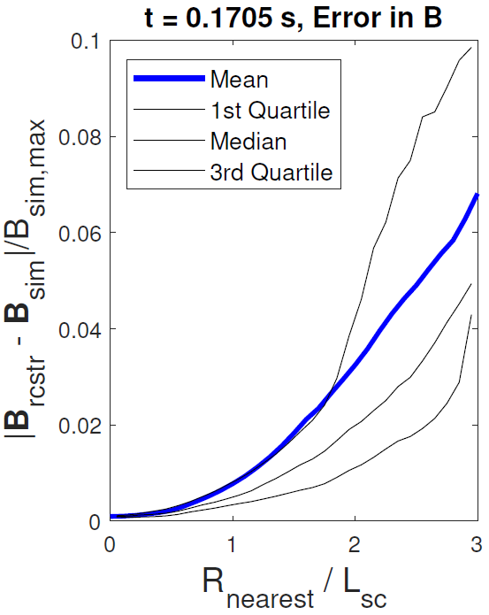
Reduced and full eqs Error 1st column

Slide 23
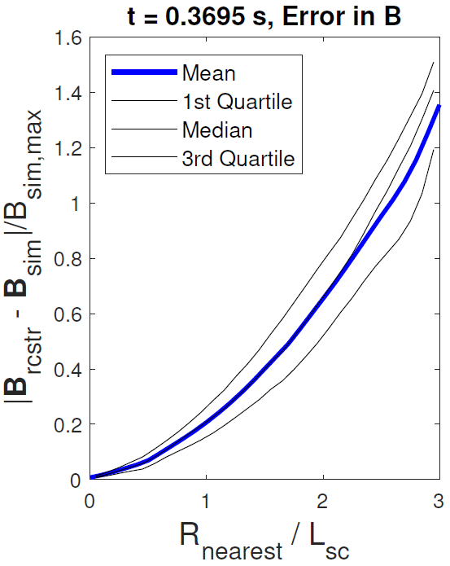
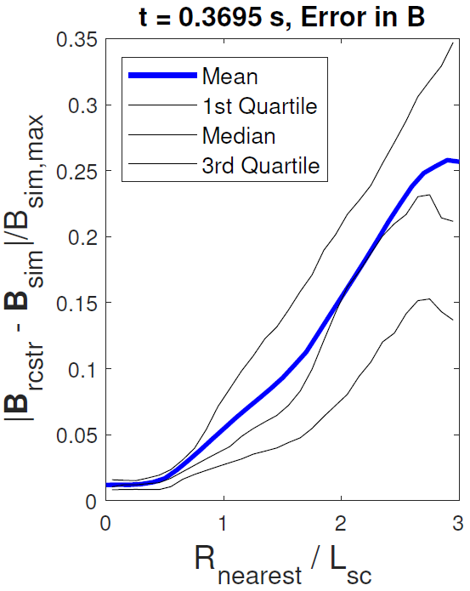
Reduced and full eqs Error 4th column

