Slide 1
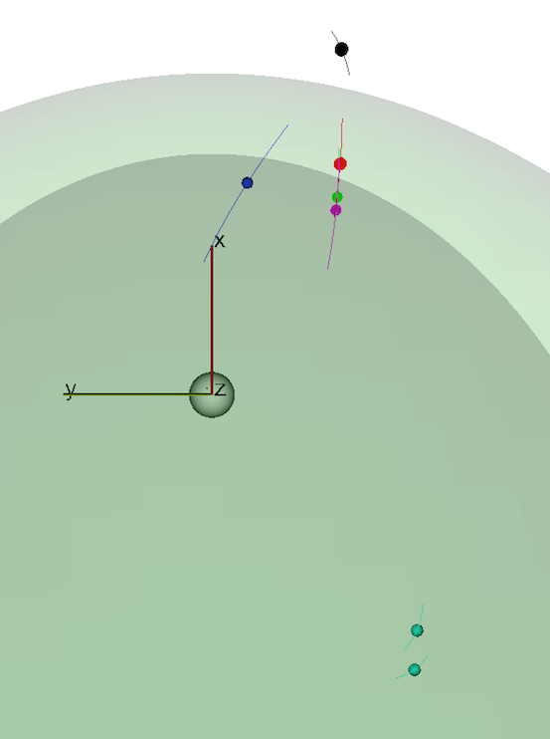
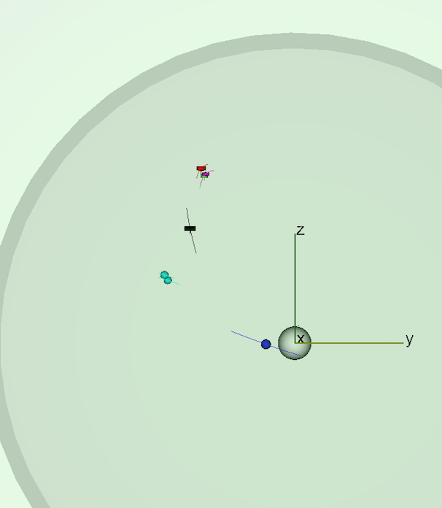
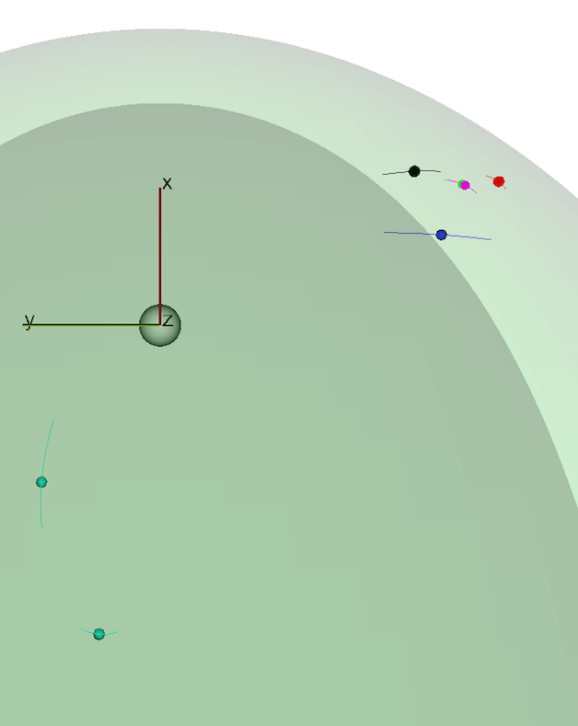
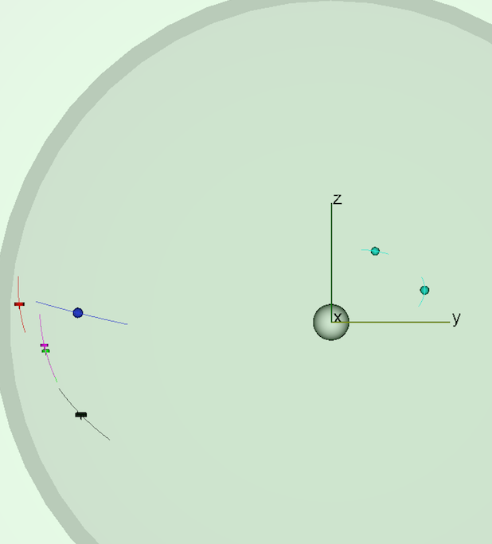
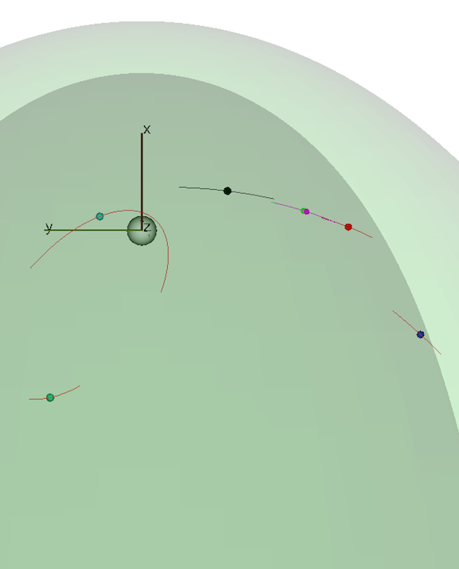
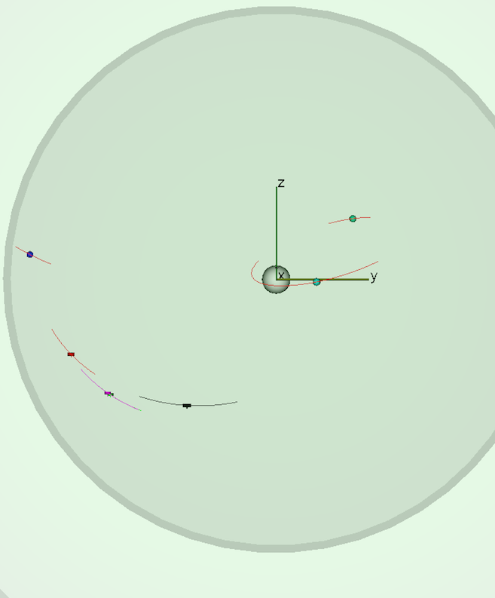
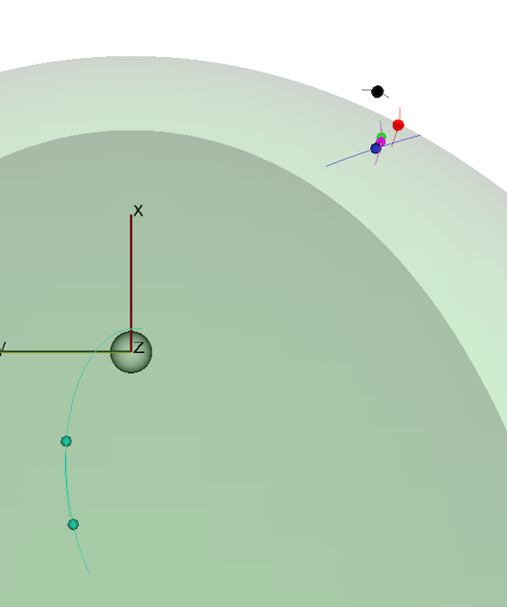
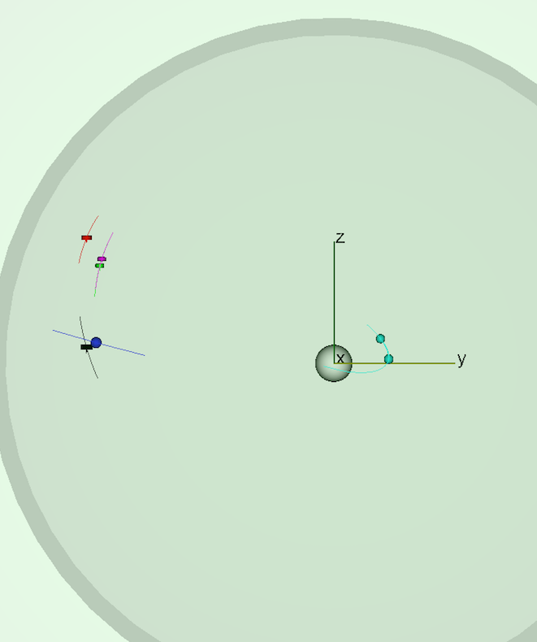
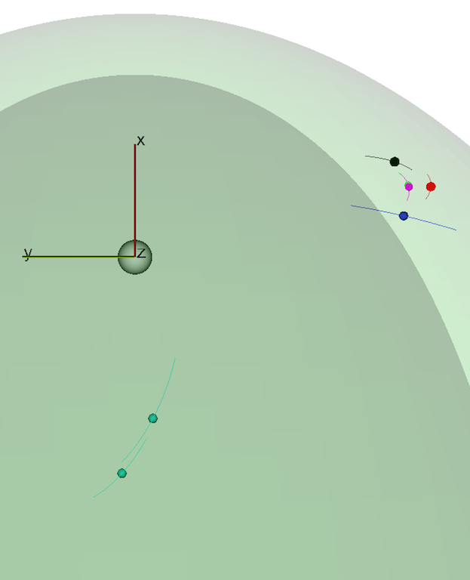
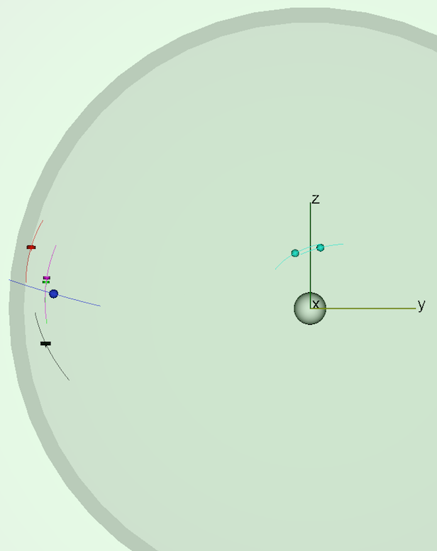
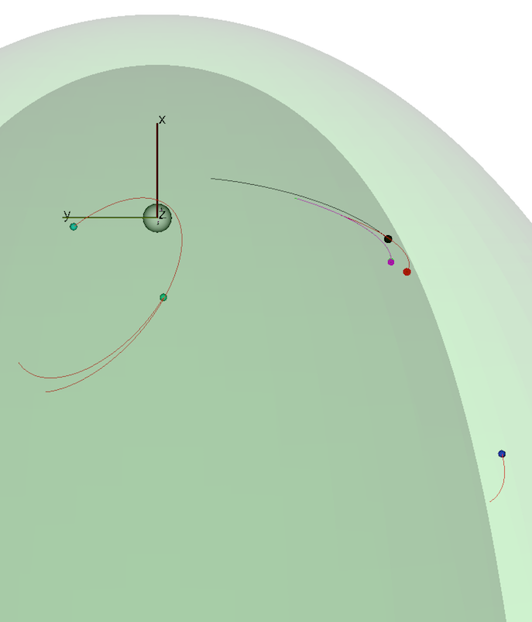
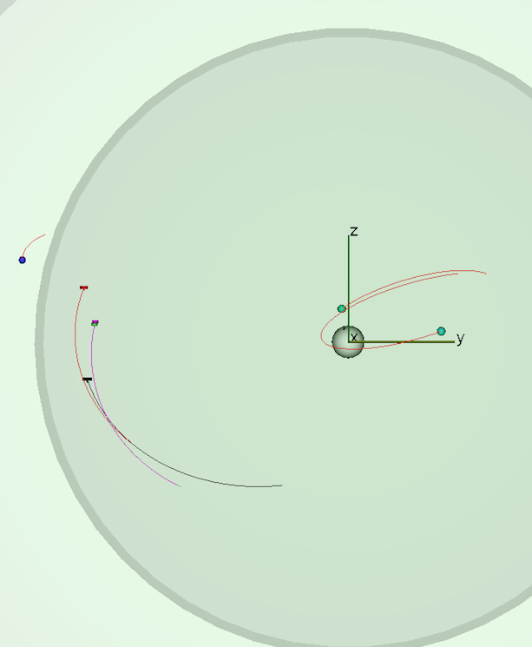
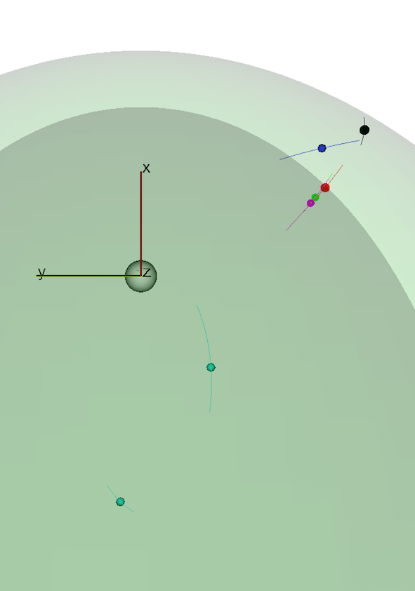
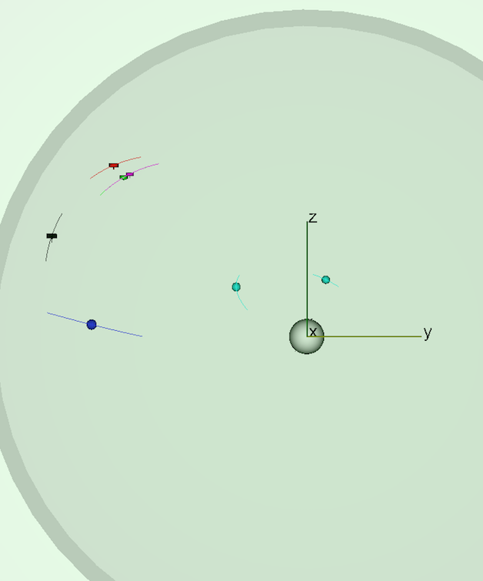
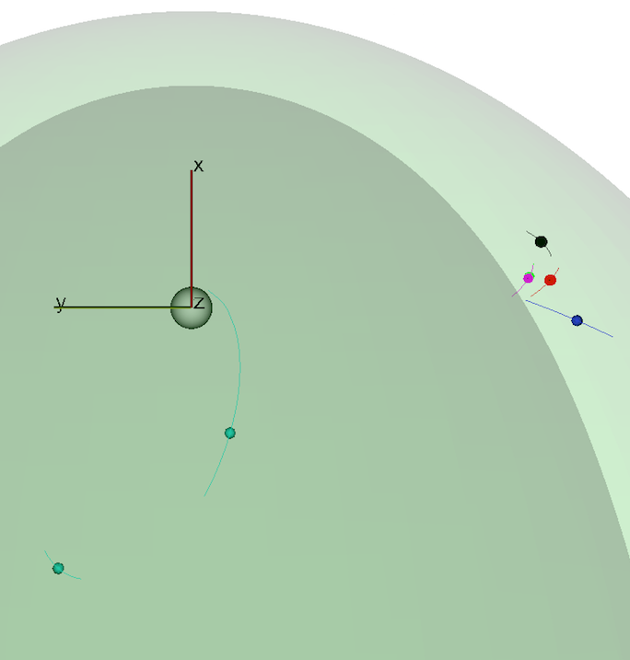
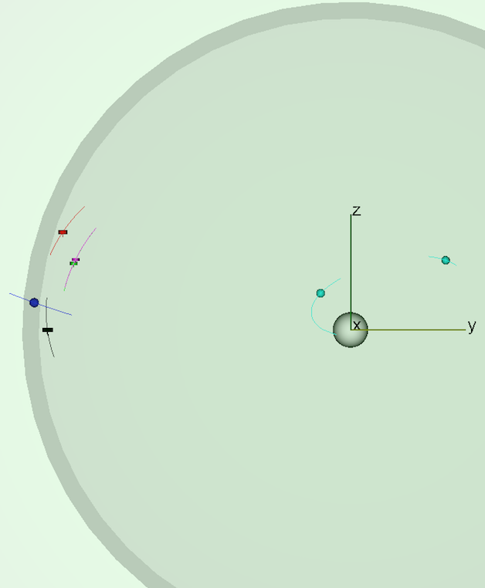
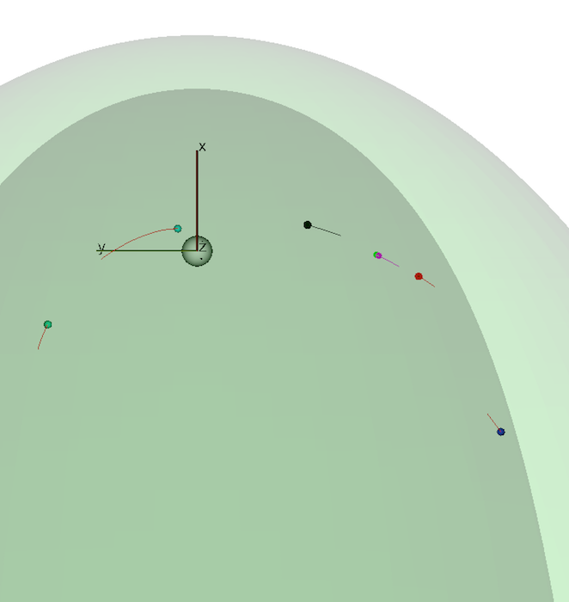
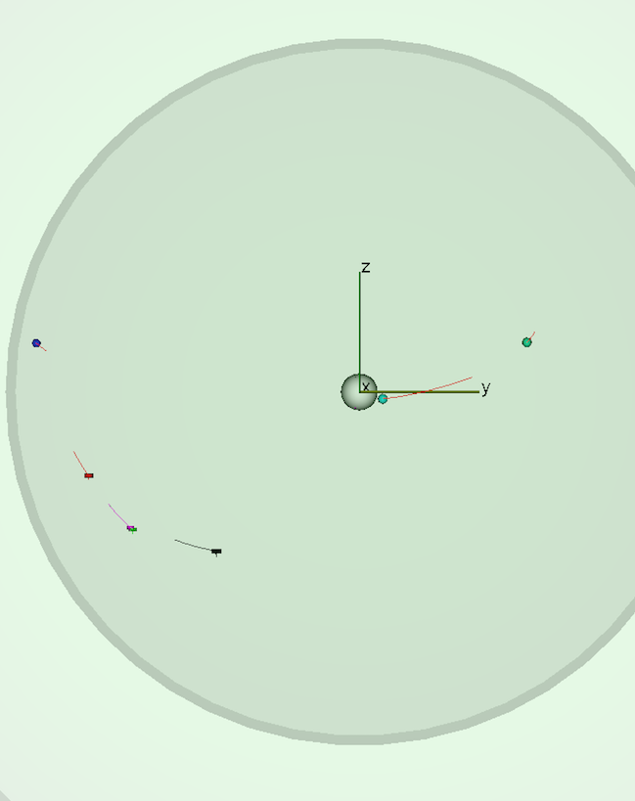
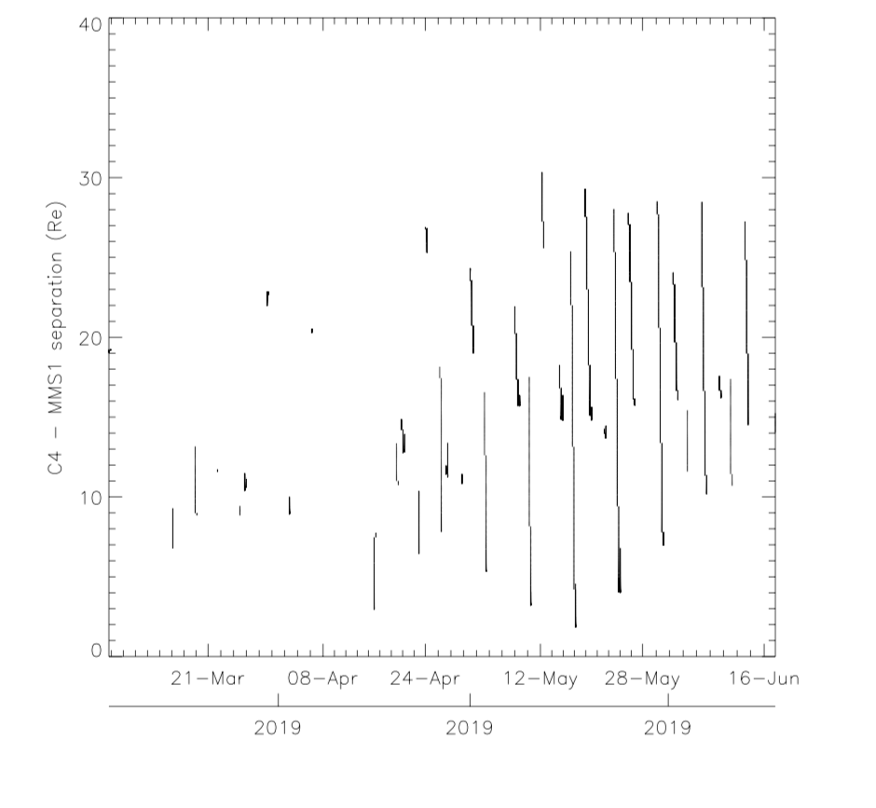
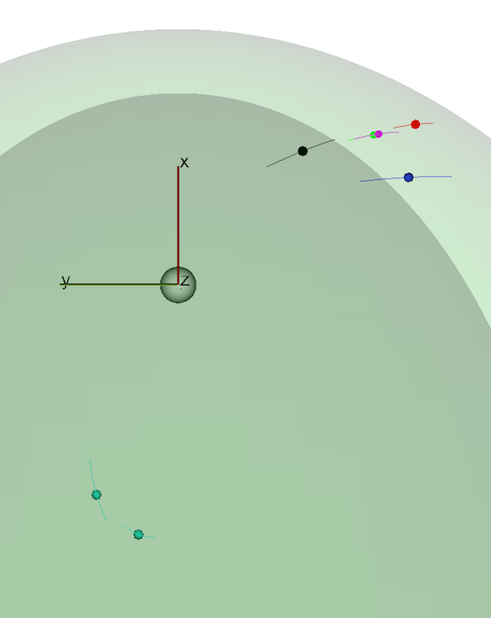
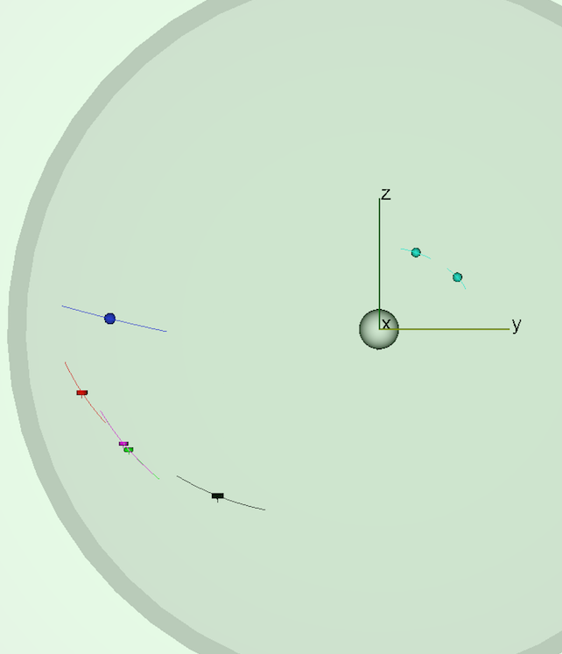
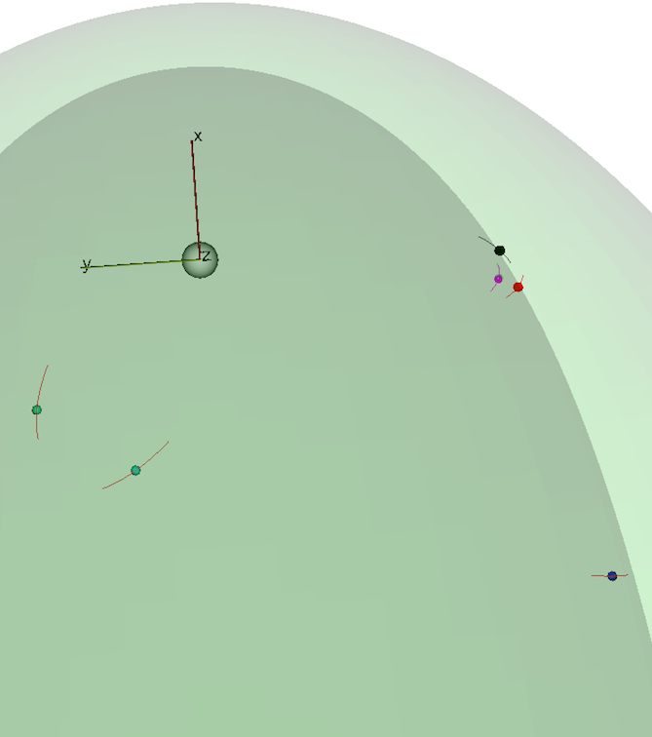
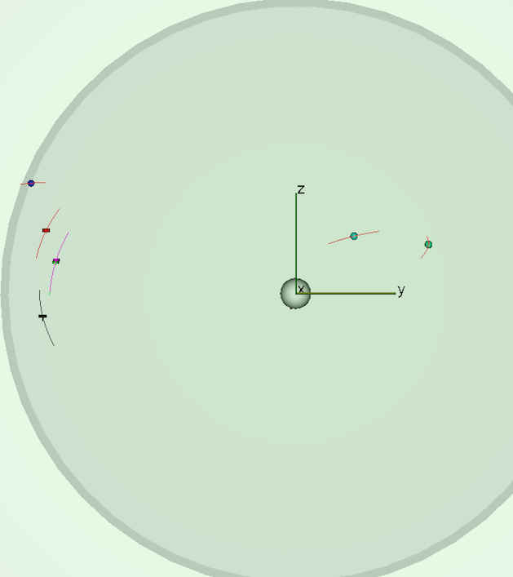
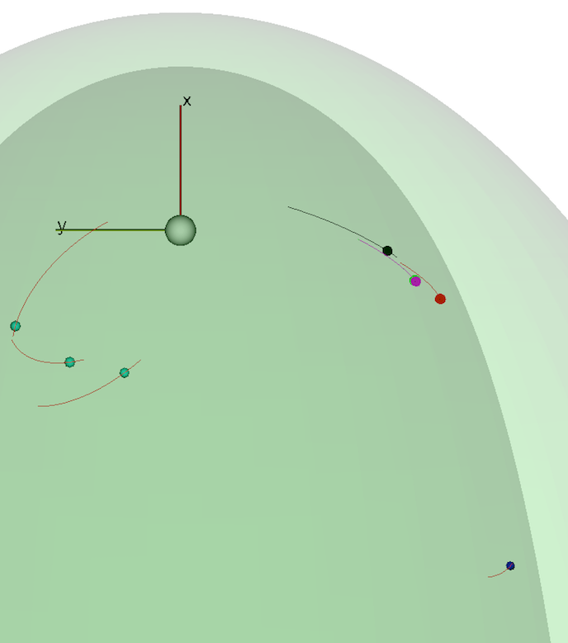
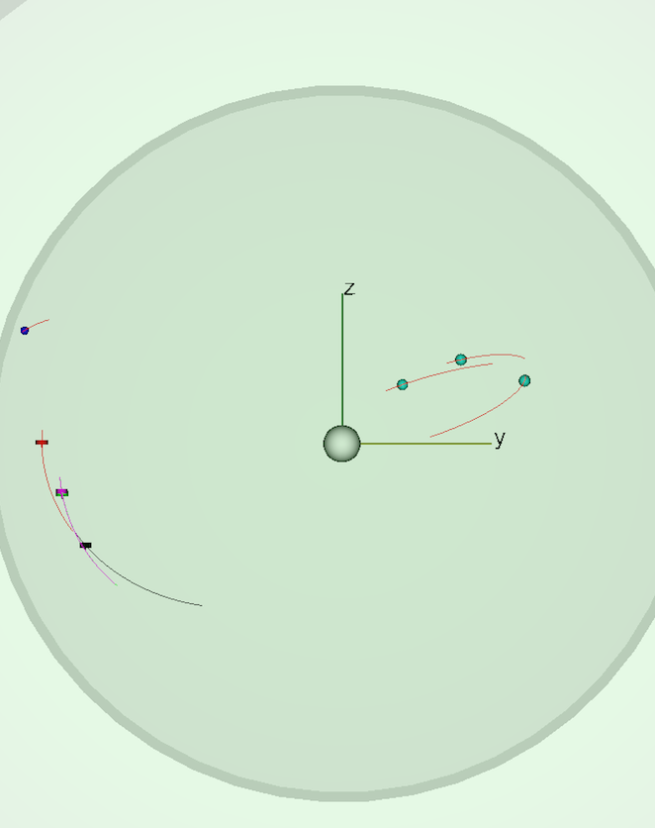
Upcoming Candidate MMS-Cluster-THEMIS Conjunctions Within the Magnetosheath, at the Magnetopause and the LLBL
C.P. Escoubet¹, S.M. Petrinec², R. Nakamura³, J. Hwang^{4,} S. Toledo⁵ and the MMS-Cluster ISSI team
¹ESA/ESTEC; ²Lockheed Martin Advanced Technology Center; ³Space Research Institute, Austria; ⁴Southwest Research Institute; ⁵IRAP/CNRS
Abstract. The MMS constellation continues its extended mission at a raised apogee of ~29.3 R_{E}, with highly elliptic 3-day orbits that sweep the dayside magnetosphere/magnetosheath/solar wind from local noon towards the dawn terminator and flank. Other operating missions (Cluster and THEMIS) also continue to actively sample the plasmas and fields of these regions of space. As such, during the next few months several candidate conjunction opportunities exist between these missions. This poster describes the most likely of these upcoming conjunction opportunities for which multi-point observations over a large range of spatial scales can be fully utilized.
A sampling of candidate conjunctions – projections of orbit segments
2019/03/15 14:00-18:00 (Magnetosheath/Magnetopause)
2019/05/10 11:00-15:00 (Magnetosheath C4-MMS1 < 5 R_{E})
2019/06/10 19:20 (Magnetopause skimming)
MMS
Cluster
Cluster
Cluster
MMS
THEMIS
MMS
THEMIS
THEMIS
Operating models used; criteria for conjunctions
Magnetopause:
Shue et al. 1997 model: ρv²=1.9 nPa, IMF B_{z} = 0 nT
‘conjunction’ relies on MP crossing times: |T_{Cl} – T_{MMS}| < 3hr
Magnetosheath:
Model magnetosheath region uses:
Bow shock: modified Fairfield 1971 model
Magnetopause: Roelof and Sibeck 1993 model
‘conjunction’ relies on spatial separation between
C4 and MMS 1 when both are in magnetosheath
High Latitude Boundary Layer (HLBL) and
Low Latitude Boundary Layer (LLBL):
Annular volume of thickness D defined just inside magnetopause. D widens from 0.4 R_{E} at the terminator to a fixed 4 R_{E} tailward of X=-40 R_{E}
LLBL: Location within D of MP; |Z| ≤ 3 R_{E} from neutral sheet
HLBL: Location within D of MP; |Z| > 3 R_{E} from neutral sheet
View from above equator (Sun at top)
View from Sun
View from above equator (Sun at top)
View from Sun
View from above equator (Sun at top)
View from Sun
2019/04/15 22:00-2019/04/16 02:00 (Magnetosheath C4-MMS1 < 5 R_{E})
2019/05/17 08:30-14:00 (Magnetosheath - nice constellation < 2 R_{E})
2019/06/13 14:00 (Magnetopause skimming, Cluster inside MP, MMS outside)
Cluster
MMS
Cluster
MMS
Cluster
THEMIS
THEMIS
THEMIS
MMS
View from above equator (Sun at top)
View from Sun
View from above equator (Sun at top)
View from Sun
View from above equator (Sun at top)
View from Sun
MMS-Cluster conjunctions:*
2019/04/22 23:00- 2019/04/23 03:00 (Magnetosheath/Magnetopause)
2019/05/24 09:00 (Magnetosheath C4-MMS1 < 5 R_{E})
2019/06/17 15:00 (Magnetopause skimming, Cluster & MMS inside MP)
Candidate Intervals (UT):
2019/03/15 14:00-18:00 (Msheath/Mpause)
2019/03/30 03:00-07:00 (Mpause)
2019/04/02 16:00-20:00 (Mpause)
2019/04/15 22:00 - 2019/04/16 02:00 (Msheath)
2019/04/19 12:30-16:30 (Mpause)
2019/04/22 23:00 - 2019/04/23 03:00 (Msheath/Mpause)
2019/04/30 20:00 - 2019/05/01 00:00 (Mpause)
2019/05/03 11:00-15:00 (Msheath)
2019/05/04 06:30-10:30 (Mpause)
2019/05/10 11:00-15:00 (Msheath)
2019/05/17 08:30-14:00 (Msheath)
2019/05/22 03:00-07:00 (Mpause)
2019/05/24 07:30-13:30 (Mpause + Msheath)
2019/05/25 19:00 - 2019/05/26 20:00 (Msheath)
2019/05/30 08:00 - 2019/05/31 07:00 (Msheath)
2019/06/01 19:00 - 2019/06/02 13:00 (Msheath)
2019/06/03 04:00-23:59 (Msheath)
2019/06/09 00:00-05:00 Cluster and MMS skimming MP
2019/06/10 17:00-21:30 Cluster and MMS skimming MP
2019/06/13 00:00-14:00 Cluster and MMS skimming MP
2019/06/17 15:00-17:00 Cluster and MMS skimming MP
2019/06/19 21:30 - 2019/06/20 04:30 HLBL or LLBL
MMS
Cluster
Cluster
Cluster
MMS
THEMIS
THEMIS
THEMIS
MMS
Cluster/MMS separation
in magnetosheath
View from above equator (Sun at top)
View from Sun
View from above equator (Sun at top)
View from Sun
View from above equator (Sun at top)
View from Sun
2019/05/03 11:00-15:00 (Magnetosheath C2-MMS1 < 5 R_{E})
2019/06/09 02:40 (Magnetopause skimming)
2019/06/20 04:00 (Cluster & MMS in HLBL or LLBL)
Cluster
MMS
Cluster
Cluster
THEMIS
THEMIS
THEMIS
MMS
MMS
View from above equator (Sun at top)
View from Sun
View from above equator (Sun at top)
View from Sun
View from above equator (Sun at top)
View from Sun
Threshold
separation
SUMMARY
22 predicted Cluster-MMS conjunctions at magnetopause/magnetosheath/BL between 2019 March 15 and June 20
Cluster and MMS in magnetotail after 2019 June 20
Plan to use 4h burst mode on Cluster for most conjunctions
Tail conjunctions not looked at yet
*THEMIS A, D, E in the magnetotail during entire period

