Slide 1
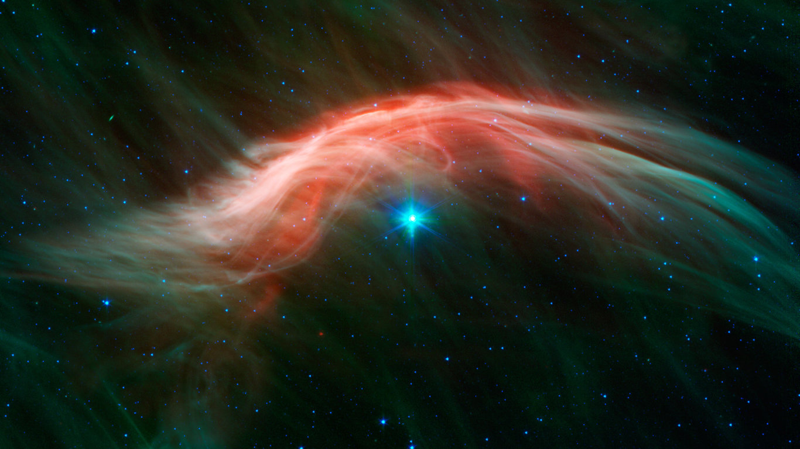
Impulsively Reflected Ions: A New Theory for Ion Acoustic Wave Growth in Collisionless Shocks
K. A. Goodrich, R. E. Ergun, S. J. Schwartz, L. B. Wilson III and the MMS Team

Slide 2
Shocks Convert Kinetic Energy to Thermal Energy… But How?
Collisionless Shocks
Rankine-Hugoniot Conditions:
mass in = mass out
momentum in = momentum out
energy in = energy out*
*We do not know exactly how energy is converted in the shock
???
Energy can be converted in many ways:
Turbulence
Particle Reflection
Other Nonlinear Processes
But this part is hard to observe

Slide 3
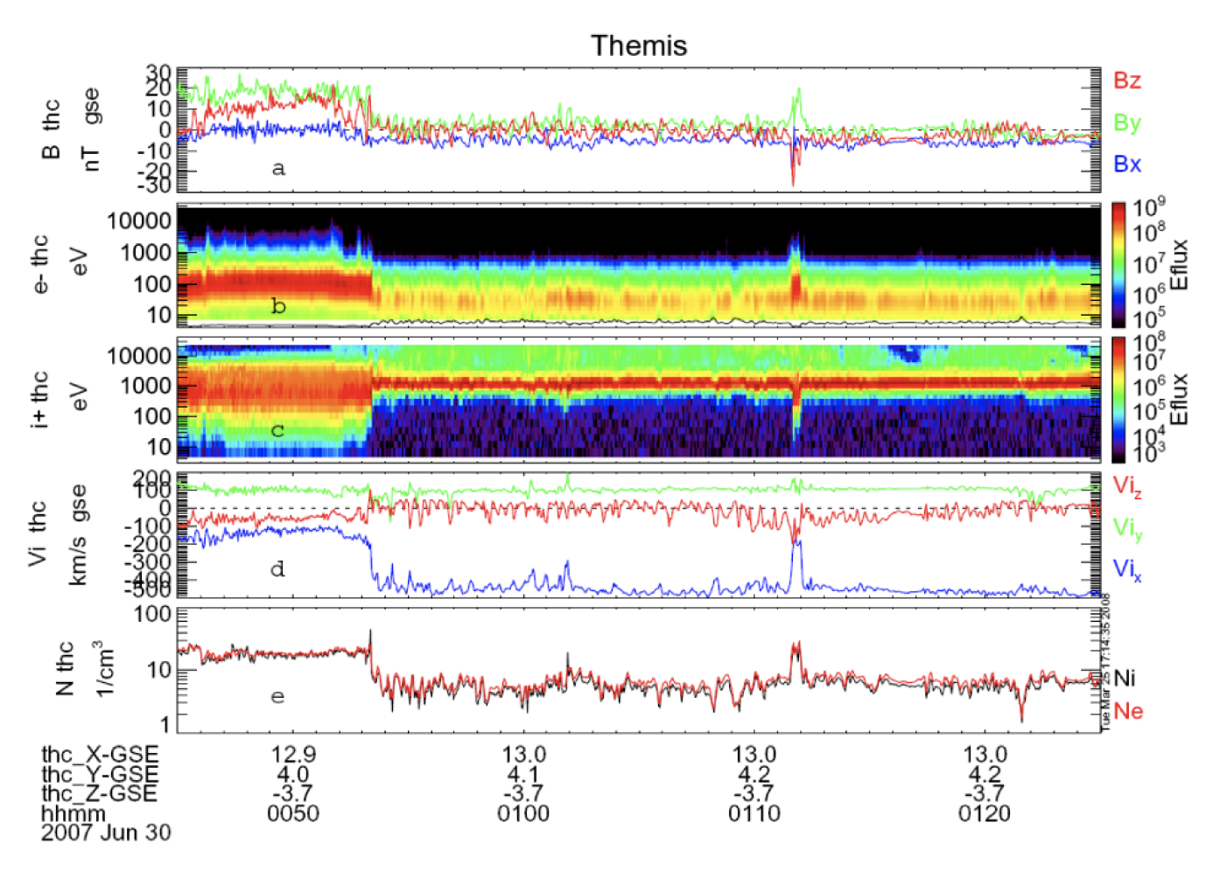
Why We Need E Field at Shocks
Shock
THEMIS
~80 minutes
~3 second
Particle time resolution
Only a few data points of particle data during actual shock
For physics inside the shock, we often need E field (kSamples/s)
McFadden et al., [2008]

Slide 4
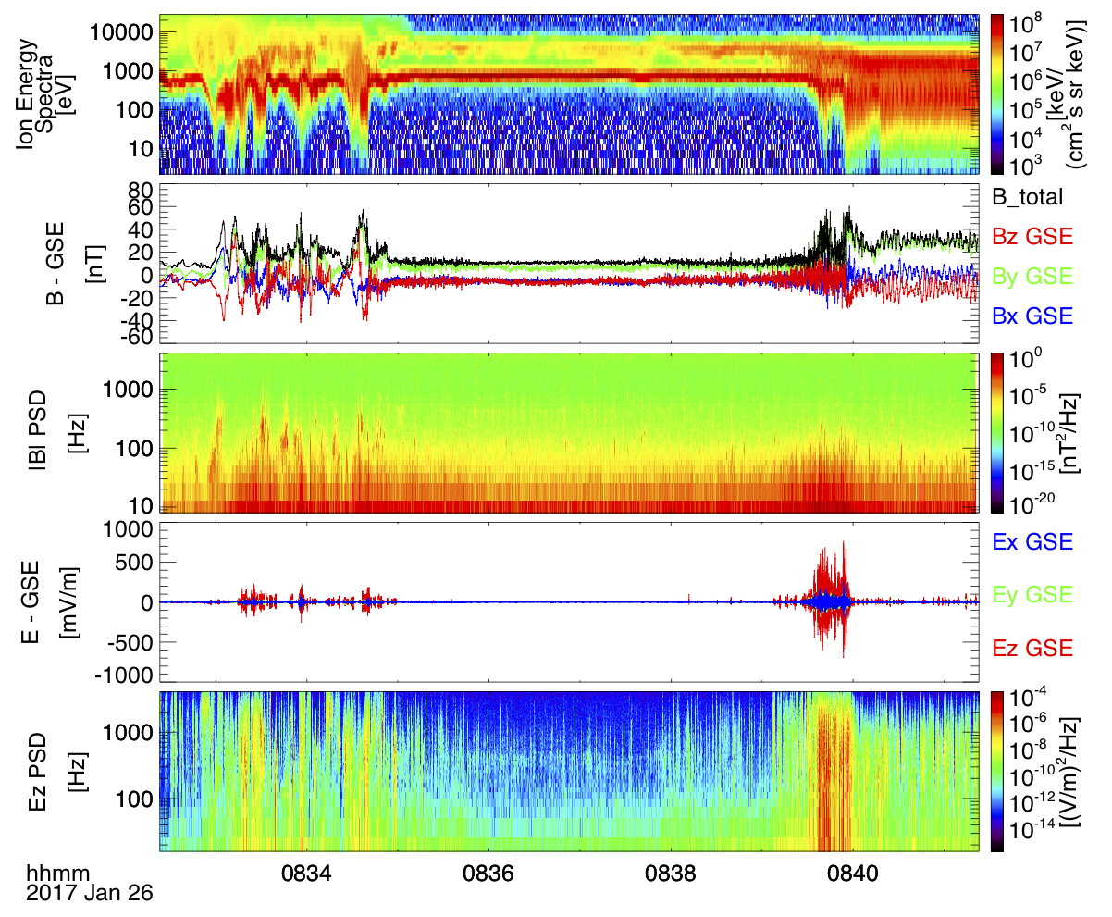
The Bow Shock has a LOT of Wave Activity
MMS
~9 min
0.03/0.15 ms
e/ion resolution
EM Whistler Waves
Magnetosonic Waves
< 100 Hz
Up to 700 mV/m!
Large Amplitude E
*(that’s really high!)
Electrostatic noise
100 Hz to kHz

Slide 5
Electrostatic Noise = Even More Waves
Electrostatic Solitary Waves
Electron Bernstein Waves
Ion Acoustic Waves

Slide 6
Electrostatic Noise = Even More Waves
Electrostatic Solitary Waves
Electron Bernstein Waves
Ion Acoustic Waves
We’re going to focus on IAWs

Slide 7
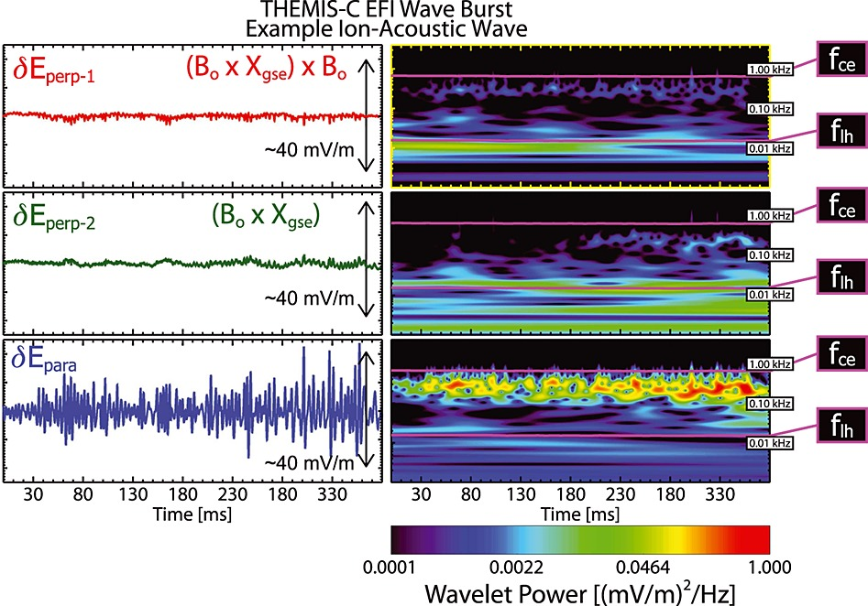
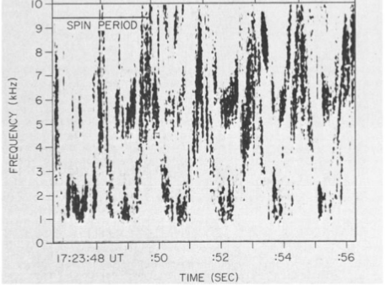
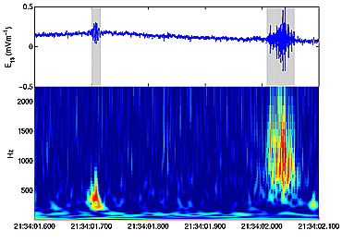
Wilson et al., [2014]
Fuselier and
Gurnett, [1984]
Ion Acoustic Waves (IAWs) are frequently observed in the terrestrial bow shock and foreshock
Short wavelength (~100 m)
Propagate obliquely to B
Can have very high amplitudes (> 100 mV/m
Balikhin et al., [2005]

Slide 8
The Problem with IAWs
IAWs are frequently observed in the bow shock
But no one really knows why…
Theoretically IAWs are generated by
Current instabilities
Ion-ion counterstreaming
But both require a high Te/Ti ratio > 3
This rarely happens at the bow shock
Some processes can reduce Te/Ti
But we haven’t been able to observe them!

Slide 9
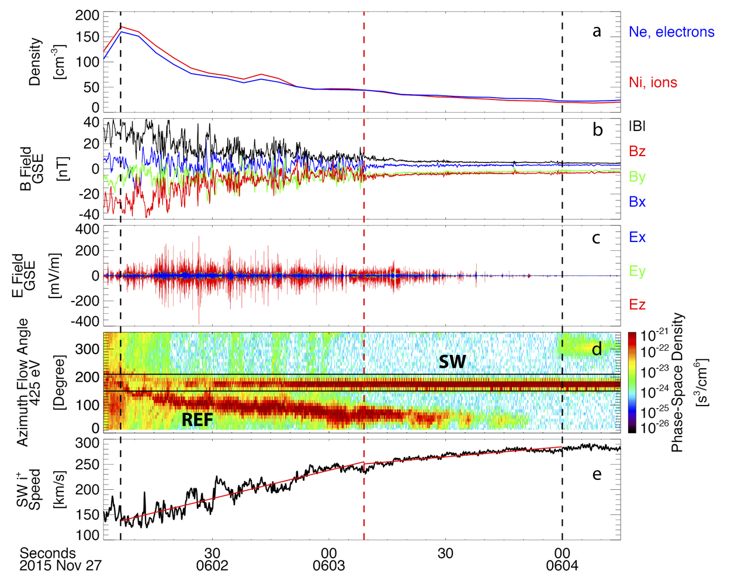
Observations: Shock Event
θ_{N} ~ 43°
M_{A} ~ 11
β ~ 3
Te/Ti ~ 2
Solar
Wind

Slide 10
Observations: Shock Event
B: Turbulent
B: Steady
E: Many wave modes
E: Mostly IAWs
SW Speed: Strong deceleration localized acceleration
SW Speed: Slight deceleration!

Slide 11
Observations: Shock Event
B: Turbulent
B: Steady
E: Many wave modes
E: Mostly IAWs
SW Speed: Strong deceleration localized acceleration
SW Speed: Slight deceleration!

Slide 12
Observations: Shock Event
B: Turbulent
B: Steady
E: Many wave modes
For more details on this event:
Goodrich, K. A., et al. (2018). MMS observations of electrostatic waves in an oblique shock crossing. Journal of Geophysical Research: Space Physics, 123. https://doi.org/10.1029/2018JA025830
E: Mostly IAWs
SW Speed: Strong deceleration localized acceleration
SW Speed: Slight deceleration!

Slide 13
Observations: Ion Acoustic Waves
Seen with reflected ions (not currents)
Short wavelength
(< 200 m)
Frequency at f_{pi}
f_{pi} ~ 1 kHz
Short durations
10 -100 ms
Broadband spectral signatures
Propagates obliquely to B
B
E
REF
SW
Speed

Slide 14
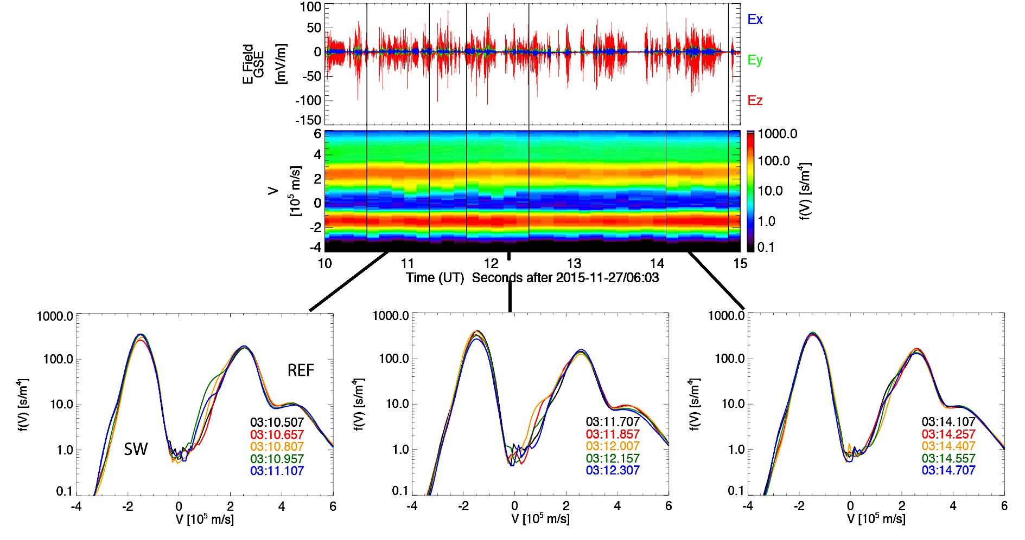
Observations: Ion Distributions
~6 seconds
Large variations between 150 ms distributions
Consistent with ion beams
.75 sec
*f(V) Integrated along vector of least difference between SW and reflected ions

Slide 15
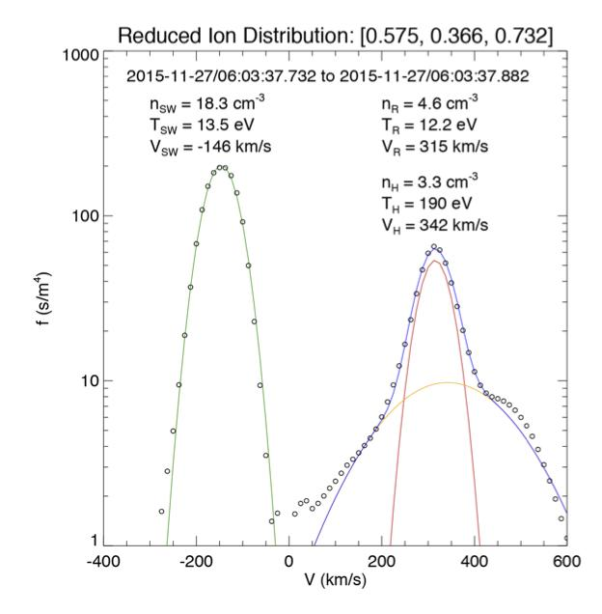
Theory and Analysis: Fried-Conte Solver
To see if IAWs can be generated we…
Break up 1D distribution into series of Maxwellians
Solar Wind
Reflected Ions
Hot Cloud
electrons (not shown)
Use Maxwellians to derive longitudinal dielectric function
H
SW
R
χ = susceptibility of each Maxwellian
3) When 0 waves can exist

Slide 16
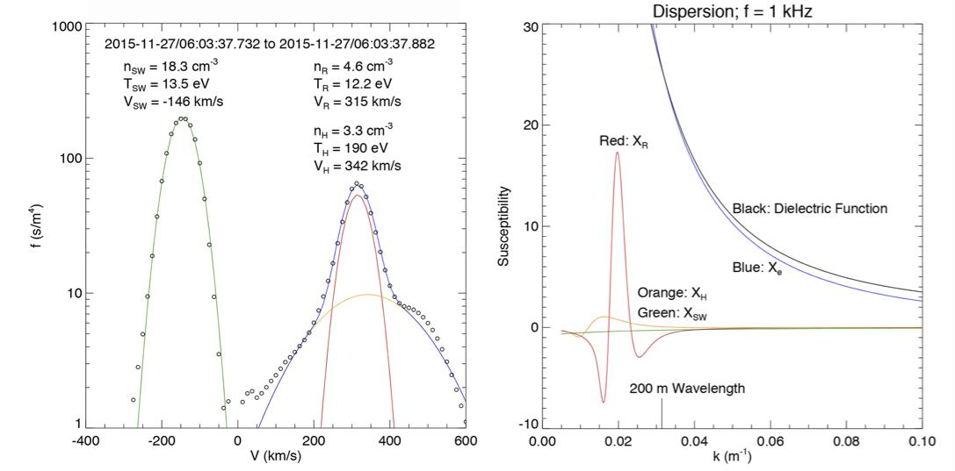
Theory and Analysis: Unaltered Distribution
No waves!

Slide 17
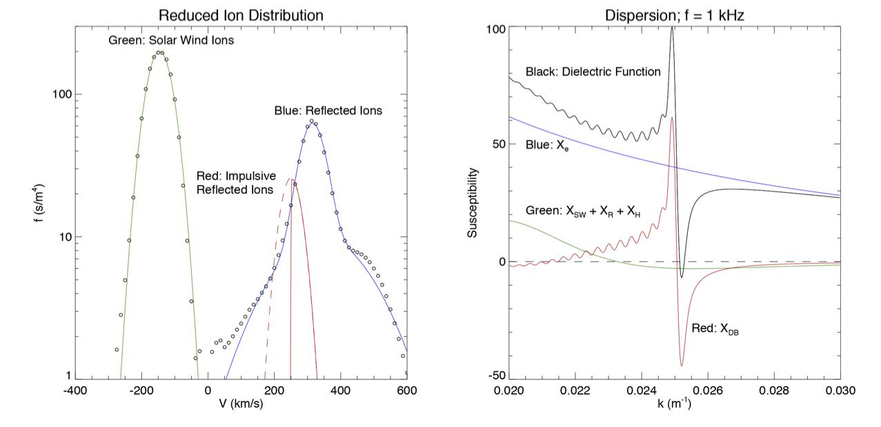
Theory and Analysis: Added Beam
Half-Maxwellian proxy for impulsive burst of reflected ions
Two roots
ϵ $=0$
Waves!

Slide 18
Theory and Analysis: Added Beam
Unstable to Waves with…
f ~ 1 kHz (close to f_{pi})
λ~250 m (close to observed λ)

Slide 19
Observations vs Model
Observations
Model
-
λ ~ 250 m
f ~ 1 kHz (f_{pi})
unclear how long these waves persist
< 100 mV/m
λ < 200 m
f ~ 1 kHz (f_{pi})
observed between 10 and 100 ms

Slide 20
Implications
Need a very strong positive slope to create instability
That slope can erode very quickly from...
Slower ions filling in the distribution
Ion reflection can happen at various points throughout the shock
Quasilinear diffusion
Slows reflected ions
May also decelerate solar wind ions!

Slide 21
Conclusions
MMS observes IAWs in an oblique shock
IAWs likely caused by ion-ion counterstreaming
Te/Ti too low to allow IAW generation
Short time-scale variations seen in ion distribution functions
Fried-Conte analysis shows dispersive ion bursts can allow IAW generation.
Waves may be quickly damped due to
Slower moving ions
Quasilinear diffusion
Suggests ions can be impulsively reflected at various points of the shock.
IAWs may also serve as a secondary method of solar wind deceleration

