Slide 1
Electron Acceleration during September 8, 2018
Andrew Marshall
Rice University, Southwest Research Institute
Jim Burch, Pat Reiff, James Webster, Joo Hwang, Rumi Nakamura

Slide 2
EDR at the center of a flux rope embedded in a dipolarization front.
There is a flux rope in a dipolarization front as first observed by
[Tang, 2018]
MMS sees an EDR at the center of the flux rope similar to the dayside event in [Øieroset, 2016]
There is a strong electron jet similar to [Liu et al., 2018]
EDR resembles a strong guide field dayside event such as the December 8, 2015 event [Genestreti et al., 2017]

Slide 3
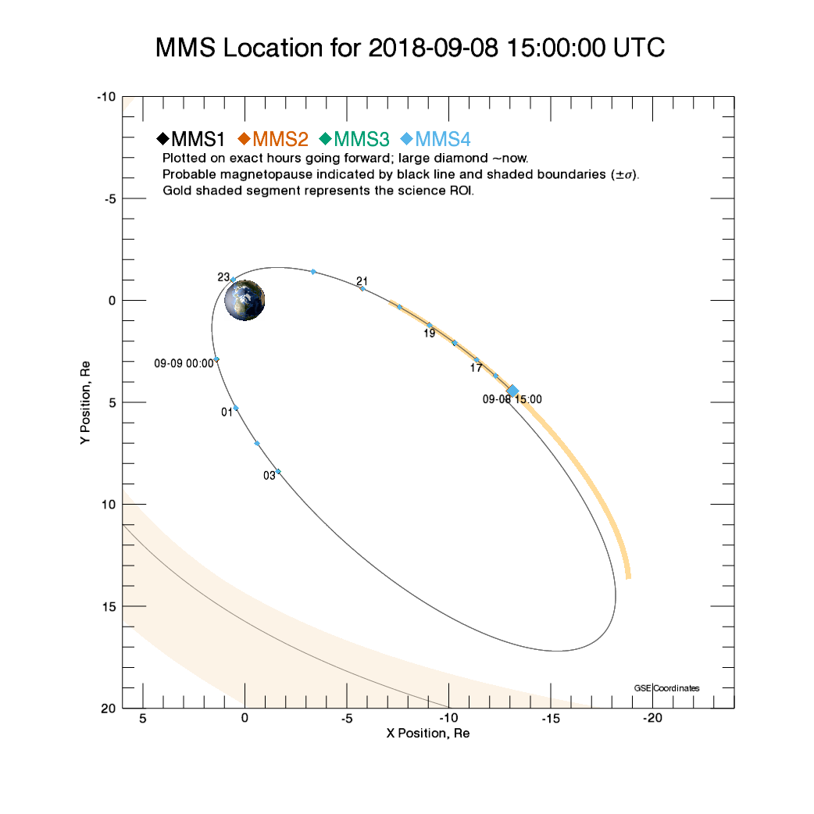
Event occurred at 14:51:31 UTC
MMS position in GSE was about (x,y,z)=(-13.4, 5.6, 0.84) Re
Spacecraft separation was 60km.

Slide 4
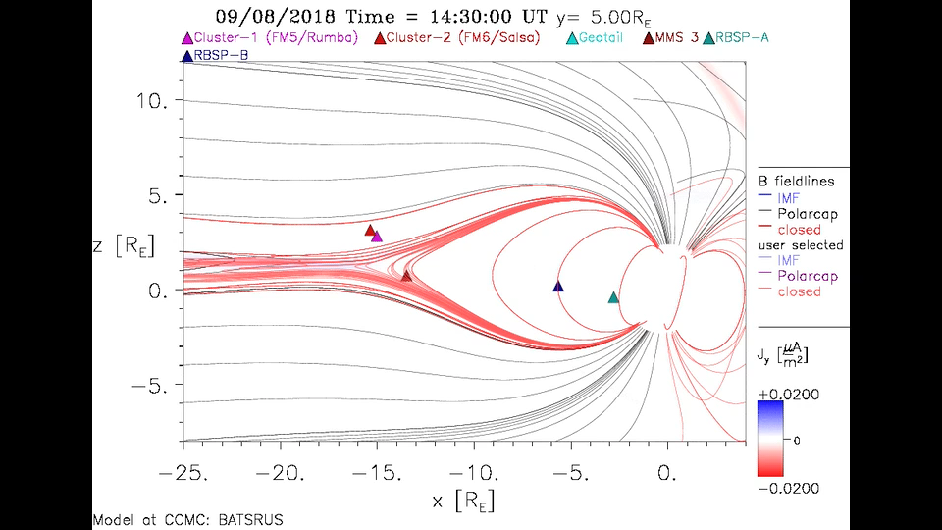
14:30 – 15:15 MHD Simulation

Slide 5
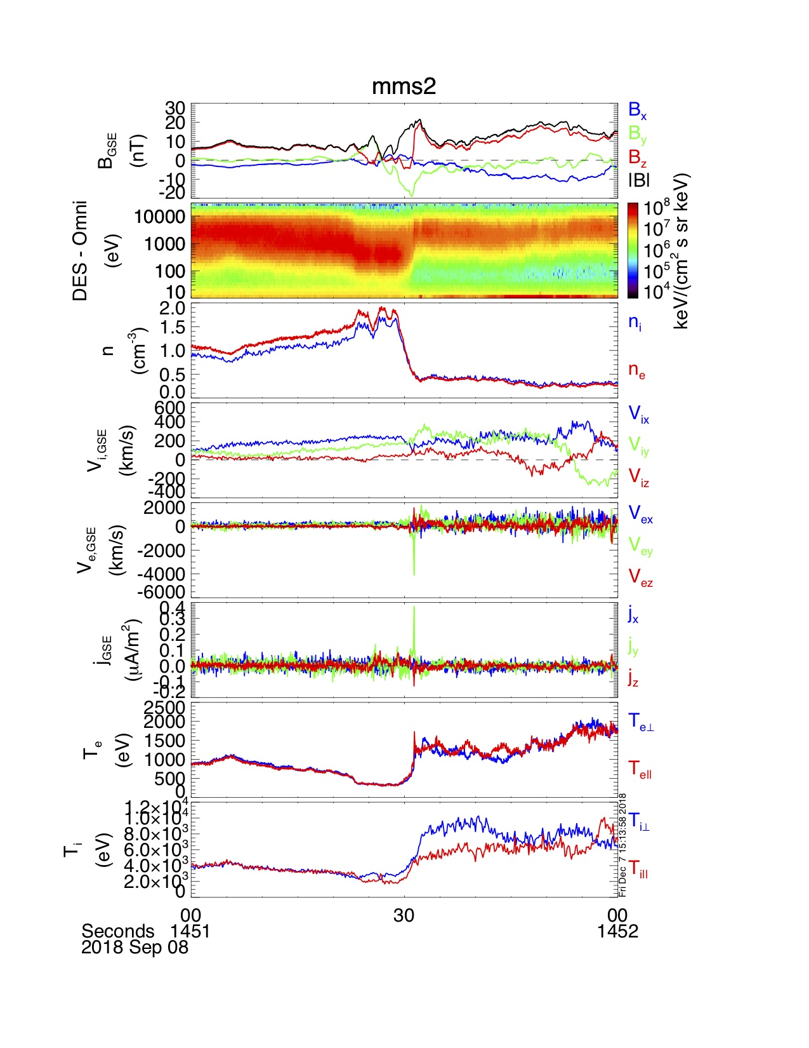
Dipolarization Front
B_{z} increases noticeably across the event
Before 14:51:30 UTC, number density builds slightly
Density drops significantly as temperature rises.
B_{z} also has a dipolar signature suggesting a flux rope

Slide 6
Flux Rope
Increase in |B|
Enhancement in B_{y} near maximum |B|
B_{z} is dipolar and increases noticeably across the event
B_{z} drops a bit just before center and overshoots its final value

Slide 7
EDR?
Applied MFR analysis [Khrabov, 1998]
L = [-0.103, 0.408, 0.907]
M = [0.103, 0.911, -0.398]
N = [ -0.989, 0.052, -0.136]
Clear reversal in L-component of magnetic field
Large electron jet in M-direction
Significant dissipation

Slide 8
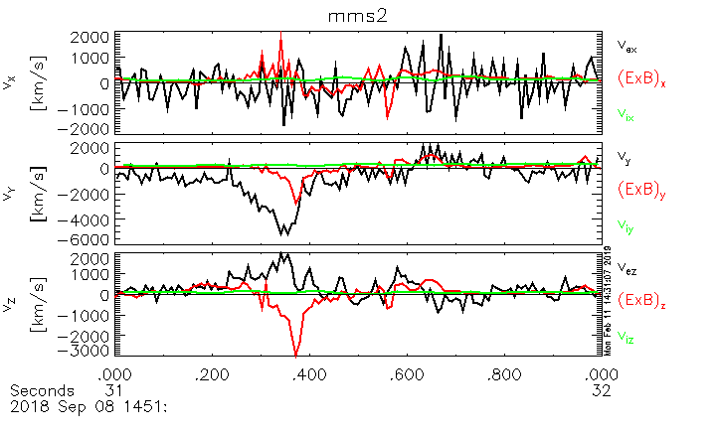
Electrons are not frozen-in
Ions seem almost unperturbed
Ions and electrons both are frozen-in before and after the event

Slide 9
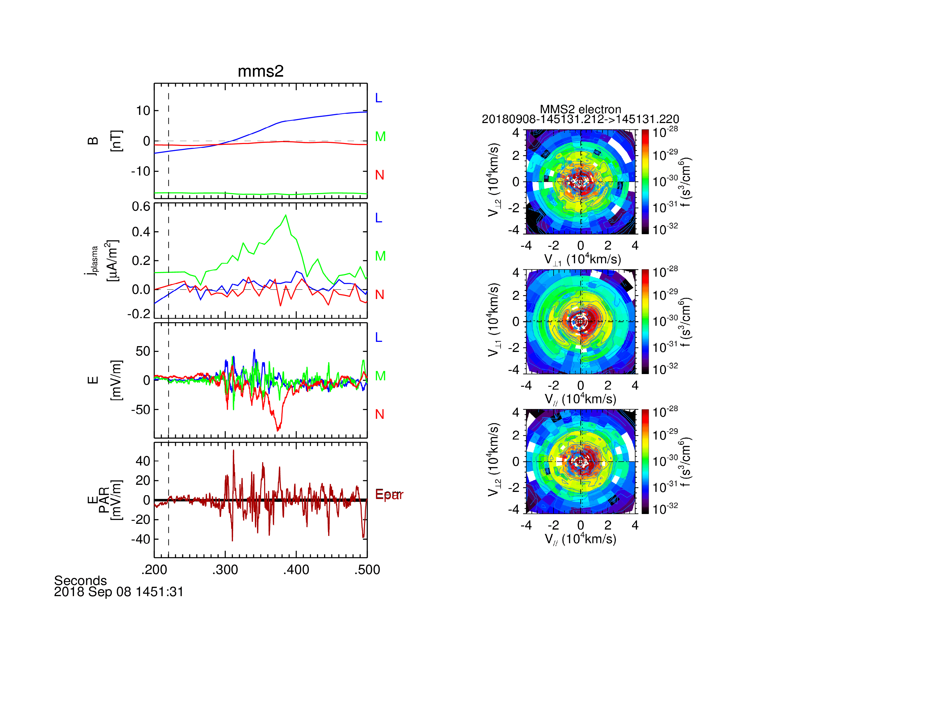
Electric Fields and Electron Acceleration
Most evident E-field structure is in the N-direction
Parallel electric field has a large magnitude, but no obvious uni-polar structure
Similar to dayside event

Slide 10
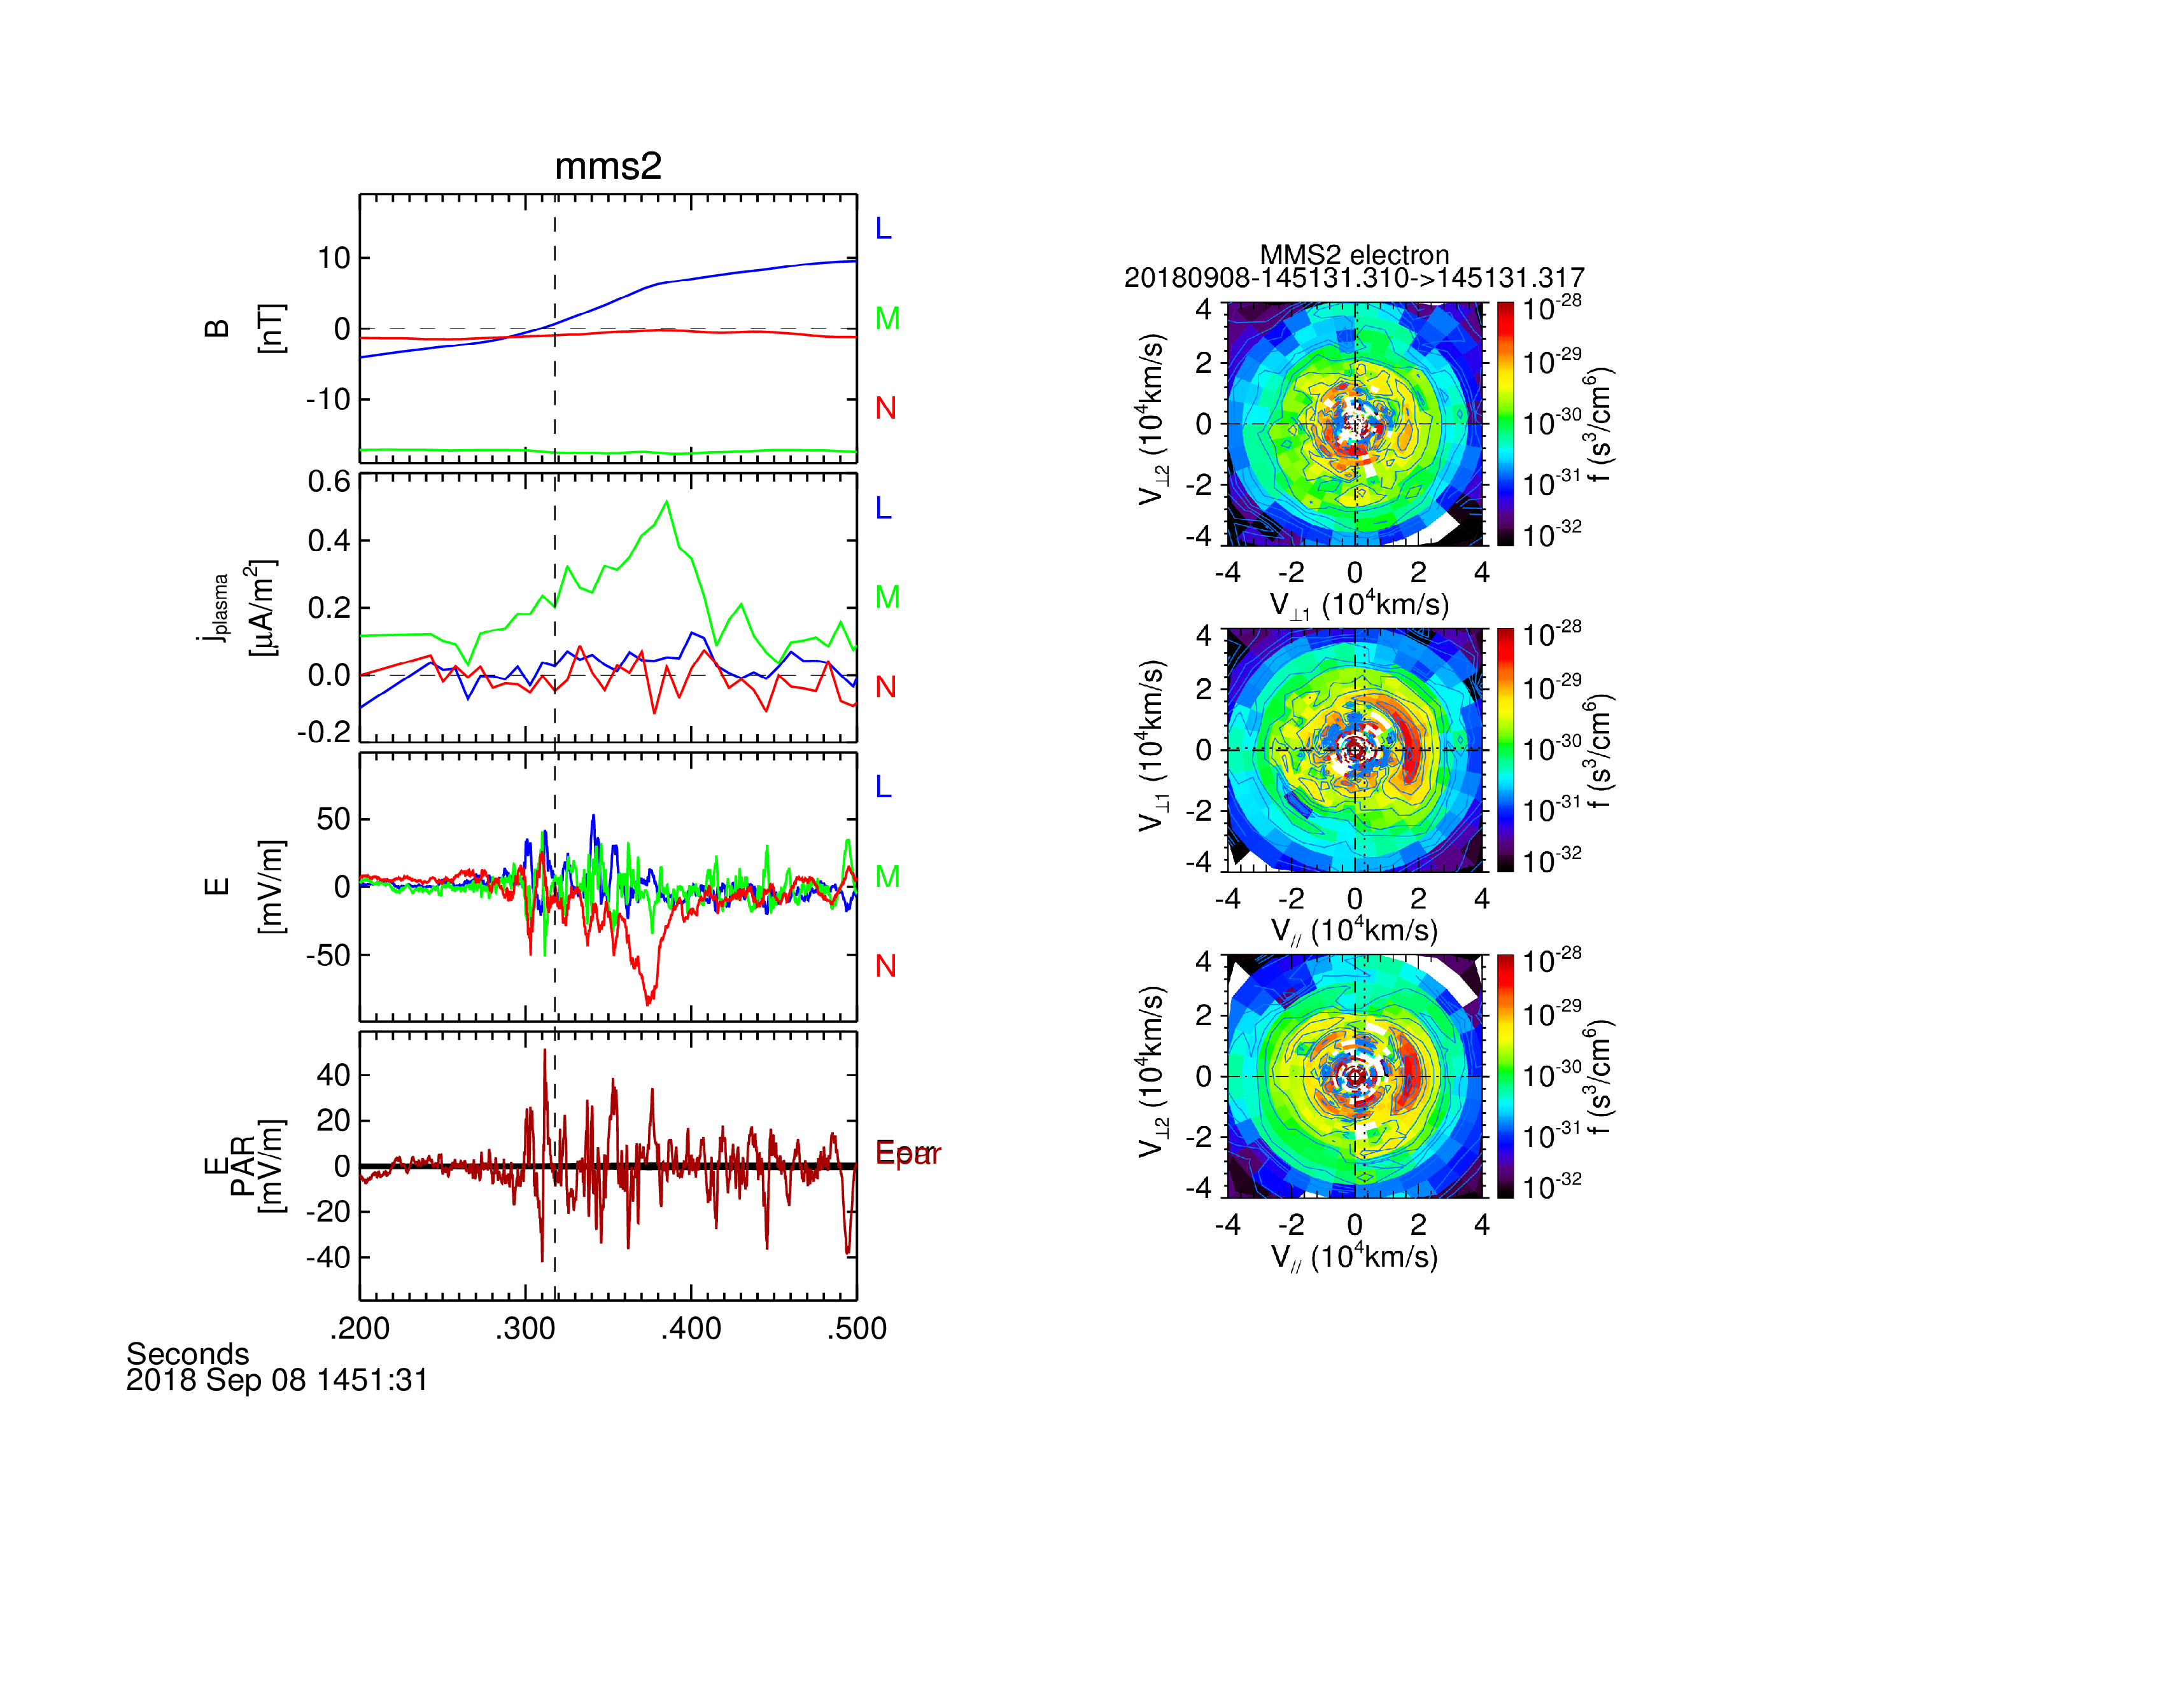
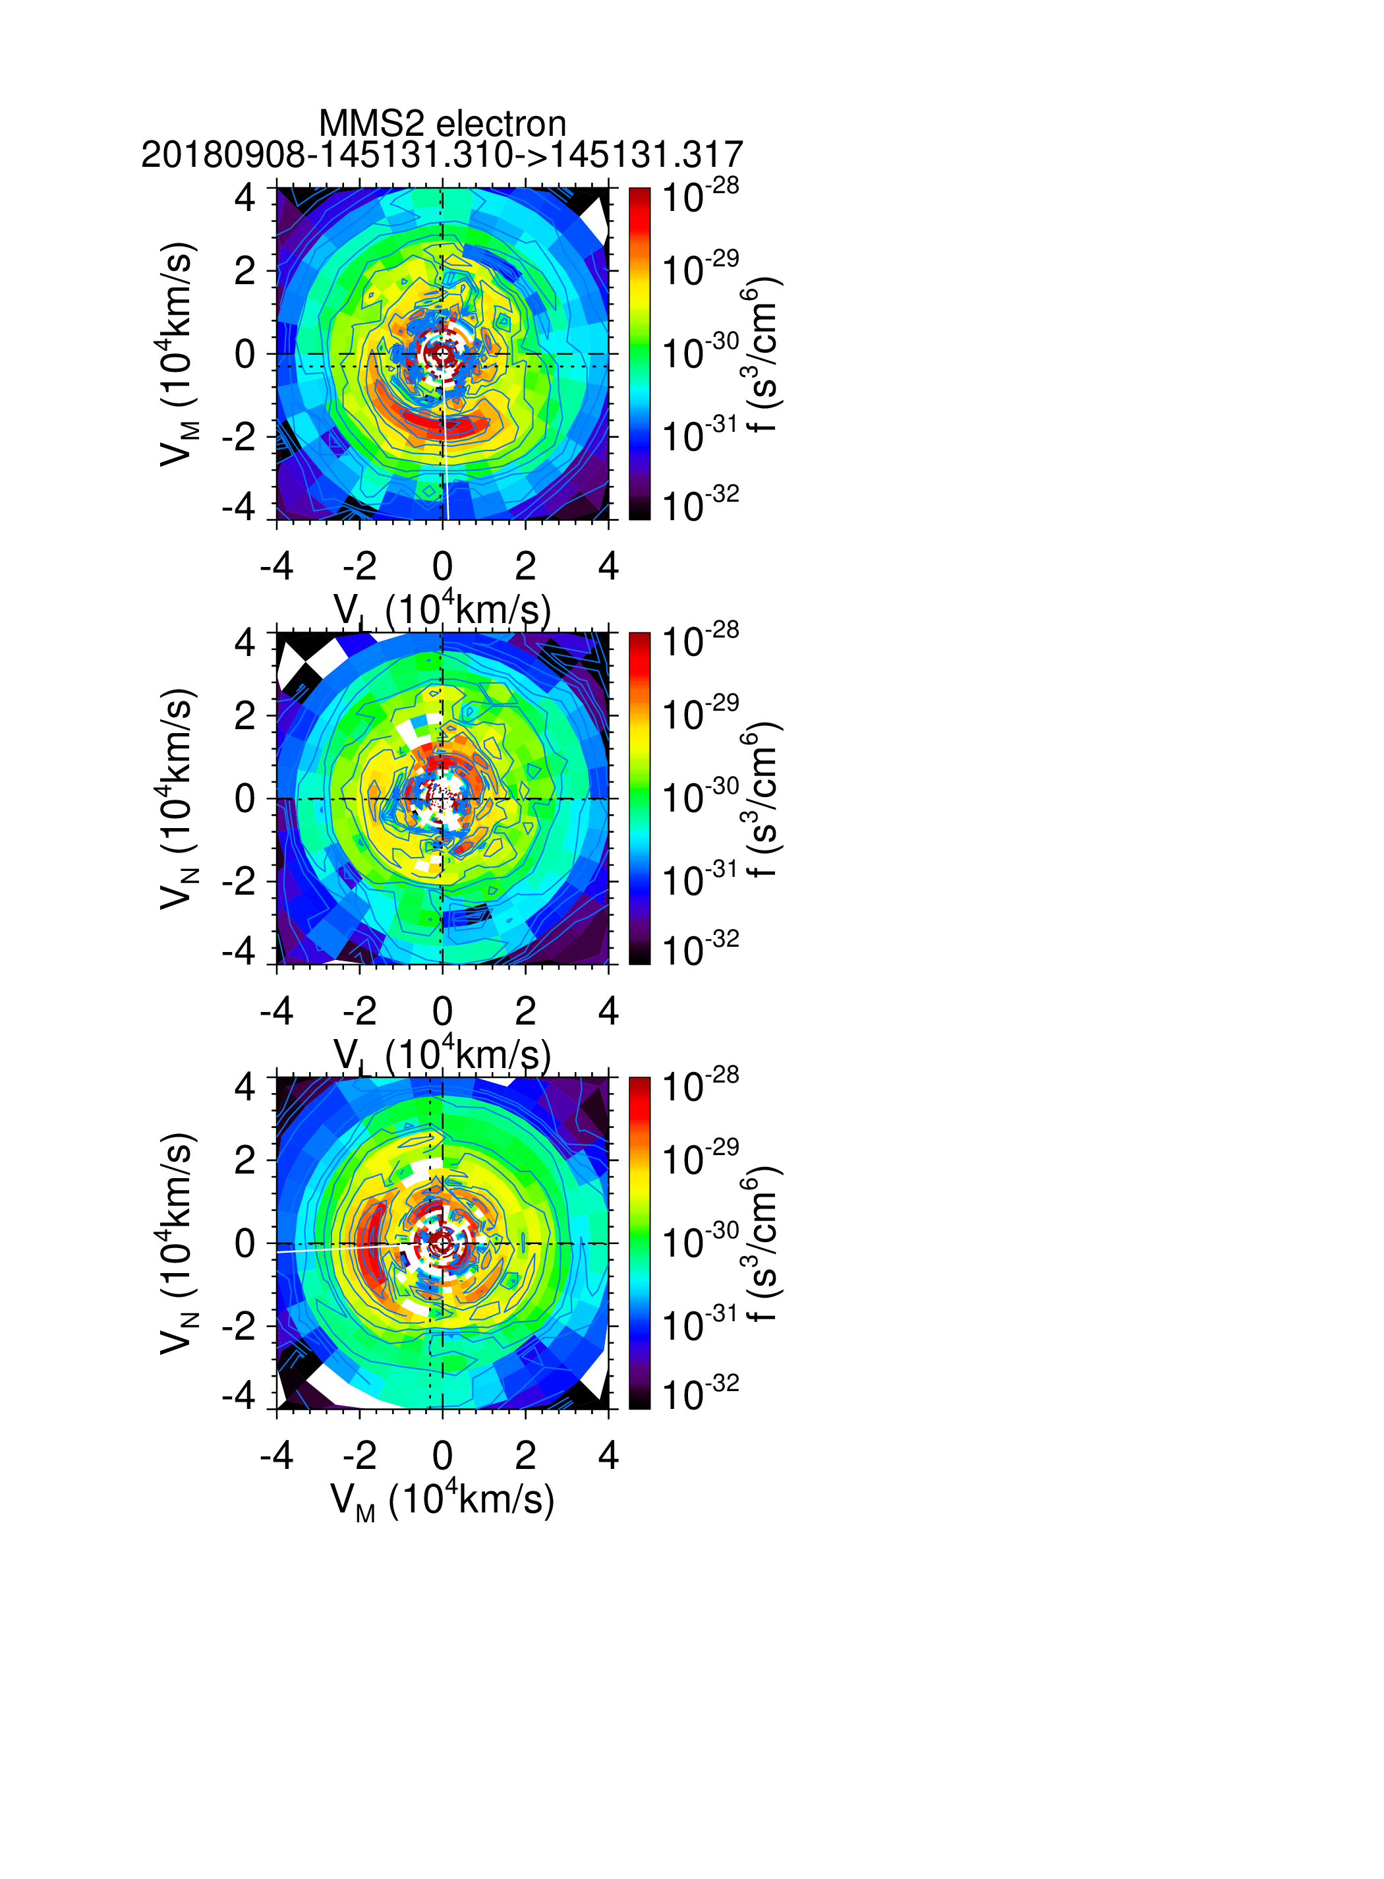

Slide 11
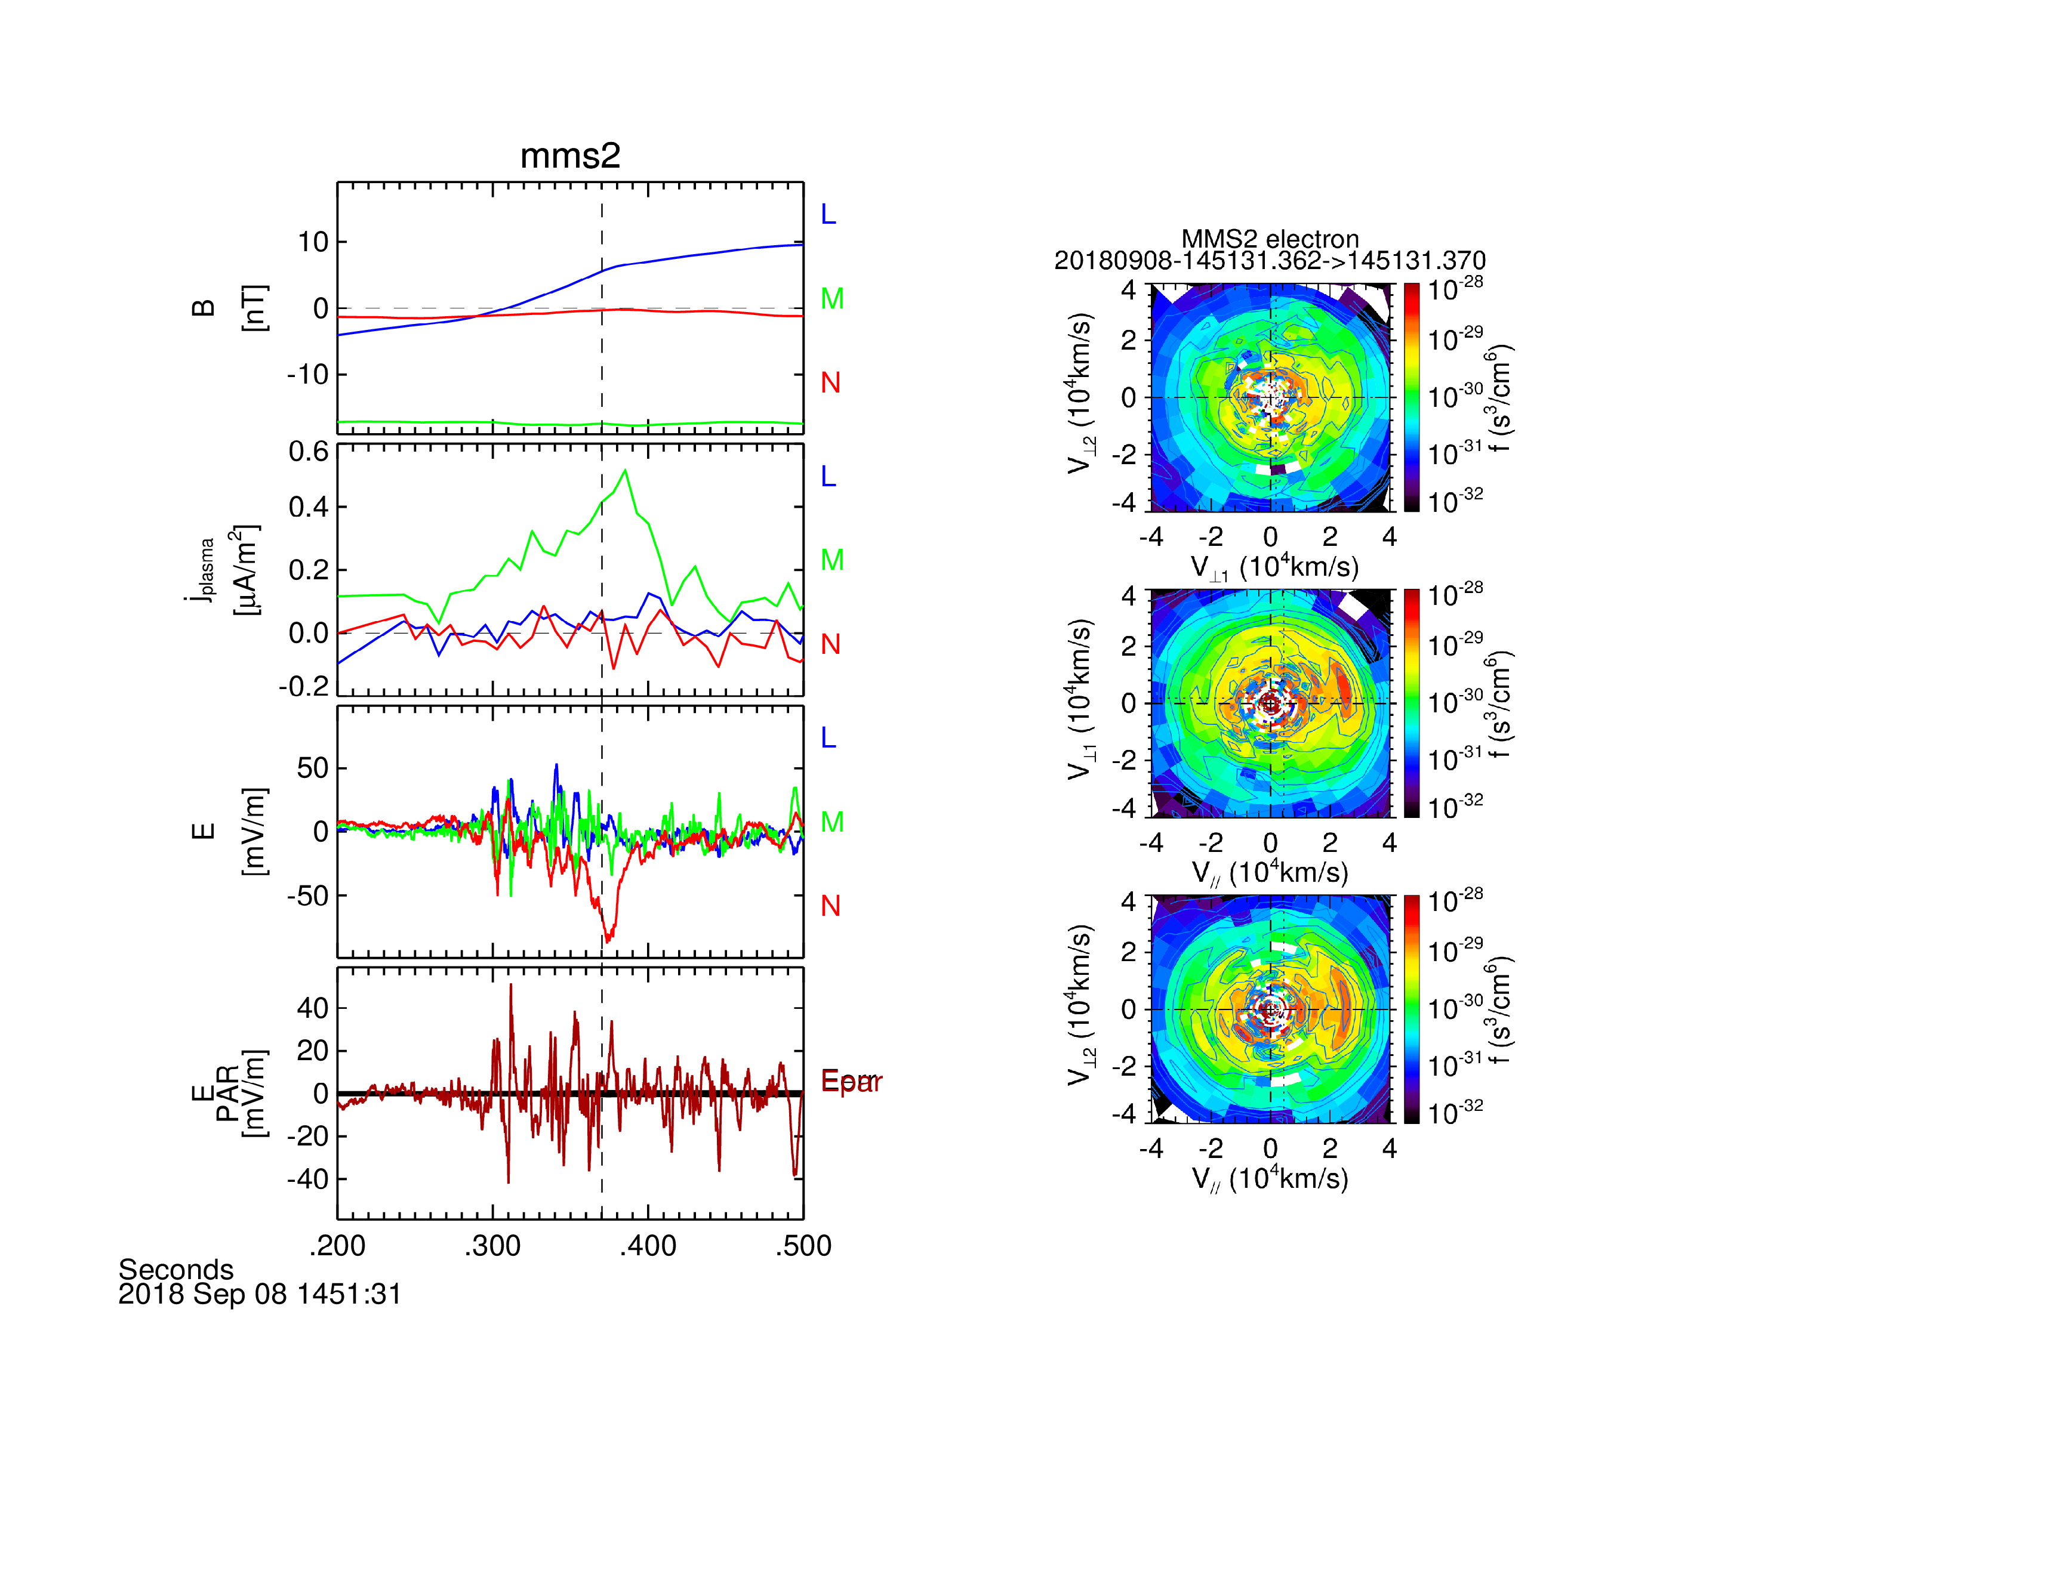
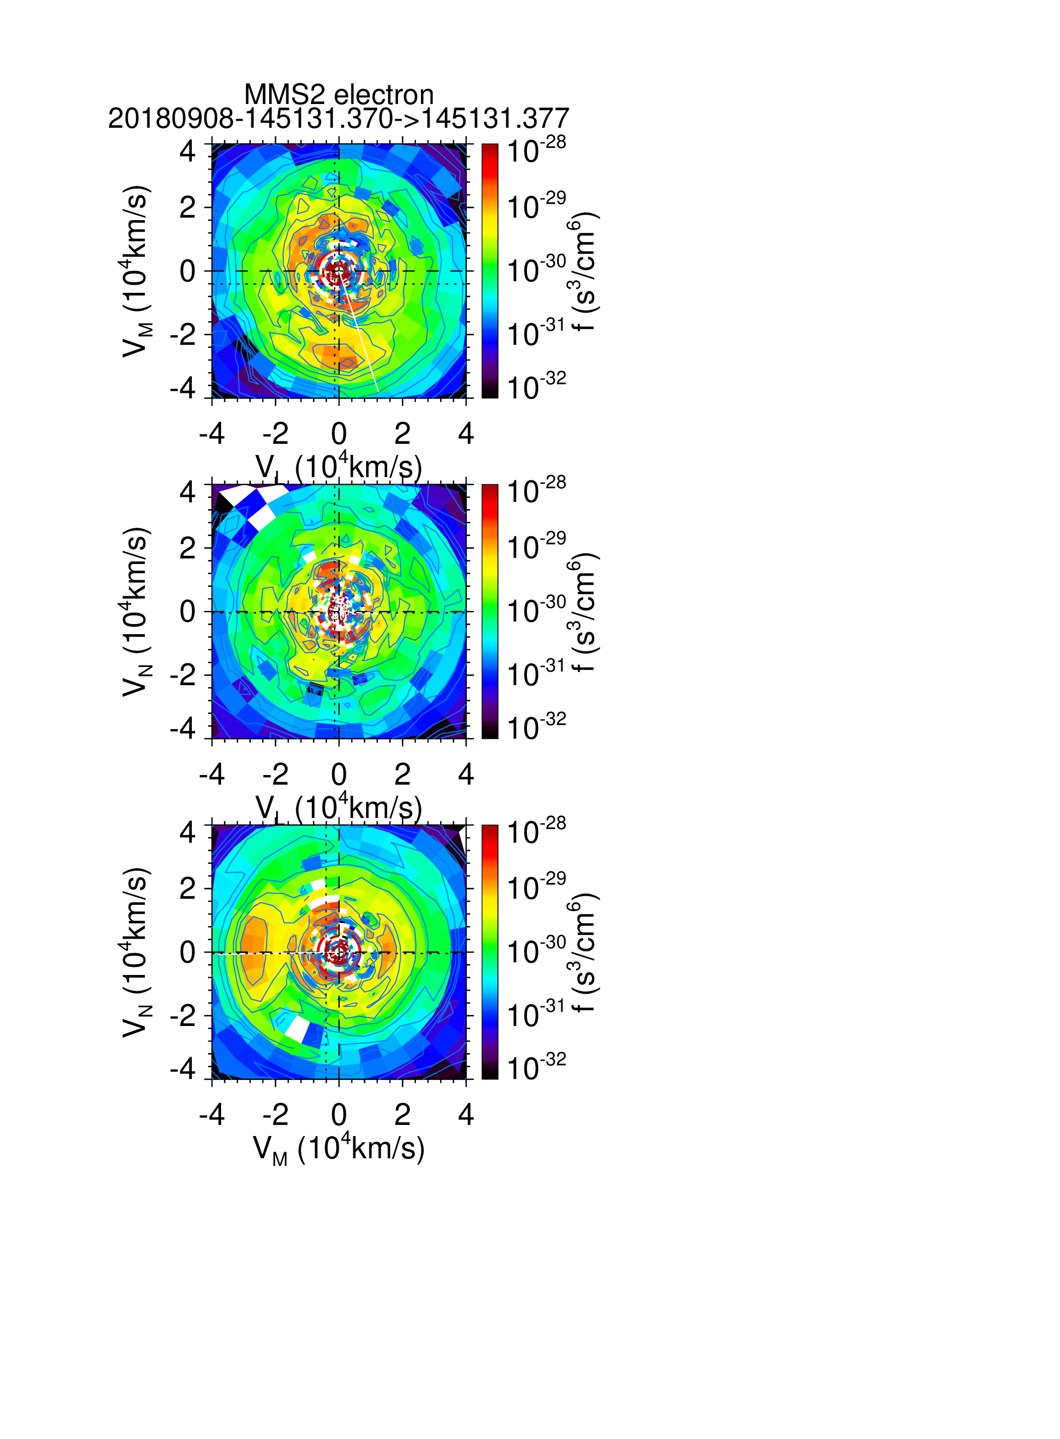

Slide 12
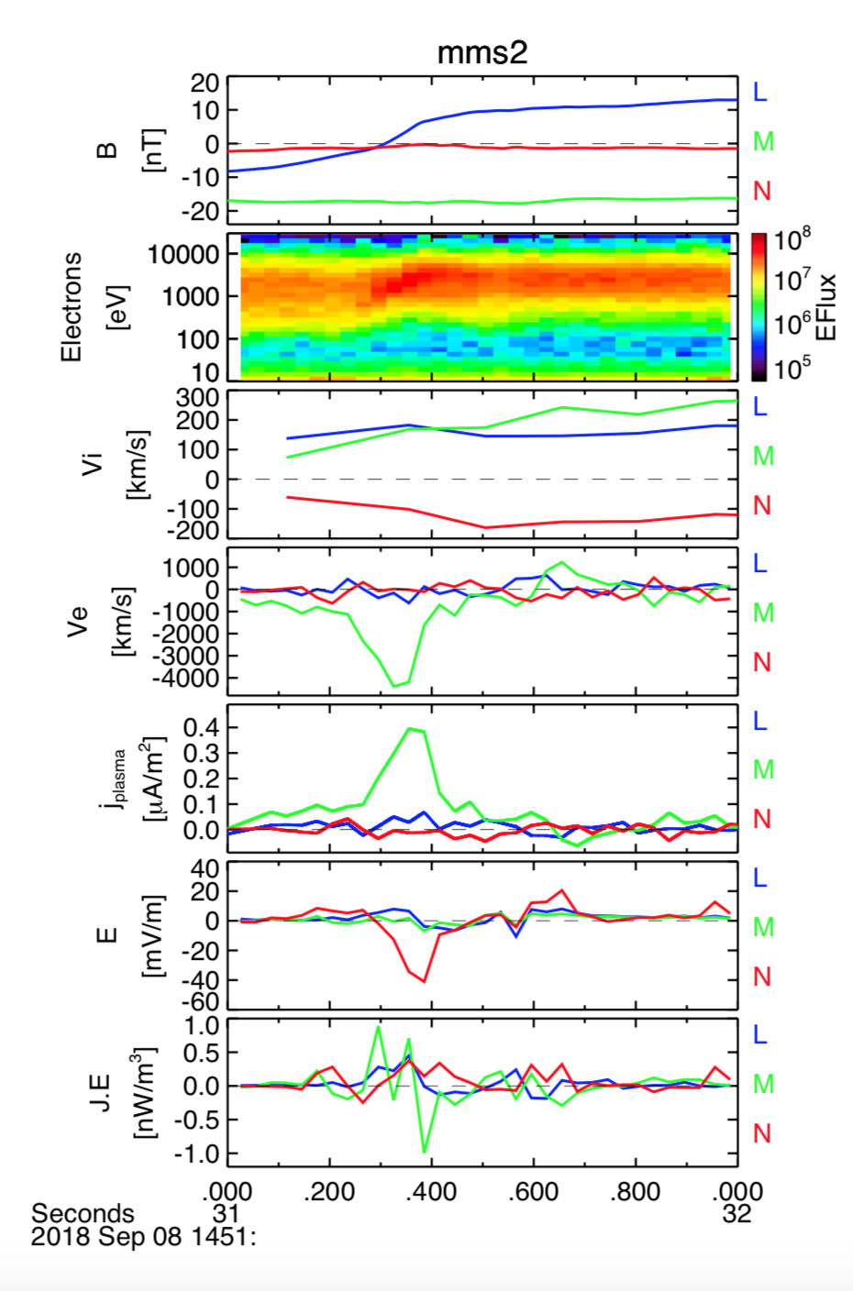
Summary
Flux rope type Dipolarization Front
EDR at Center of Flux Rope
Crescents appear to Accelerate due to Perpendicular Electric Field Similar to a Dayside Event

Slide 13
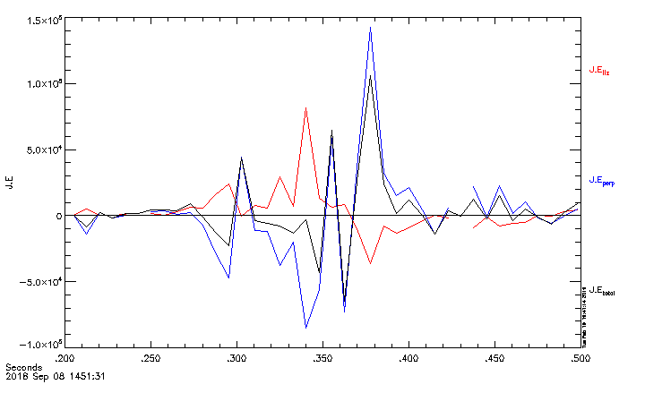
Rough sketch showing that J*E_perp dominates

