Slide 1
Mass and energy transfer across the Earth’s magnetopause caused by vortex-induced reconnection
MMS Yosemite workshop, 19 Feb., 2019
Takuma (T.K.M.) Nakamura
Space Research Institute (IWF)/Austrian Academy of Sciences
Collaborators:
H. Hasegawa (JAXA), S. Eriksson (LASP), W. Li (NSSC), W. Daughton (LANL), S. Zenitani (RISH), K.J. Genestreti (UNH) & R. Nakamura (IWF)
Simulation code:
3-D fully kinetic particle-in-cell code, VPIC
Computers:
Titan (ORNL, USA), MareNostrum (BSC, Spain), Leo (IWF, Austria)
Observations:
Magnetospheric Multiscale (MMS) mission

Slide 2
A note of my talk:
My speech is awkward by stuttering ☹
But, enjoy my talk!
- the content is not awkward ☺

Slide 3
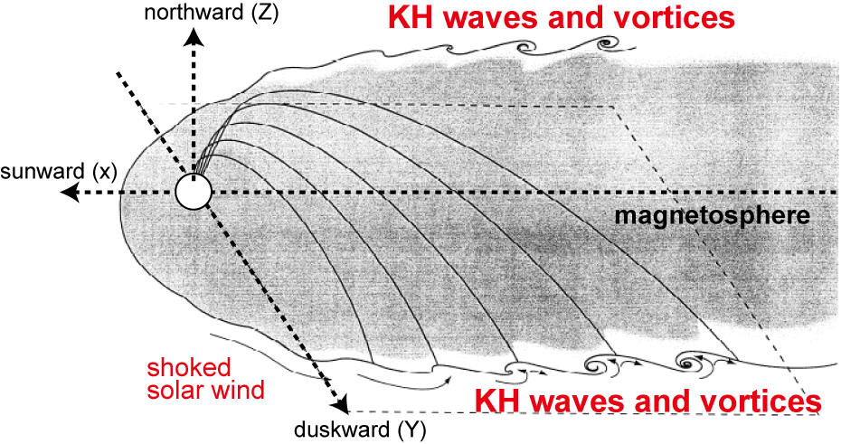
Earth’s low-latitude boundary layer (LLBL)
Along the magnetospheric side of the low-latitude magnetopause, the mixing layer called the low-latitude boundary layer (LLBL) is frequently observed.
The LLBL is thicker during the northward IMF.
[e.g., Eastman, 1976, Mitchell+, 1987; Fujimoto+, 1998; Hasegawa+, 2003]
→ anomalous solar-wind transport during the northward IMF?
Energy-time (E-t) spectrograms
Solar wind
Mpause
Msphere
Solar wind
Mpause
LLBL
Two examples of the inbound magnetopause crossing by THEMIS spacecraft
Mixing layer (δmix~10³ -10⁵ km)

Slide 4
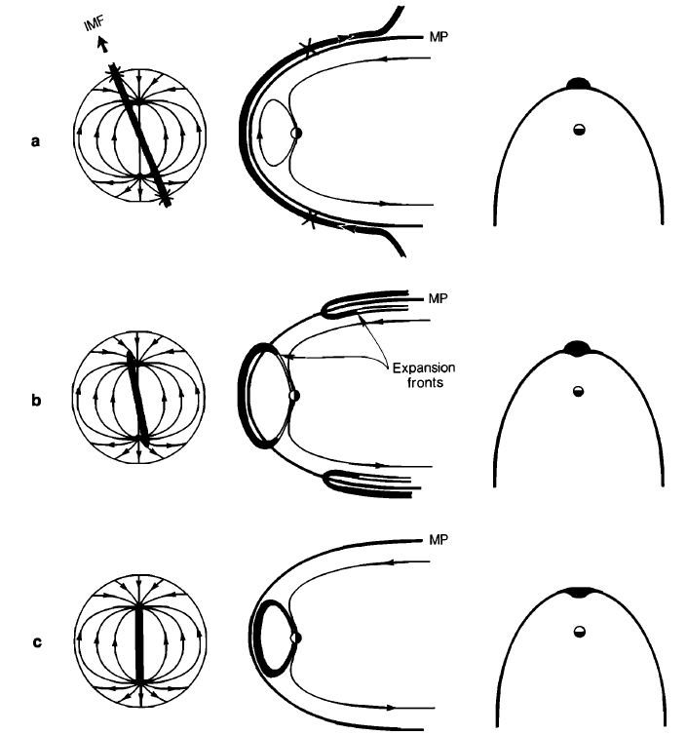
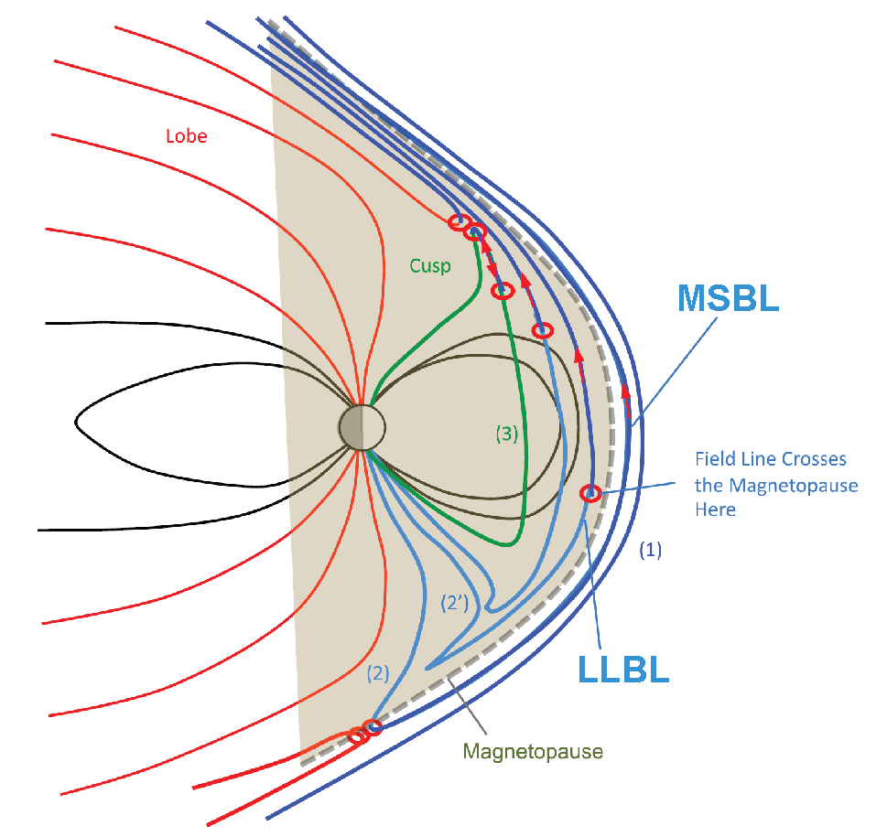
High-latitude reconnection
During northward IMF, magnetic reconnection would easily be induced at high-latitude magnetopause.
→ leading to the formation of the dayside-to-flank LLBL.
[Song & Russell, 1992]
[Fuselier+, 2012]

Slide 5
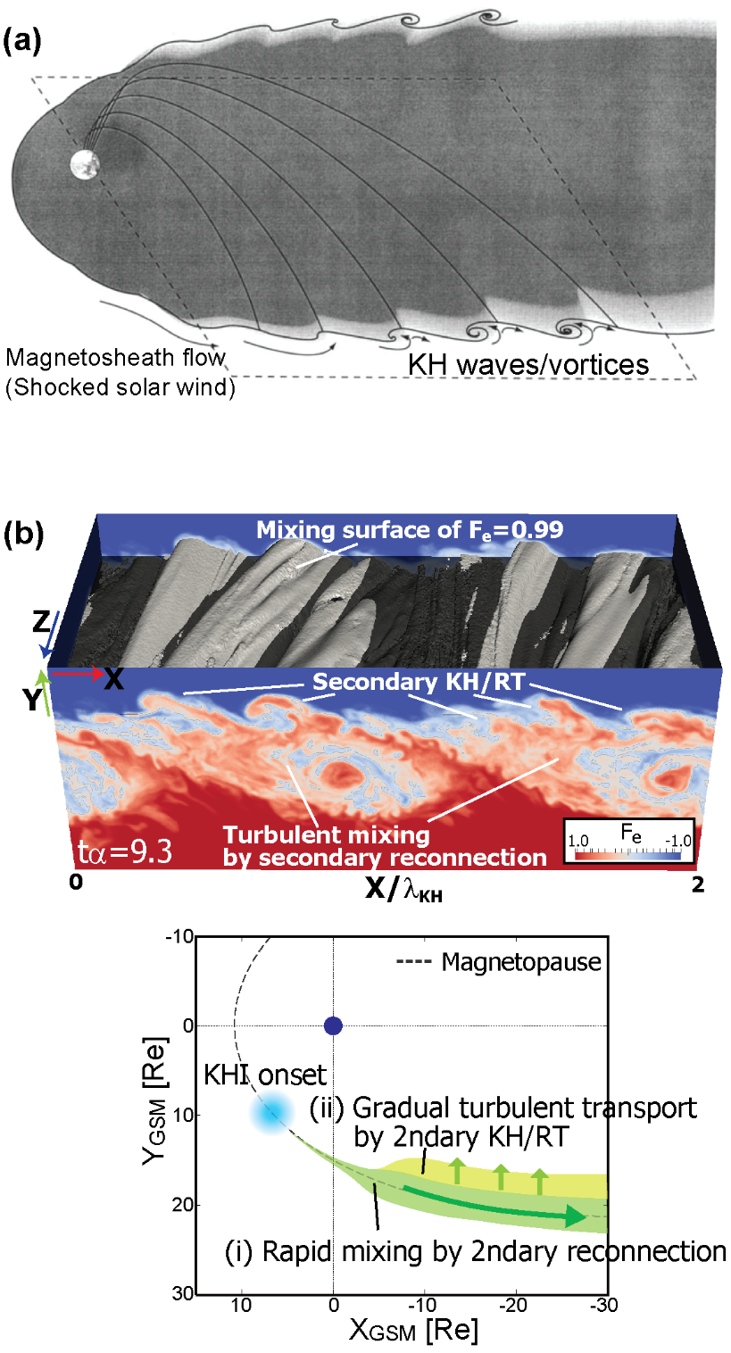
Kelvin-Helmholtz vortex
The persistent velocity shear between magnetosheath and magnetosphere can drive the KHI at low-latitudes.
The non-linear KH vortex causes the secondary tearing and KH/RT instabilities.
The secondary tearing (vortex-induced reconnection) causes a rapid expansion of the mixing layer, while the secondary KH/RT causes a gradual transport deeper into the magnetosphere.
[e.g., Nakamura & Daughton, 2014]
[Fairfield+, 2000]
[Nakamura & Daughton, 2014]

Slide 6
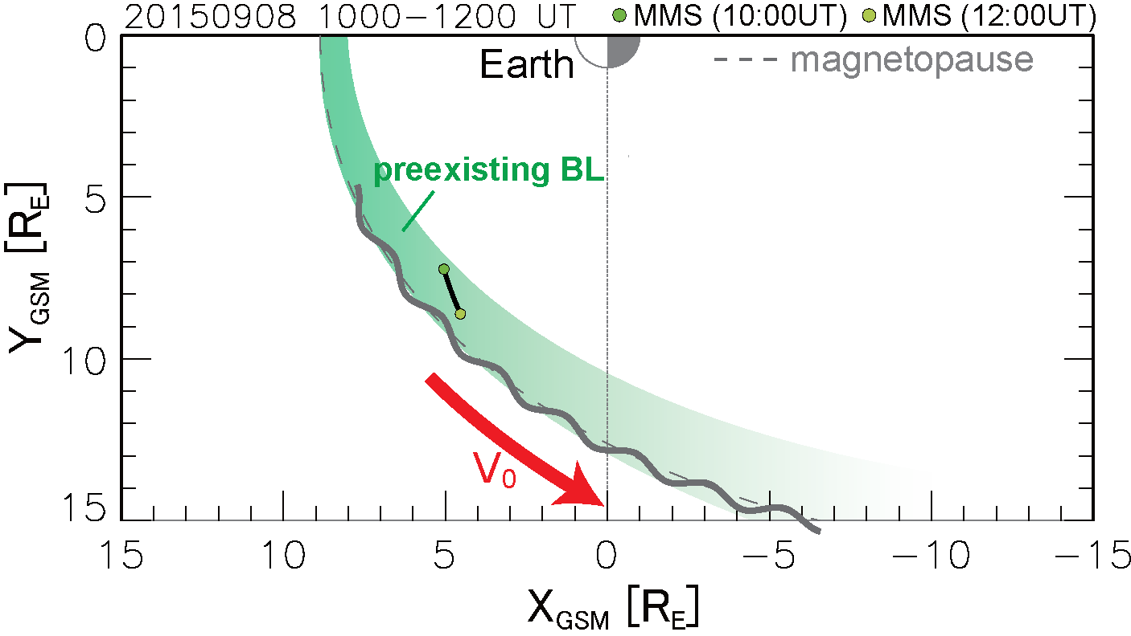
Coupling between high-lat. reconnection & KHI
Super-Alfvénic unstable condition for the KHI [Chandrasekhar, 1961]
M_{A}=A/B>1 : KHI unstable
M_{A}=A/B>5 : producing non-linear vortex flow [Nakamura+, 2005]
Higher density enhancing M_{A}
Pre-existing BL by high-lat. reconnection
can play a key role in exciting strong KHI.
[Hasegawa+, 2009; Nakamura+, 20017b ]
$$γ_{KH}^{2}=\underset{A}{\underbrace{\frac{ρ_{1}ρ_{2}}{{\left(ρ_{1}+ρ_{2}\right)}^{2}}{\left[k∙\left(U_{1}−U_{2}\right)\right]}^{2}}}−\underset{B}{\underbrace{\frac{1}{μ_{0}\left(ρ_{1}+ρ_{2}\right)}\left[{\left(k∙B_{1}\right)}^{2}+{\left(k∙B_{2}\right)}^{2}\right]}}>0$$
$$M_{A}=\frac{A}{B}=\frac{ρ_{1}ρ_{2}}{ρ_{1}+ρ_{2}}∙\frac{{\left[k∙\left(U_{1}−U_{2}\right)\right]}^{2}}{{\left[{\left(k∙B_{1}\right)}^{2}+{\left(k∙B_{2}\right)}^{2}\right]}/{μ_{0}}}>1$$

Slide 7
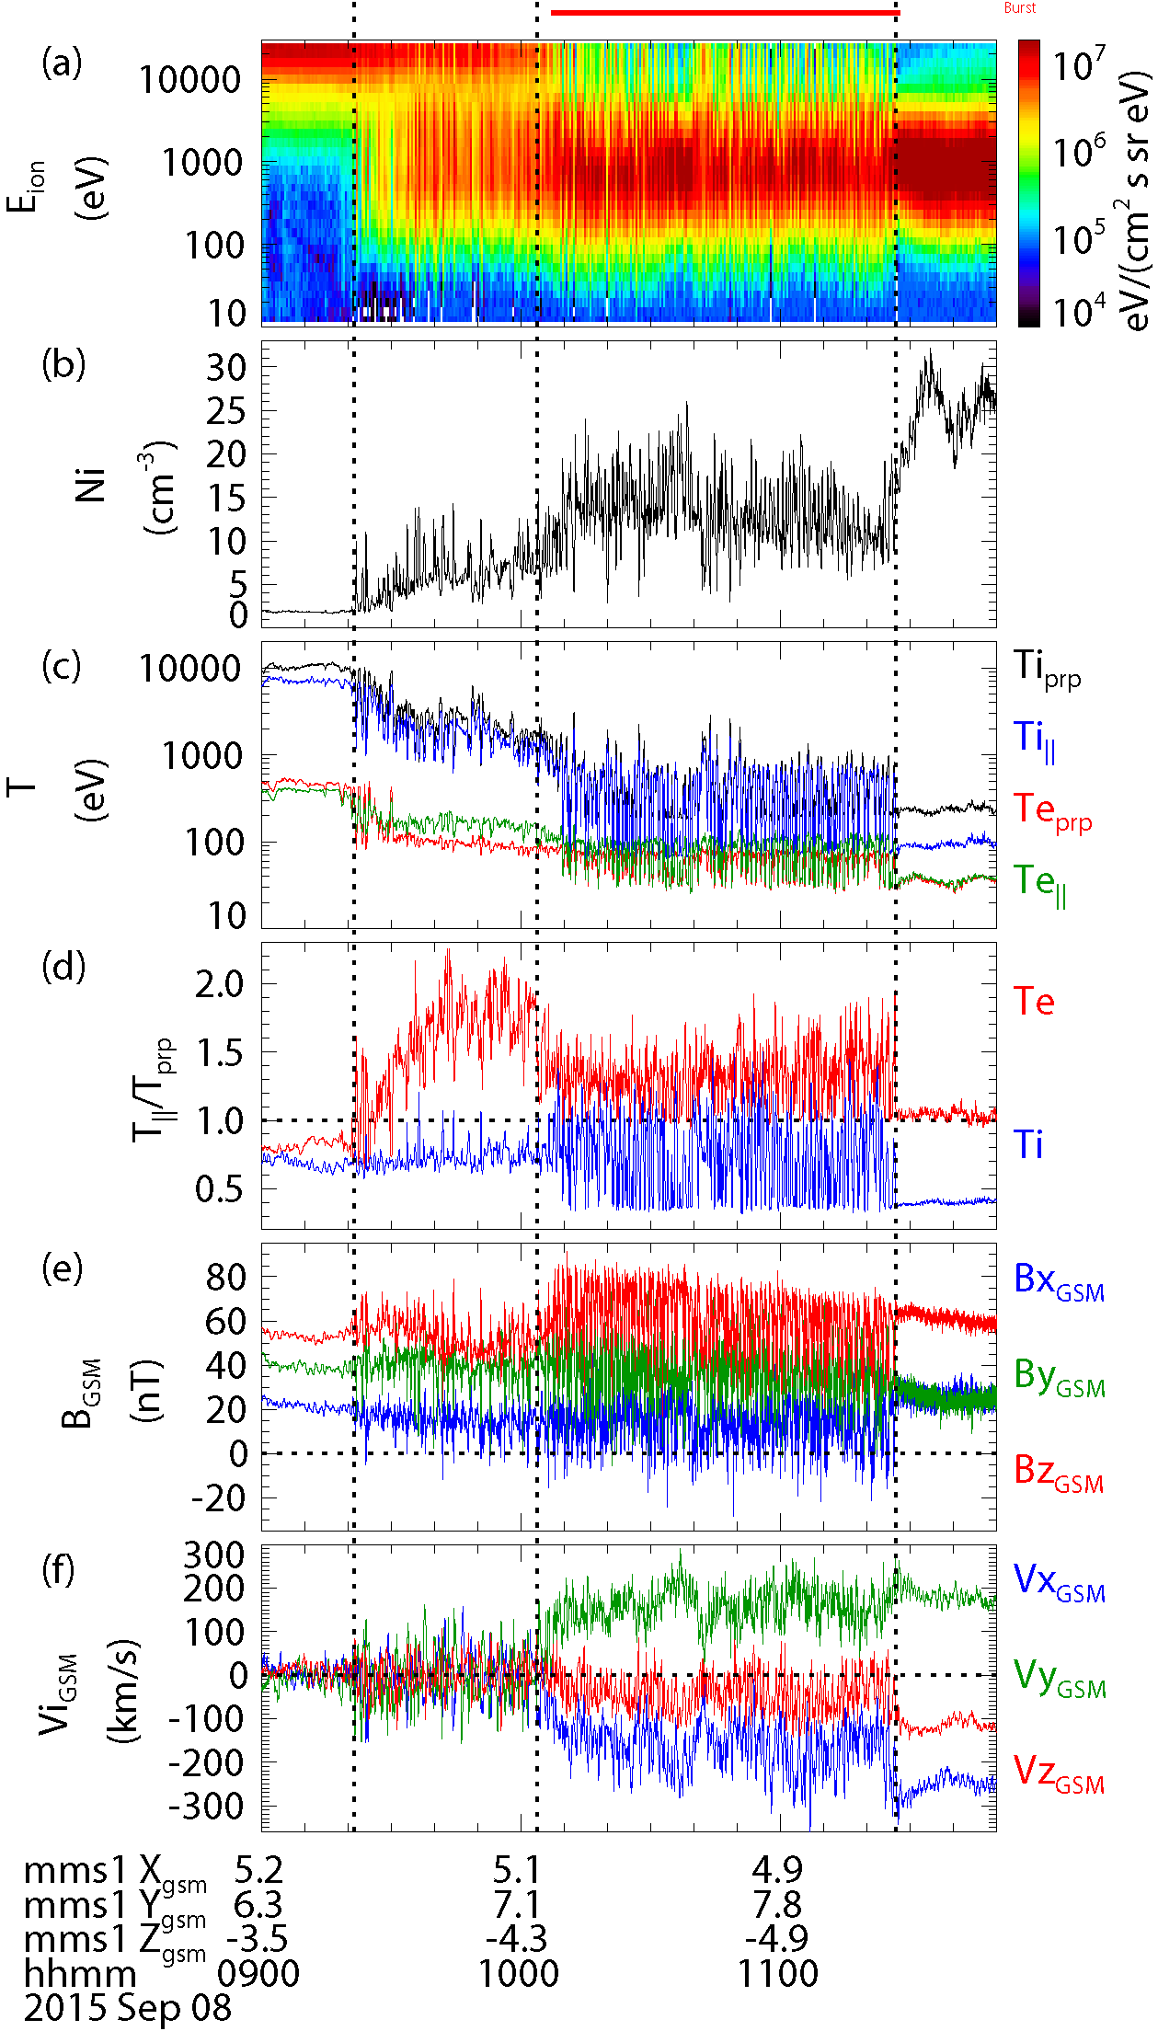
MMS event on 8 Sep. 2015
SP
BL
KH-active
SH
BL
SP
SH
Prolonged northward IMF
Quasi-periodic strong waves b/w SH & BL
T_{e}$∥$>T_{e}$⊥$ indicating BL is produced by the high lat. reconnection
M_{A}~5.6 b/w SH & BL, while ~1 b/w SH & SP
KH waves enhanced by pre-existing BL
[Nakamura+, 2017b]
[Eriksson+, 2016a; Nakamura+, 2017b]

Slide 8
Simulation setup
SP
BL
KH-active
SH
Simulaiton code:
High-performance fully kinetic particle-in-cell code
(VPIC) [Bowers+, 2007; 2008]
Plasma and field setup:
Density, ion & ele. bulk velocities and magnetic field conditions are setup as closely as the MMS data before (BL) and after (SH) the wave period.
System size:
The system size is setup as largely as we can within the limit of computer resource on Titan as
Lx x Ly x Lz = 100di x 50di x 150 di
= 2048 x 1024 x 3072 grids
→ 1.3 x 10¹² total particles
differences:
pressure balance is sustained only by T_{i} variation with uniform T_{e}
mi/me = 25
ω_{pe}/Ω_{e}=1.0
2
1
[Eriksson+, 2016a; Nakamura+, 2017b]

Slide 9
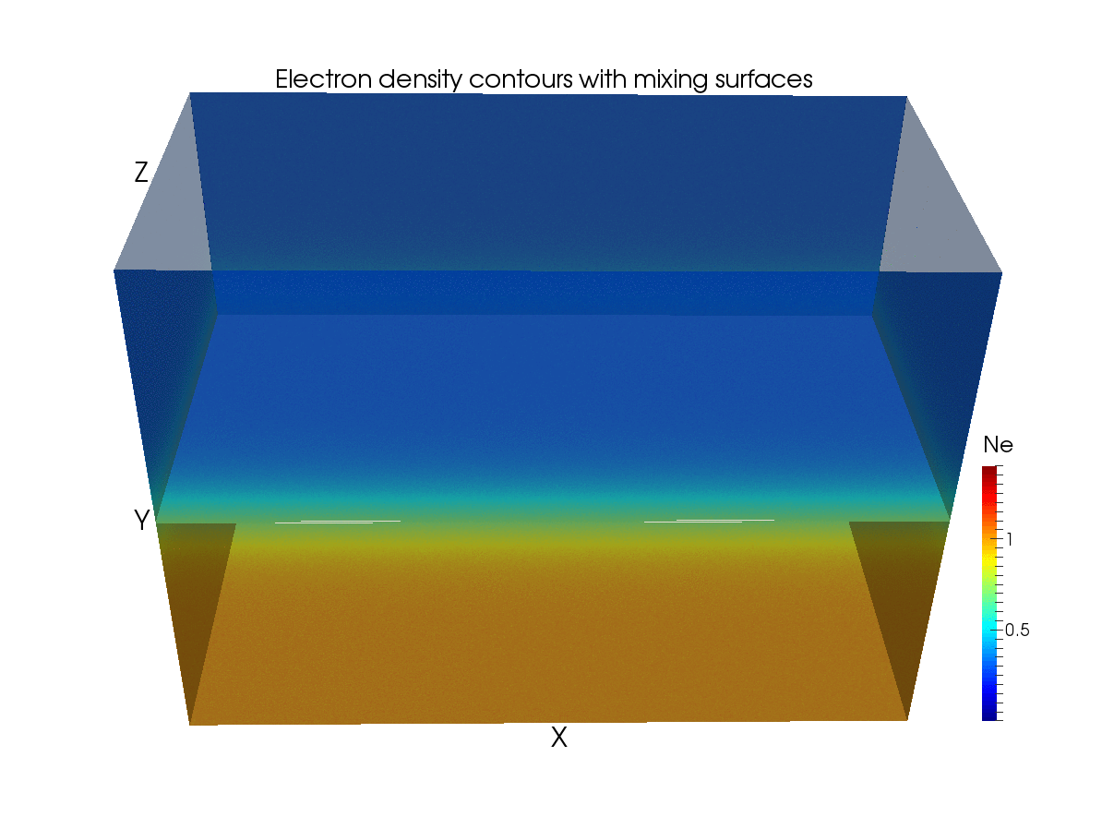
3D fully kinetic simulation
X: k-vector of KHI
Y: boundary normal
Z: perp. to X, Y (~Z_{GSM})
Mixing surfaces:
Fe=-0.99, 0.99
Mixing fraction:
F=1: Magnetosheath
F=-1: Magnetosphere
|F|<1: Mixing
[Nakamura+, 2017a, 2017b]

Slide 10
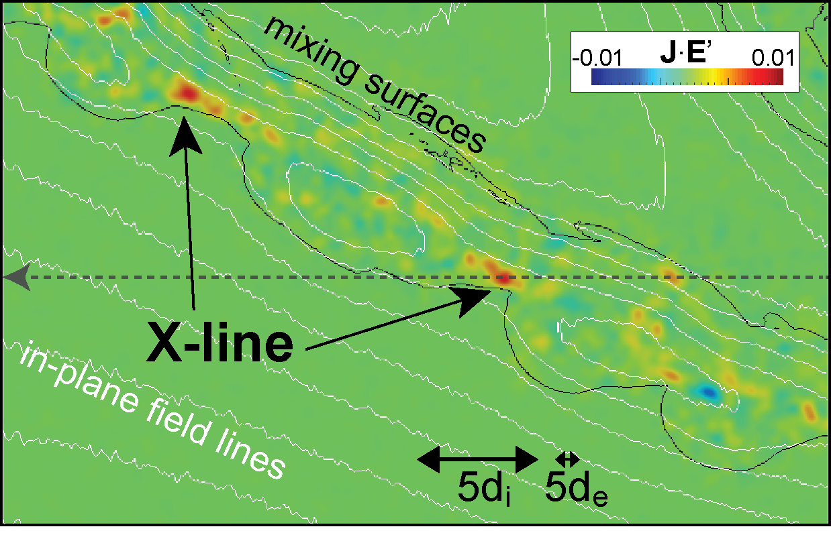
3D fully kinetic simulation
$$J∙E^{′}=J∙\left(E+U_{e}×B\right)$$
X: k-vector of KHI
Y: boundary normal
Z: perp. to X, Y (~Z_{GSM})
Mixing surfaces:
Fe=-0.99, 0.99
Mixing fraction:
F=1: Magnetosheath
F=-1: Magnetosphere
|F|<1: Mixing
[Nakamura+, 2017a, 2017b]

Slide 11
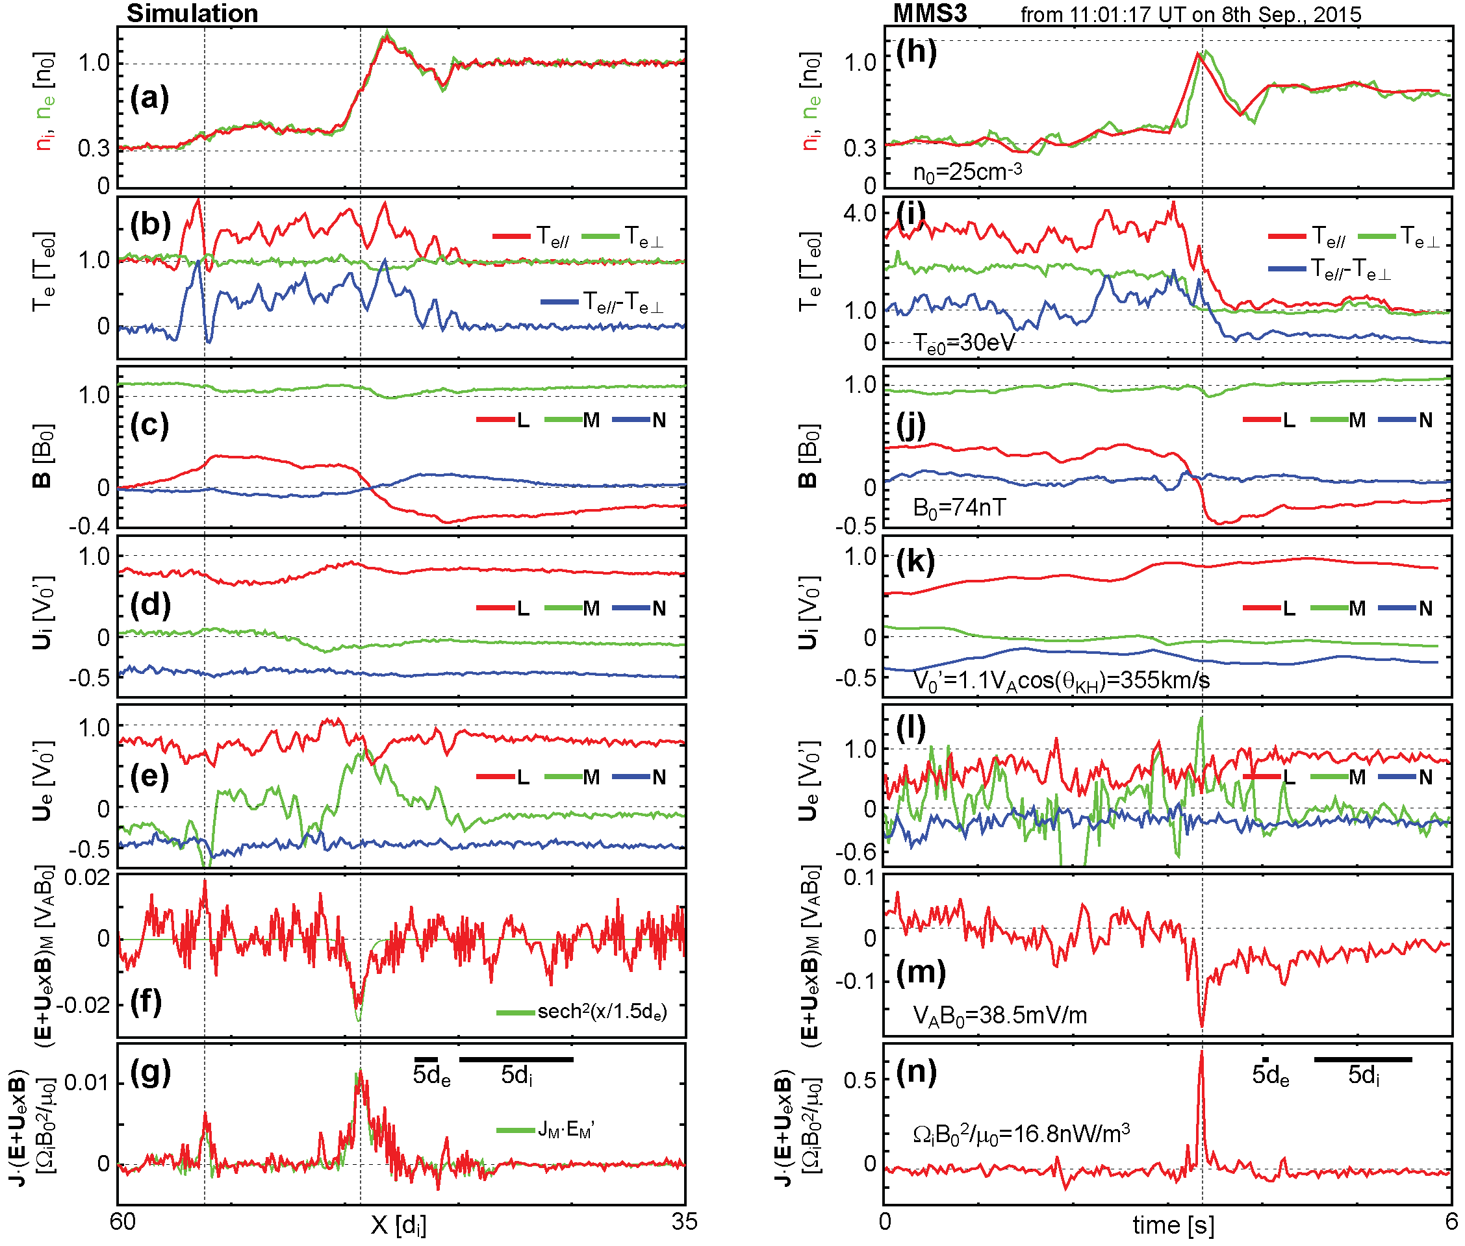
Virtual observation 1: EDR
Density peak
within the layer
- Para. electron heating
Thin current sheet
- No ion jet
No ele. Jet
Current sustained by electorn flow
$$E^{′}=E+U_{e}×B$$
$$E^{′}=E+U_{e}×B$$
Strong E_{M}‘
(more than 5 times larger than 0.1 rate)
d_{e}-scale strong $J∙E^{′}$
[Nakamura+, 2017b]
[Eriksson+, 2016b]

Slide 12
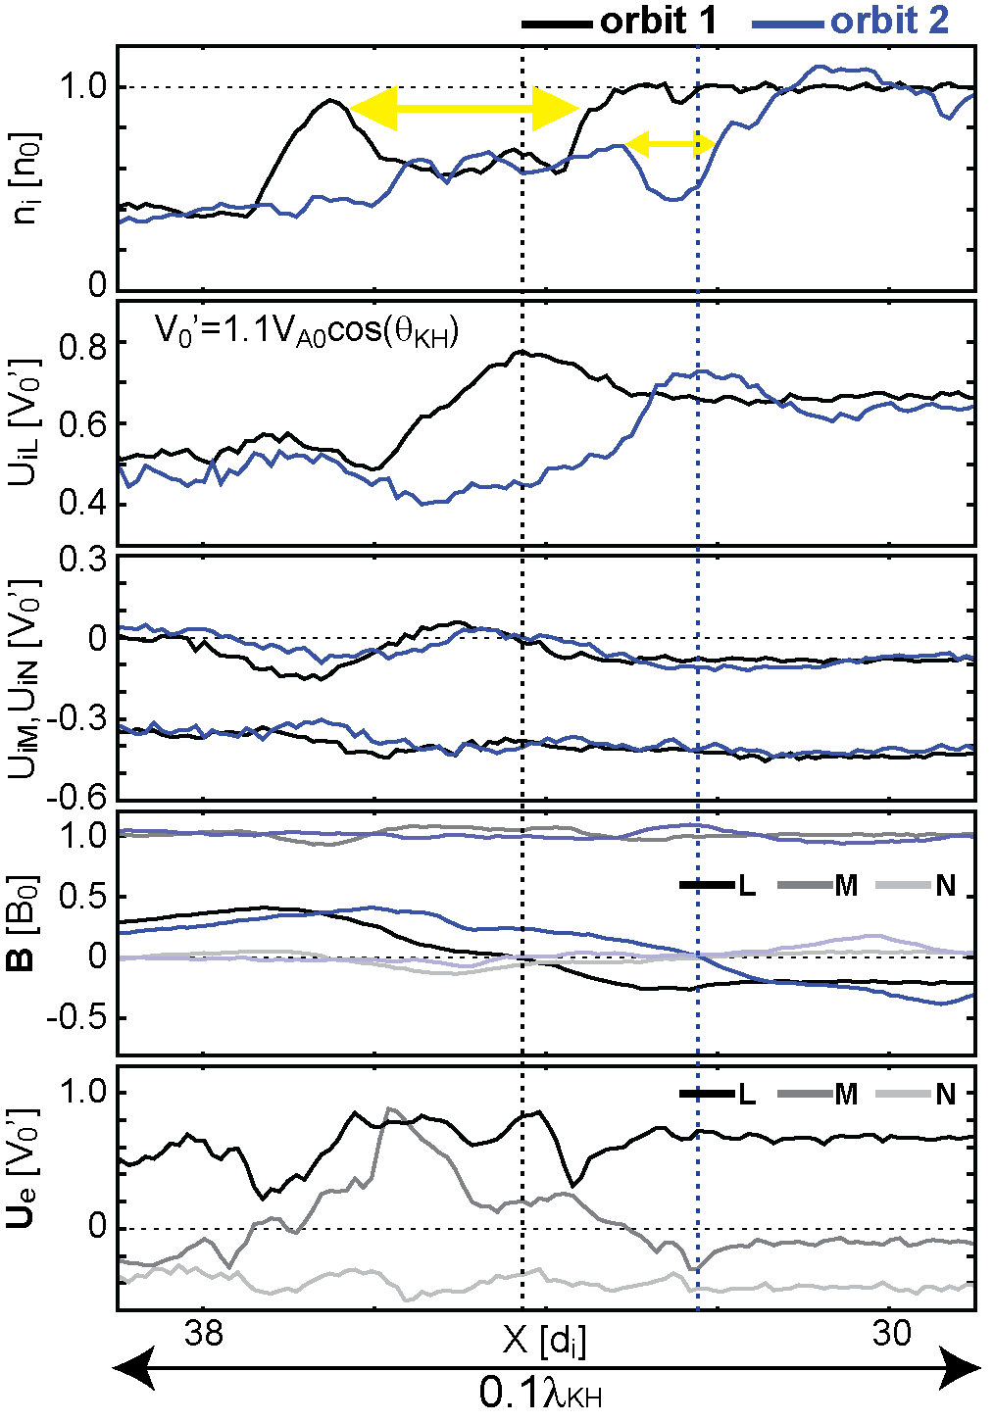
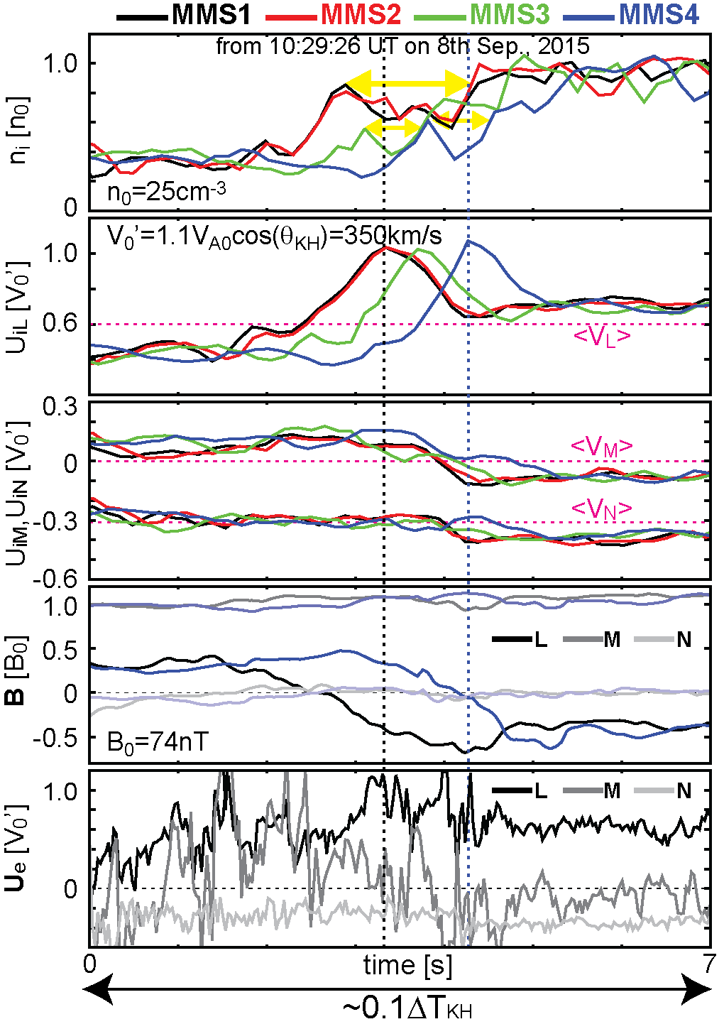
Virtual observation 2: ion-scale jet
[Nakamura+, 2017a]

Slide 13
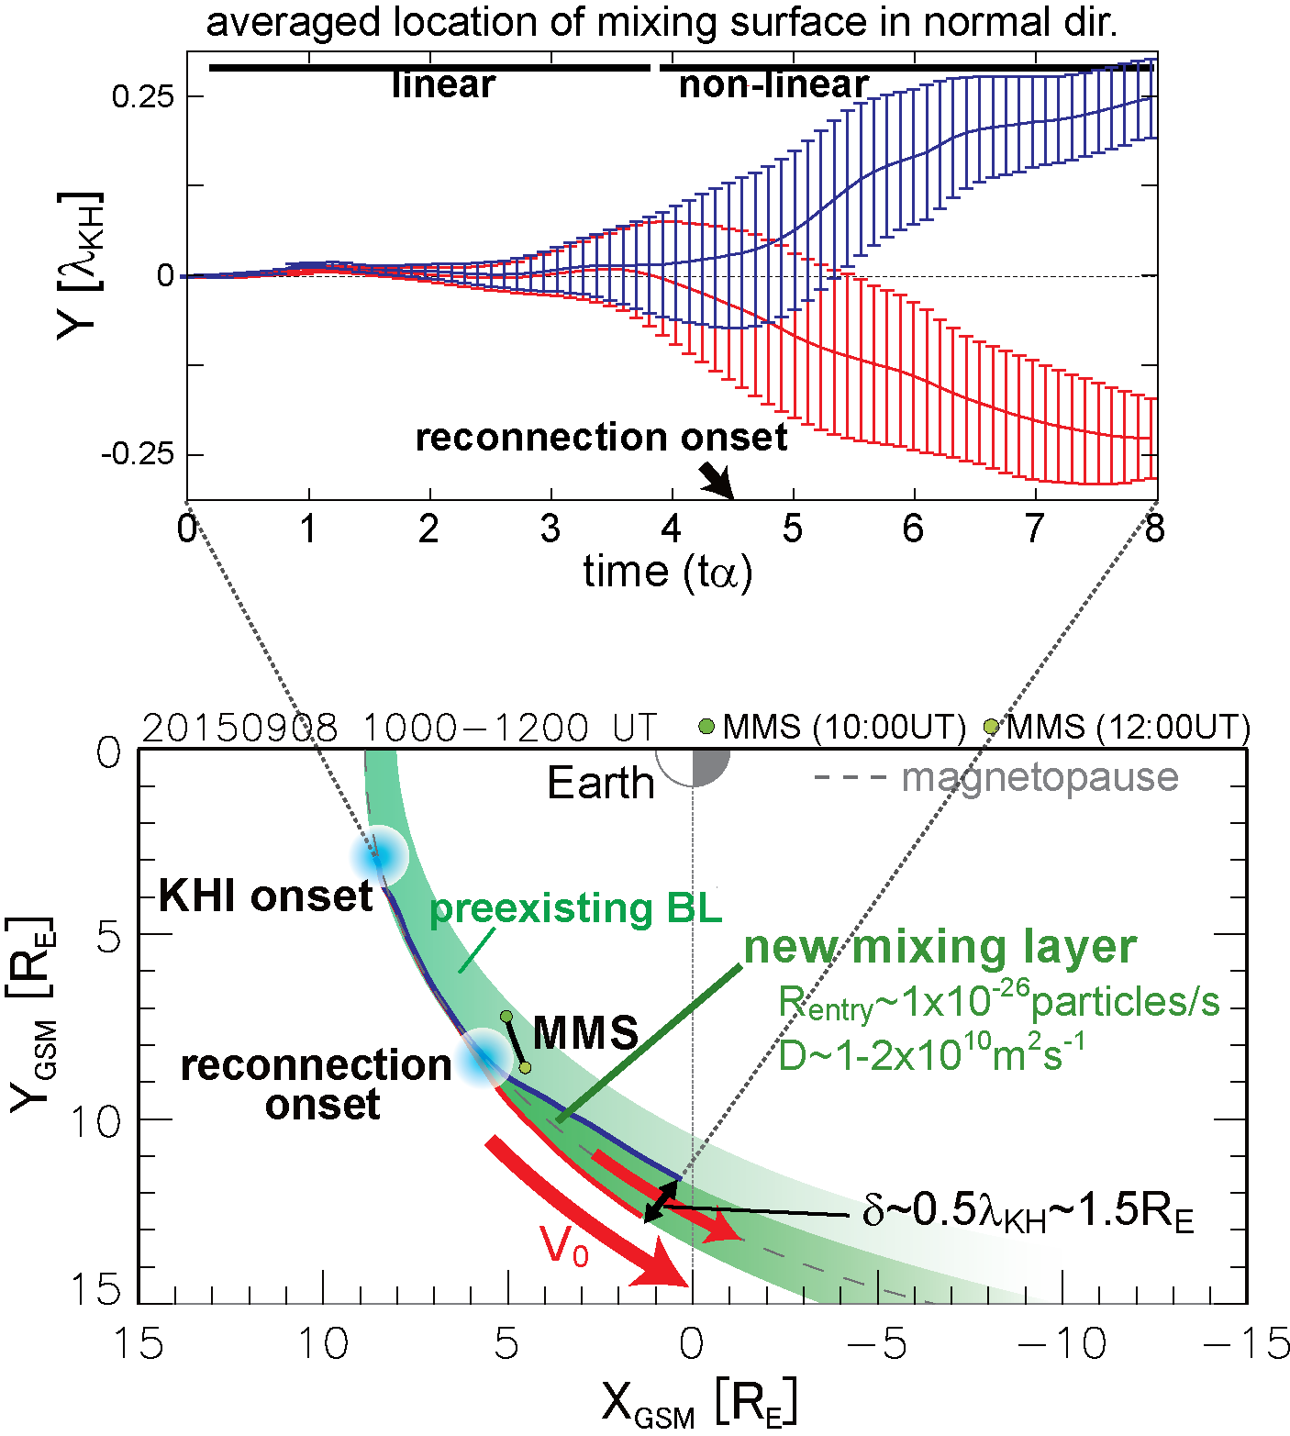
Mixing by the vortex-induced reconnection
~1.5 RE (~0.5λ_{KH}) thickness of a new mixing layer is formed along the dayside-to-flank magnetopause.
The estimated total particle entry rate into the new mixing layer is
Rentry~NKH x 10²⁶ particles/s
(N_{KH}: the number of the KH waves)
The estimated diffusion coefficient reaches D~1.0 x 10¹¹ m²s⁻¹
More than one-order higher than past predictions for the KHI.
[Nakamura+, 2017a, 2017b]
[Nakamura+, 2017b]

Slide 14
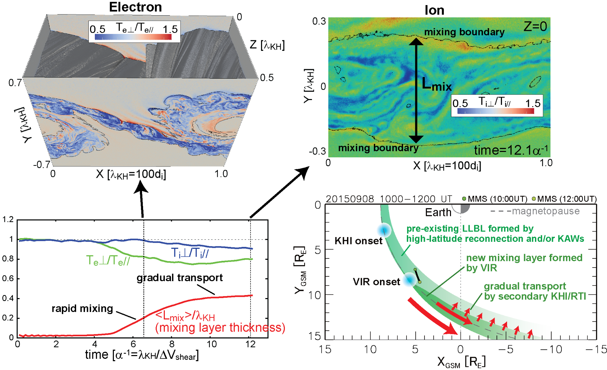
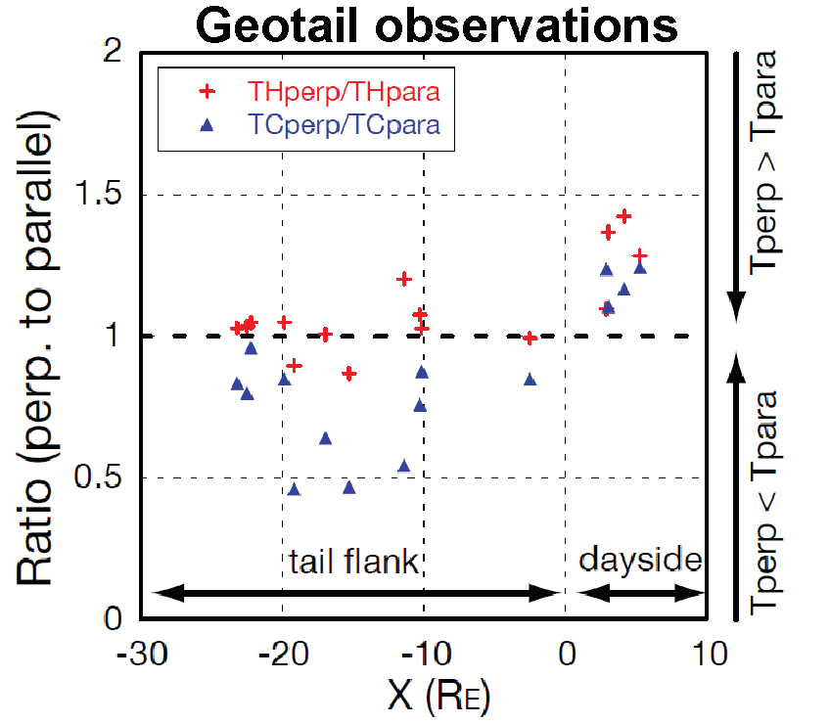
Heating by the vortex-induced reconnection
Parallel electron heating starts just after the onset of the VIR [Nakamura+, 2011, 2017b].
Parallel ion heating also occurs in the later non-linear phase [Nakamura, 2019].
→ consistent with a past statistical study of the LLBL [Nishino+, 2007]

Slide 15
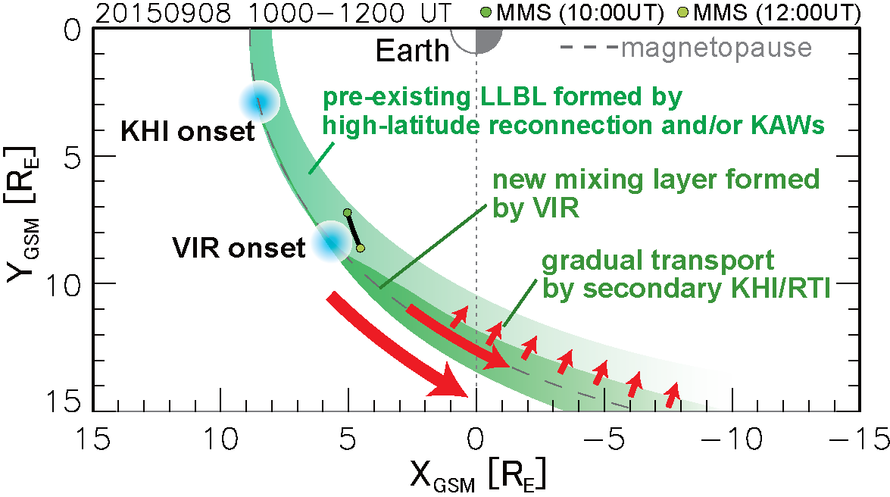
Summary
Analyzed an MMS vortex-induced reconnection event on 8 September 2015.
The pre-existing boundary layer, which was likely formed by high-latitude reconnection, played a key role in strong excitation of the KH vortex in this event.
Quantitative agreements between simulation and MMS observtion indicate that the vortex-induced reconnection and the subsequent rapid formation of a new dayside layer with parallel electron heating may really occur.
The simulation suggests that the VIR can also cause parallel ion heating in the later non-linear phase, corresponding to the flank-to-tail region.
→High-latitude reconnection, KHI and their coupling can significantly contribute to the LLBL formation during northward IMF.
References:
- Nakamura+, 2017a, Nature communications,
- Nakamura+, 2017b, JGR special issue for MMS phase-1
- Nakamura+, the Earth's low-latitude boundary layer,
accepted in "Solar/heliosphere 2, Magnetospheres of the solar system, Wiley"

