Slide 1
Reconnection with magnetic flux pileup at the interface of interlinked flux tubes
Marit Øieroset
UC Berkeley
Collaborators:
T. D. Phan, J. F. Drake, J. P. Eastwood, S. A. Fuselier, R. J. Strangeway, C. Haggerty, M. A. Shay, M. Oka, S. Wang, L. J. Chen, I. Kacem, B. Lavraud, V. Angelopoulos, J. L. Burch, R. B. Torbert, R. E. Ergun, Y. Khotyaintsev, P. A. Lindqvist, D. J. Gershman, B. L. Giles, C. Pollock, T. E. Moore, C. T. Russell, Y. Saito, L. A. Avanov, and W. Paterson
Without B pileup interlinked flux tubes cannot reconnect
(Øieroset et al., GRL 2019)

Slide 2
Outline
Interlinked flux tubes
- Reconnected field lines from two X-lines converge
- Thin current sheet at the interface
- Thin current sheet can reconnect
- Strong magnetic field pileup
Cause and effect of magnetic field pileup
- Leads to conditions favorable for reconnection
- Enhanced electron heating

Slide 3
THEMIS: Bi-directional jets at the magnetopause
|B|
(nT)
Z
X
B_{X}
B
(nT)
B_{Y}
B_{Z}
Bi-directional plasma jets
V
(km/s)
V_{Z}
X-line or O-line?
(Øieroset et al.,2011)

Slide 4
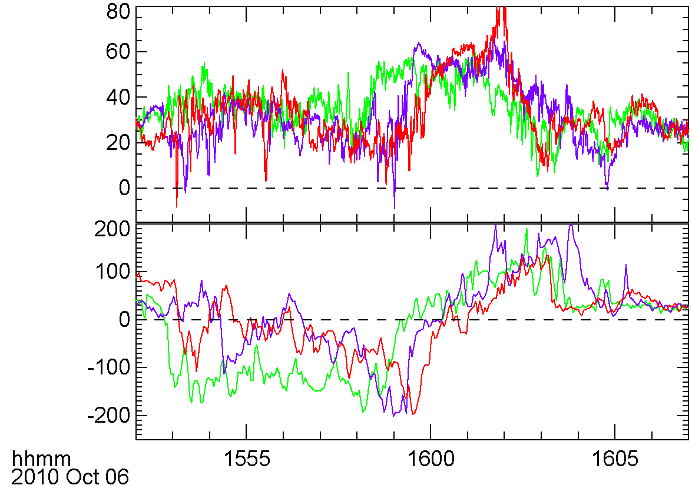
THEMIS: Three-spacecraft observations
TH-A
TH-E
TH-D
B_{Y}
(nT)
Z
X
TH-E
TH-D
V_{Z}
(km/s)
TH-A
TH-E
TH-D
TH-A
Bi-directional jets are converging
Flux rope?

Slide 5
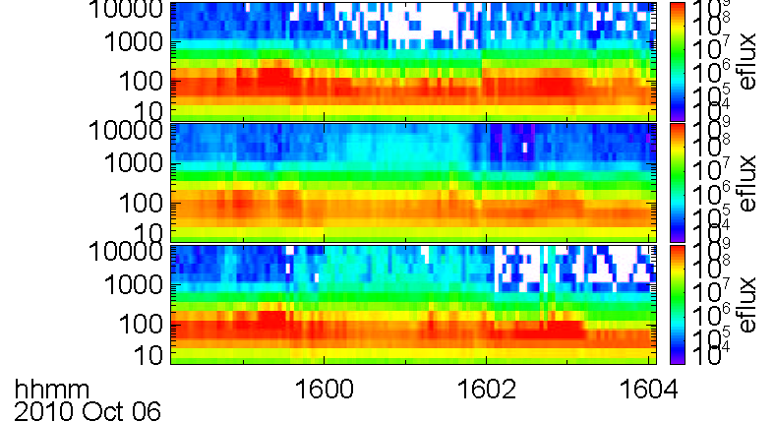
THEMIS: Converging jets
|B|
(nT)
Flux rope-like:
Converging jets
Large core field
B_{N} reversal
NOT flux rope-like:
Converging jets create a thin interface current sheet
Disconnection across B_{N} reversal (Kacem et al. 2018)
Strong magnetic field pileup on both sides
B
(nT)
magneto-
sphere
B_{X}
magneto-
sheath
B_{Y}
Z
B_{Z}
X
V
(km/s)
V_{Z}
THEMIS
180°
(eV)
90°
(eV)
0°
(eV)
Not a usual flux rope. What can it be?

Slide 6
Interlinked flux tubes
Can form when multiple X-lines are present
(Nishida, 1989)
(Hesse et al., 1990)
Thin current sheet can form at the interface of interlinked flux tubes

Slide 7
THEMIS: Converging jets at the magnetopause
|B|
(nT)
B
(nT)
magneto-
sphere
B_{X}
magneto-
sheath
B_{Y}
Z
B_{Z}
X
V
(km/s)
V_{Z}
THEMIS
180°
(eV)
90°
(eV)
0°
(eV)

Slide 8
THEMIS: Converging jets at the magnetopause
|B|
(nT)
B
(nT)
magneto-
sphere
B_{X}
Can explain thin current sheet and disconnection at interface
magneto-
sheath
B_{Y}
Z
B_{Z}
X
V
(km/s)
V_{Z}
THEMIS
180°
(eV)
Can the thin current sheet reconnect?
90°
(eV)
0°
(eV)

Slide 9
MMS: Reconnection in the interface current sheet
MMS
|B|
(nT)
Flux rope-like structure
Thin (~2 s, 2.5 d_{i}) current sheet at center
V_{X} jet indicates reconnection
Electron heating
Strong current
Large electric field
magneto-
sphere
B
(nT)
magneto-
sheath
B_{X} B_{Y} B_{Z}
Z
X
V_{i}
(km/s)
V_{X} V_{Y} V_{Z}
T_{e}
(eV)
T_{e,perp}
T_{e||}
j_{curlB}
(μA m⁻²)
j_{X} j_{Y} j_{Z}
Reconnection between interlinked magnetic fields
E
(mV/m)
E_{X} E_{Y} E_{Z}
(Øieroset et al., 2016)

Slide 10
Detailed thin current sheet observations and comparison with simulations
MMS4
Simulation
B
(nT)
B_{L} B_{M} B_{N}
B_{M}
(nT)
B_{M}
Out of plane B_{M}
Density asymmetry
Shift in T_{i} anisotropy
Shift in T_{e} anisotropy
E_{N} mostly monopolar
Bifurcated J_{M}
N_{e}
(cm⁻³)
N_{e}
Large guide field
Symmetric inflow
Good agreement with
simulations
V_{i}
(km/s)
V_{iL} V_{iM}
V_{iN}
T_{i}
(eV)
T_{i,perp} T_{i||}
T_{e}
(eV)
T_{e,perp}
T_{e||}
E
(mV/m)
E_{L} E_{M} E_{N}
j_{curlB}
(μA m⁻²)
j_{L} j_{M} j_{N}
(Øieroset et al., 2016)

Slide 11
Four converging jet events
Øieroset et al. (2019)
Øieroset et al. (2016)
B_{L}
(nT)
B_{L}
(nT)
B_{M}
(nT)
Thin current sheet
Strong electron heating
Large B pileup
B_{M}
(nT)
V_{i}
(km/s)
V_{i}
(km/s)
T_{e}
(eV)
T_{e}
(eV)
Kacem et al. (2018)
THEMIS – Øieroset et al. (2011)
B_{L}
(nT)
B_{L}
(nT)
B_{M}
(nT)
B_{M}
(nT)
V_{i}
(km/s)
V_{i}
(km/s)
Large B pileup rarely seen in other regimes
Why do we have B pileup?
T_{e}
(eV)
T_{e}
(eV)

Slide 12
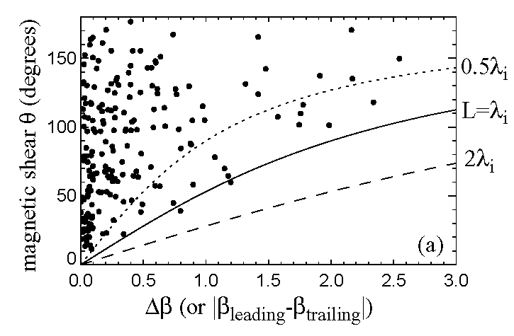
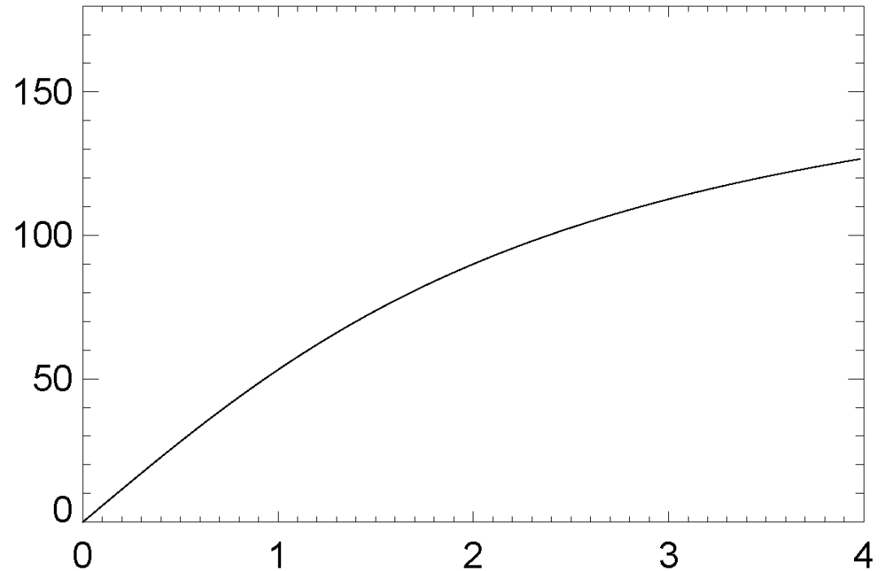

Reconnection occurrence depends on Δβ and magnetic shear
$$Δβ>2\left(\frac{L}{λ_{i}}\right)\tan\left(\frac{θ}{2}\right)$$
Diamagnetic drift of X-line prevents reconnection if drift speed > Alfvén speed:
(Swisdak et al., 2003, 2010; Phan et al., 2010, 2013)
180
180
Reconnection allowed
magnetic shear θ (degrees)
no reconnection
Δβ = β2−β1
How does B pileup affect Δβ and magnetic shear?

Slide 13
Four converging jet events
Øieroset et al. (2019)
Øieroset et al. (2016)
B_{L}
(nT)
B_{L}
(nT)
B_{M}
(nT)
Thin interface current sheet
Strong electron heating
Large B pileup
B_{M}
(nT)
V_{i}
(km/s)
V_{i}
(km/s)
T_{e}
(eV)
T_{e}
(eV)
Kacem et al. (2018)
THEMIS – Øieroset et al. (2011)
B_{L}
(nT)
B_{L}
(nT)
B_{M}
(nT)
B_{M}
(nT)
V_{i}
(km/s)
V_{i}
(km/s)
Large B pileup rarely seen in other regimes
Why do we have B pileup?
T_{e}
(eV)
T_{e}
(eV)

Slide 14
Effect of B pileup on Δβ and shear
Before pileup: Reconnection not allowed

Slide 15
Effect of B pileup on Δβ and shear
Before pileup: Reconnection not allowed
After pileup: Reconnection allowed!

Slide 16
Effect of B pileup on Δβ and shear
Δβ decreases with pileup
Magnetic shear increases with pileup
Magnetic fields rotate to become more perpendicular to each other
Leads to conditions favorable for reconnection
We have B pileup because without pileup reconnection cannot happen

Slide 17
Electron heating
Øieroset et al. (2019)
Øieroset et al. (2016)
B_{L}
(nT)
B_{L}
(nT)
B_{M}
(nT)
Strong heating in the interface current sheet
Why?
B_{M}
(nT)
V_{i}
(km/s)
V_{i}
(km/s)
T_{e}
(eV)
T_{e}
(eV)
Kacem et al. (2018)
THEMIS – Øieroset et al. (2011)
Enhanced electron heating is a consequence of B pileup
B_{L}
(nT)
B_{L}
(nT)
B_{M}
(nT)
B_{M}
(nT)
V_{i}
(km/s)
V_{i}
(km/s)
T_{e}
(eV)
T_{e}
(eV)

Slide 18
Electron heating is function of available magnetic energy per particle
When the magnetic energy increases, the electron heating also increases
ΔT_{e} = 0.017 m_{i} V_{A,asym}²
ΔT_{e} ~ 1.7% of magnetic energy
Pileup leads to enhanced electron heating
Slope= 0.017
ΔT_{e} (eV)
m_{i} V_{A,asym}² (eV)
(Phan et al., 2013)

Slide 19
Electron heating is function of available magnetic energy per particle
MMS converging jet events
Slope= 0.017
ΔT_{e} (eV)
m_{i} V_{A,asym}² (eV)
Electron heating in the interface current sheet is well predicted by the empirical formula from Phan et al. (2013)

Slide 20
Conclusions
Multiple X-lines can create interlinked flux tubes
Thin reconnecting current sheet at the interface
Significant B pileup on approach to the interface current sheet
B pileup because at first the interlinked flux tubes cannot reconnect. Only after pileup is reconnection possible
B pileup also leads to strong electron heating

Slide 21
Open questions
How common are interlinked flux tubes?
Why do some multiple X-line events develop into flux ropes/FTEs while others do not?

