Slide 1
High-resolution measurements of the cross-shock potential, ion reflection, and electron heating at an interplanetary shock by MMS Steven J Schwartz¹, Ian J Cohen², Robert Ergun^{1,3}, Narges Ahmadi¹, Katherine Goodrich^{1,4}, Hanying Wei⁵, Brian J Anderson⁶, Matthew R Argall⁷, James L Burch⁸, Eric R Christian⁹, Mihir Indrajit Desai⁹, Stephen A Fuselier⁸, Barbara L Giles⁹, Olivier Le Contel¹⁰, Barry Mauk⁷, David J McComas¹¹, Jason R Shuster⁷, Robert J Strangeway⁵, Roy B Torbert⁷, Sarah K. Vines^{12,2}, Joseph H Westlake⁶ and Gary Paul Zank¹³ (1)Laboratory for Atmospheric and Space Physics, Boulder, CO, United States, (2)Applied Physics Laboratory Johns Hopkins, Laurel, MD, United States, (3)University of Colorado, Boulder, CO, United States, (4)SSL, UC Berkeley, (5)University of California Los Angeles, Los Angeles, CA, United States, (6)Johns Hopkins Univ, Laurel, MD, United States, (7)University of New Hampshire, Durham, NH, United States, (8)Southwest Research Institute San Antonio, San Antonio, TX, United States, (9)NASA GSFC, Greenbelt, MD, United States, (10)Laboratoire de Physique des Plasmas (UMR7648), CNRS/Ecole Polytechnique/UPMC/Univ. Paris Sud/Obs. de Paris, Paris, France, (11)Princeton University, Department of Astrophysical Sciences, Princeton, NJ, United States,(12)University of Texas at San Antonio, San Antonio, TX, United States, (13)Univ of Alabama, Huntsville, Huntsville, AL, United States

Slide 2
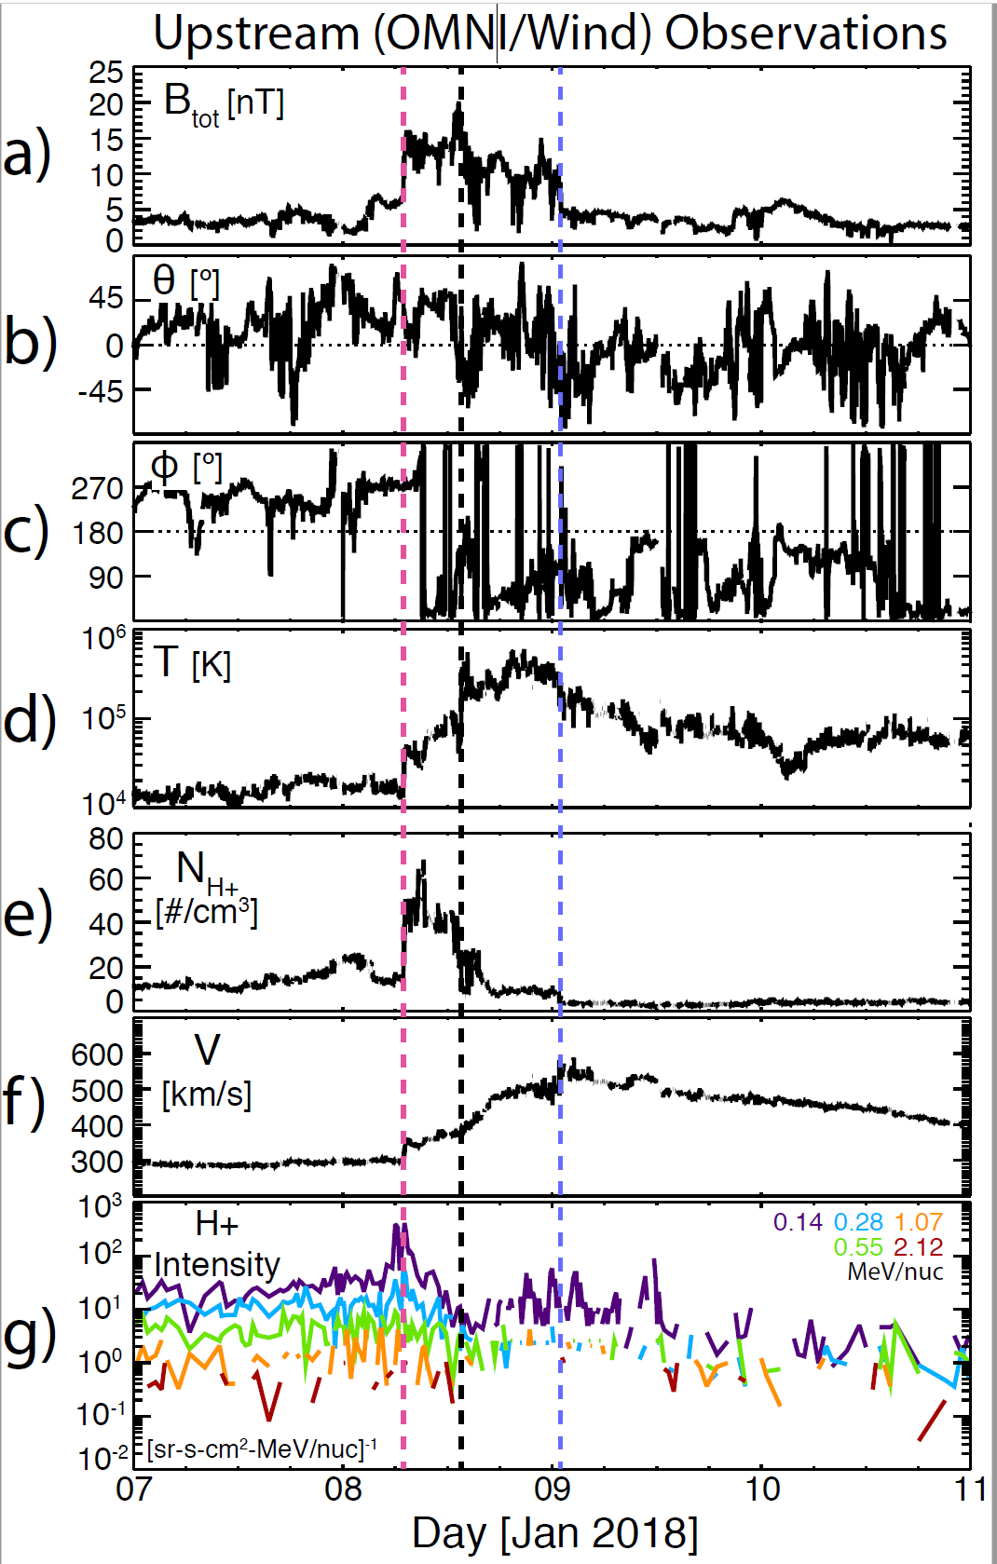
Outline/Motivation
Low Mach number travelling interplanetary shock (Forward shock @ CIR)
Electrodynamics (E, B) and structure
Compare fields, potentials and particle proxies thereof
Resolve particle dynamics
Requires MMS capabilities

Slide 3
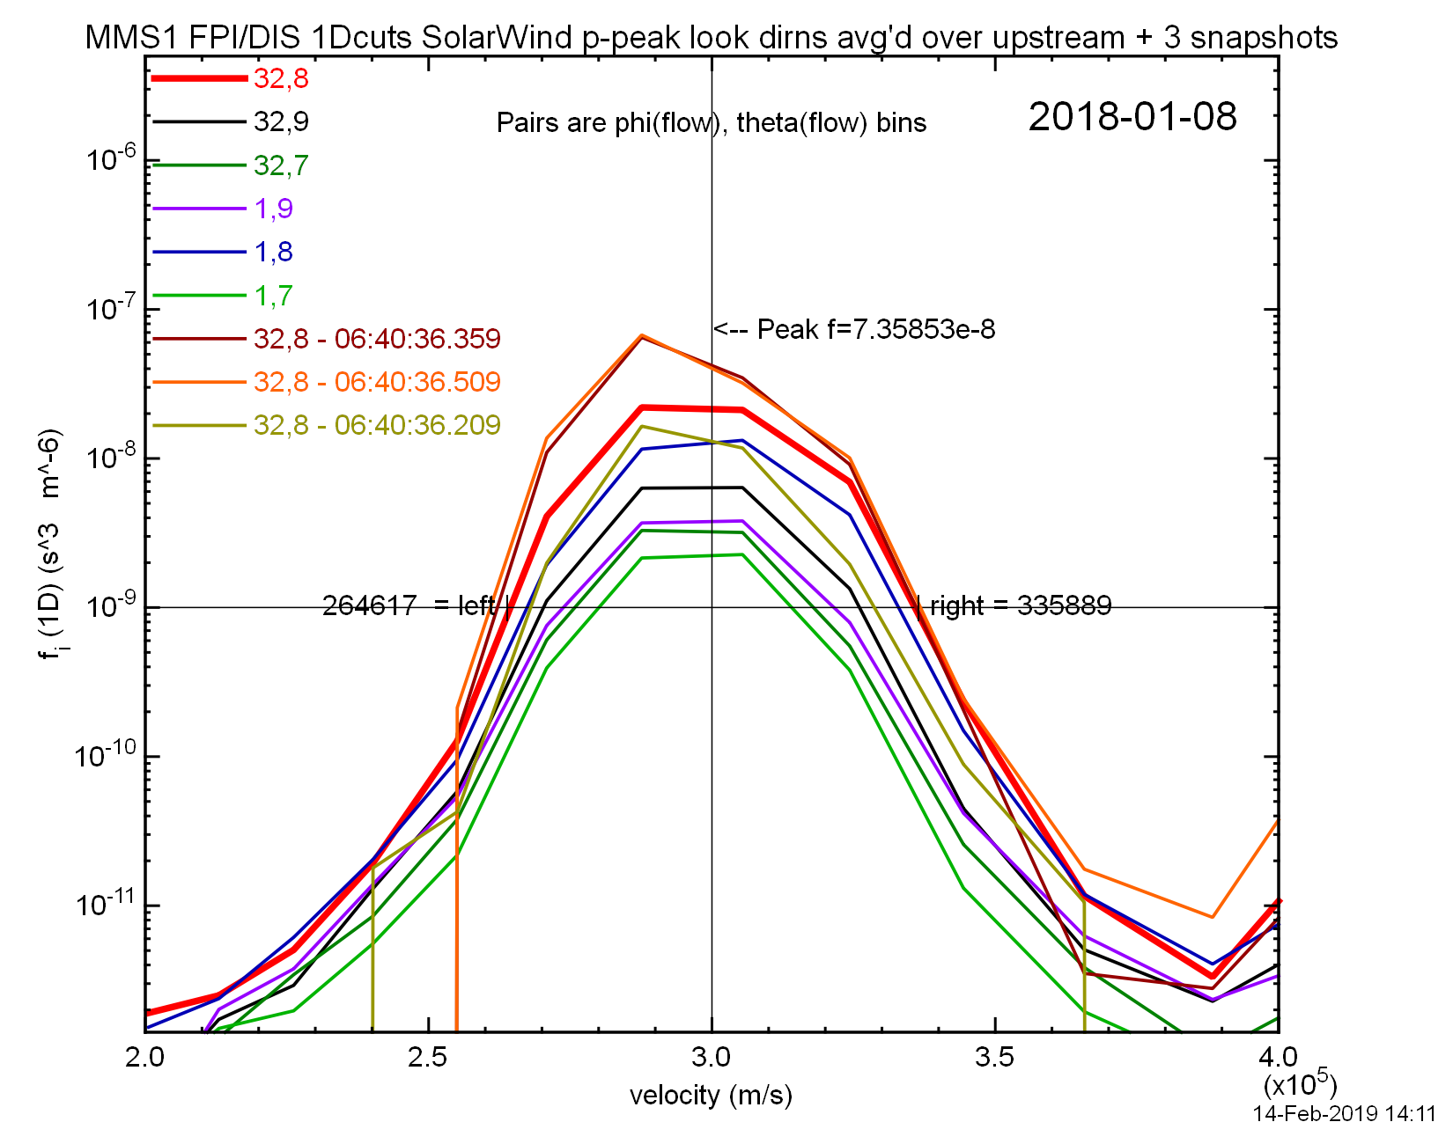
Aside: Solar wind moments <-> shock params
SW proton beam not well resolved by FPI
From Nov 2017, better energy res, but same angular
Strategies (all bad!):
Source | Ni (/cm³) | Ti (eV) | Ne (/cm³) | Te (eV)
Mission L2 CDFs | 8 | 27 | 11 | 10
Partial moment sums | 7 | 4.3
Ion 1D Fits | 2.1 | 1.6
OMNI/Wind | 10 | 3 | 11 | 9

Slide 4
Overview
M_{ms} ~ 1.9 [M_{crit} ~1.5]
β~ 1.5
θ_{Bn} ~ 113º (67º)
V_{N}^{NIF} ~ 113 km/s
Ramp ~ 34 km ~ 1.25 c/ω_{pi}
Above utlizes 4 s/c capabilities

Slide 5
Electrodynamics
Consistent E signatures all 4 s/c
Some features < s/c separation ( ~ 17 km ~ 0.6 d_{i})
Estimates of E_{N} from:
<DC 3D E booms>_{s/c}
<e- momentum eqn>_{s/c}
1 s/c 1D Hall physics
=> potential ≤ 40 eV
Uses 4 s/c ∇•P_{e}
.

Slide 6
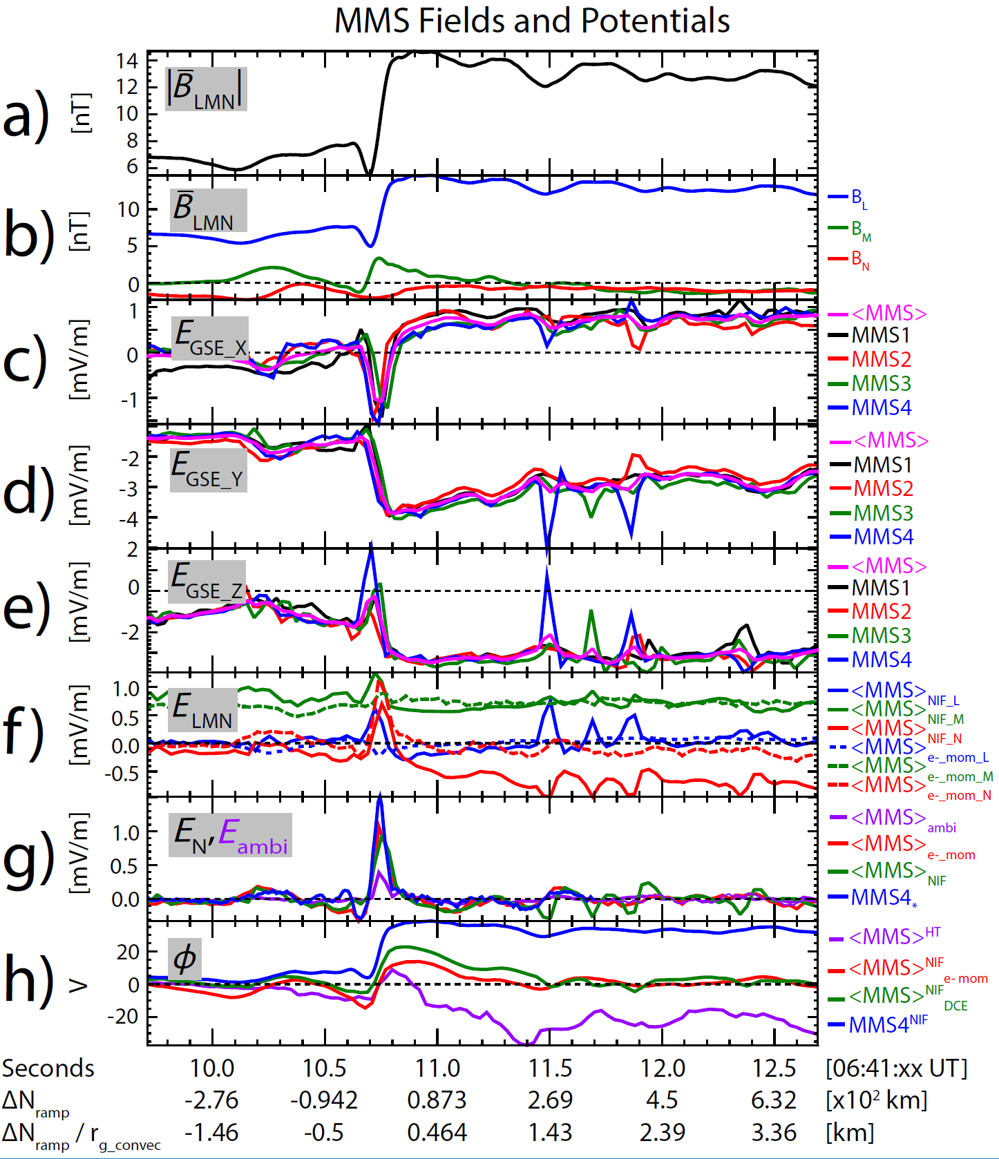
Electrodynamics
Consistent E signatures all 4 s/c
Some features < s/c separation ( ~ 17 km ~ 0.6 d_{i})
Estimates of E_{N} from:
<DC 3D E booms>_{s/c}
<e- momentum eqn>_{s/c}
1 s/c 1D Hall physics
=> potential ≤ 40 eV
Uses 4 s/c ∇•P_{e}
De Hoffmann-Teller (ambipolar) potential ~ 18 eV
Downstream spikes ⬄ ongoing relaxation < s/c scales

Slide 7
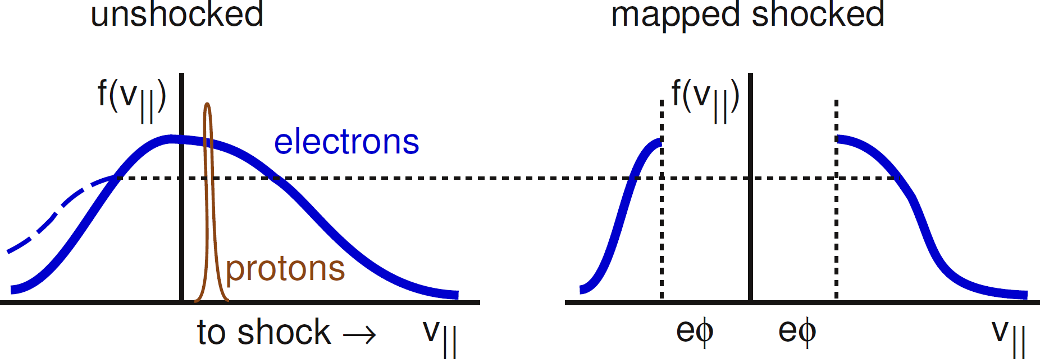
Electrons
V_{th e} >> V_{flow} i.e. shock sub-thermal
e- remain magnetized
Energy ⬄ dHT (ambipolar) φ
Inferred φ ~ 10eV < 18 eV from ∇•P_{e}
Accumulation of errors in ∇•P_{e} from t-resolution (3pts), linear ∇ approx., shock velocity, …
|B|
φ^{HT}
“unshocked“
+10eV

Slide 8
DC-AC fields
B
E_{N}
Bi-polar DC E_{N} @ 12Hz
=> non-monotonic φ
Some structure @ 100 Hz
Linked to mono-polar & bi-polar E|| @ 8192 Hz with x10 E amplitude
Downstream bursts similar
E||
B
E_{N}
E||
0.25 s

Slide 9
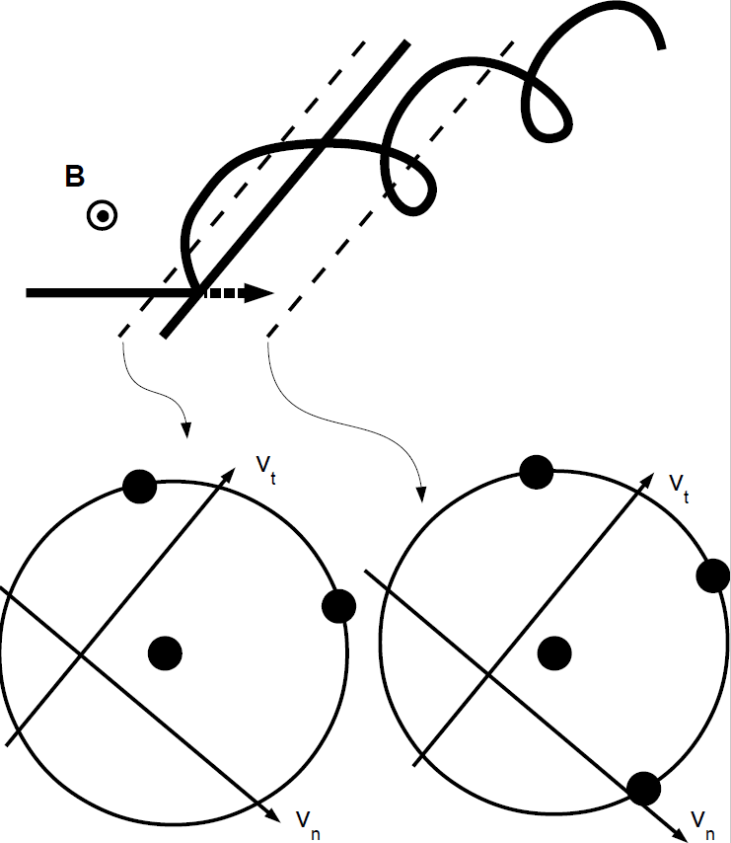
Ions: Specular Reflection
Some incident ions reflect @ ramp
Gyration returns them to shock
Simple in H-T frame
no E
V|| = const
V⊥ = gyration
Characteristic orbit in v-space
Leads to spread in velocity space ⬄ “heating”

Slide 10
Ion dynamics
Expect super-crit shock to reflect ions
Specular refl = orbit shown
φ=38 eV reflects ~3% tail of incident protons
Obs ~7% requires help from foot, B, etc.
Interesting population near O^{HT}
Lingers near shock
Small part may escape upstream
V_{m}
B
V_{l}
V_{n}->

Slide 11
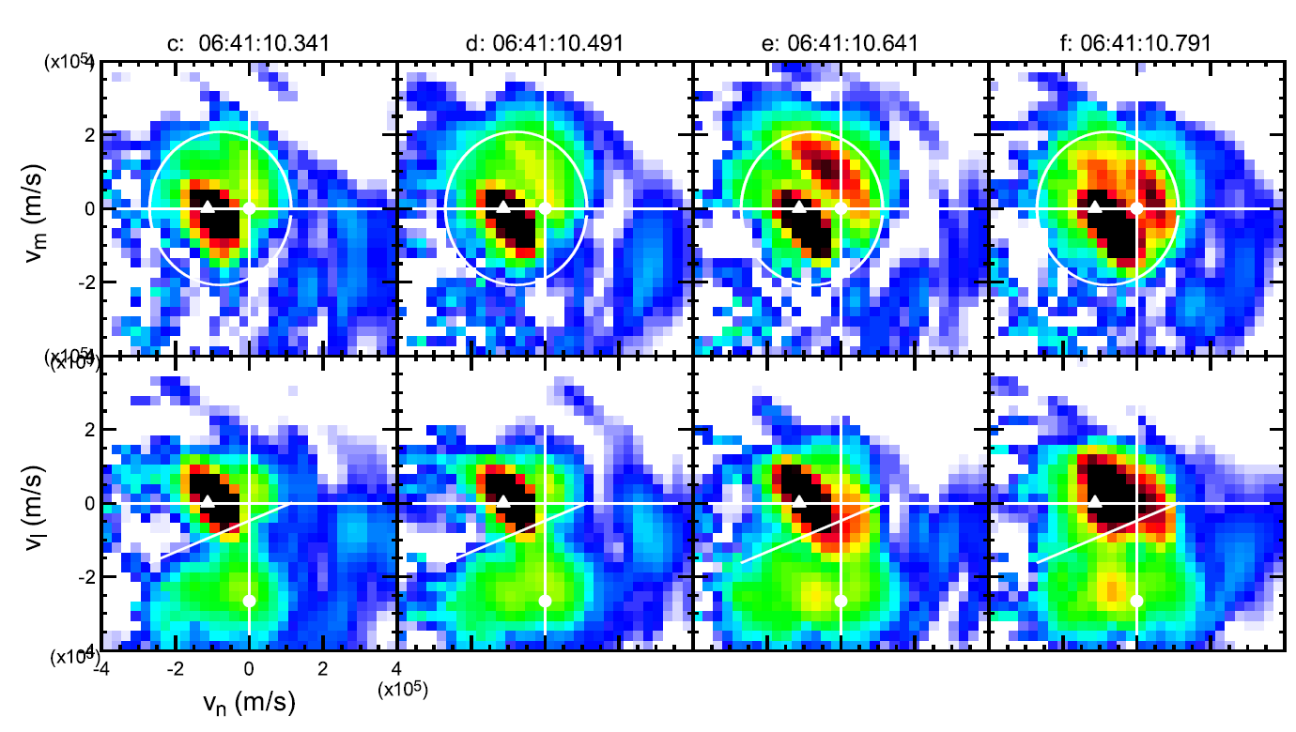
Ion dynamics
Expect super-crit shock to reflect ions
Specular refl = orbit shown
φ=38 eV reflects ~3% tail of incident protons
Obs ~7% requires help from foot, B, etc.
Interesting population near O^{HT}
Lingers near shock
Small part may escape upstream
V_{m}
B
V_{l}
V_{n}->

Slide 12
Conclusions
Low M IP shock under MMS microscope
Super-critical – looks, walks and quacks like one
DC & AC E-fields + ∇•P_{e} provide estimates of shock potential φ
Electron response consistent with simple φ^{HT} but smaller than predicted by ∇•P_{e}
High-res E reveals large-amplitude mono- and bipolar features @ shock and nearby that support this non-monotonic φ
Contributes to growing understanding of small-scale ⬄ medium-scale physics
Resolved near-specularly reflected ions
Separate near-escaping ion population near O^{HT}
Look forward to another IP shock at lower M

