Slide 1
MMS study of the structure and evolution of ion-scale flux ropes in the Earth’s cross-tail current sheet
Weijie Sun ¹, James A. Slavin ¹, Anmin Tian ², Shichen Bai ², Gangkai Poh ^{3,4}, Mojtaba Akhavan-Tafti ¹, San Lu ⁵, Shutao Yao ², Guan Le ³, Rumi Nakamura ⁶, Barbara L. Giles ³, Jim L. Burch ⁷.
1 Department of Climate and Space Sciences and Engineering, University of Michigan, Ann Arbor, Michigan 48109, USA.
2 Shandong Provincial Key Laboratory of Optical Astronomy and Solar-Terrestrial Environment, School of Space Science and Physics, Shandong University, Weihai, 264209, China
3 NASA Goddard Space Flight Center, Greenbelt, Maryland 20771, USA
4 Center for Research and Exploration in Space Sciences & Technology II, University of Maryland Baltimore County, Baltimore, Maryland 21250, USA
5 Department of Earth, Planetary, and Space Sciences, University of California, Los Angeles, California, USA
6 Space Research Institute, Austrian Academy of Sciences, Graz, Austria
7 Southwest Research Institute, San Antonio, Texas, USA

Slide 2
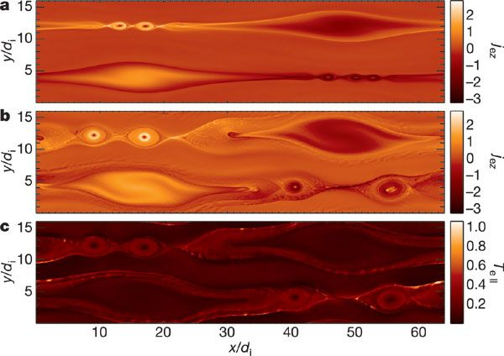
Ion Scale Flux Ropes
In simulations, ion scale flux ropes formed due to the tearing instability in the electron scale current layer.
Contracting or coalescence generate energetic electrons,
Influence the reconnection rate.
[e.g., Drake et al., 2006; Nakamura et al., 2010; Daughton et al., 2011].
[e.g., Drake et al., 2006; Chen et al., 2007; Eastwood et al., 2007; Karimabadi et al., 2007].
[Drake et al., 2006]

Slide 3
MMS observations
Flux transfer events (FTEs):
current filaments,
force balance,
evolutions in scale, etc.
[e.g., Eastwood et al., 2016; Zhao et al., 2016; Dong et al., 2017; Akhavan‐Tafti et al., 2018].
Initial results on the ion-scale flux ropes in the tail
electron vortex inside flux rope [Stawarz et al., 2018];
the flux rope axes [Teh et al., 2018].
[Stawarz et al., 2018]
[Teh et al., 2018]

Slide 4
Science Objectives
Multi-flux ropes study with multi-spacecraft technique will determine:
Magnetic field topology
Dimensionality
Magnetic field variations
Evolution of ion-scale flux ropes

Slide 5
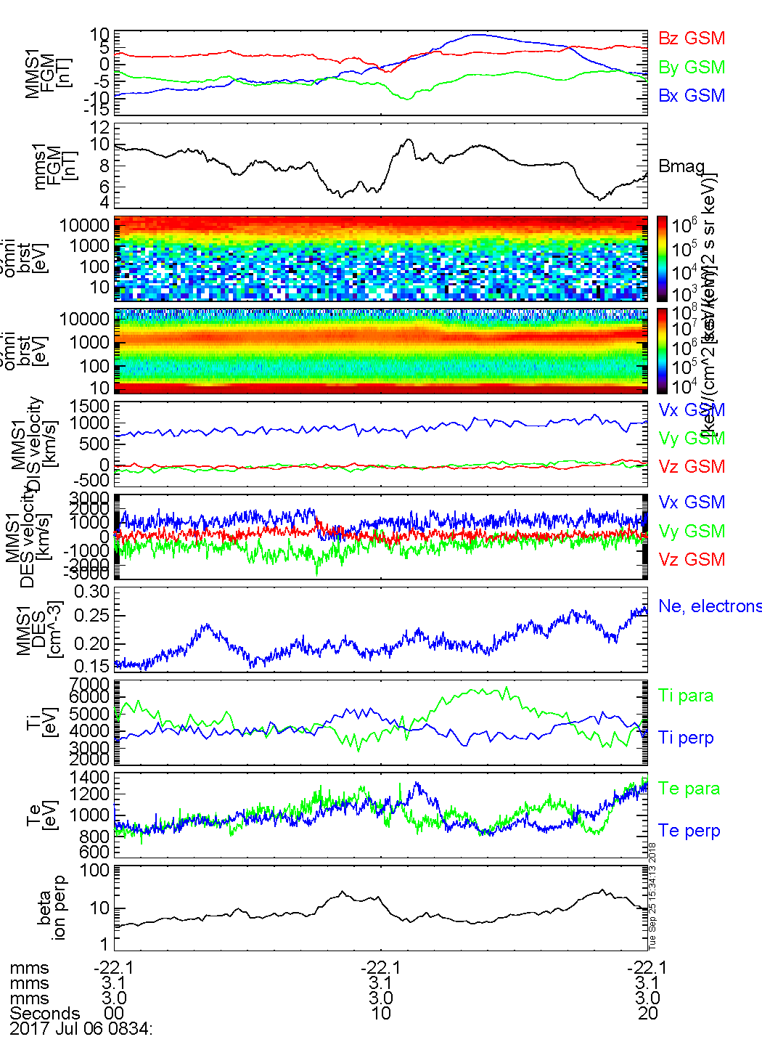
July-06 2017 flux rope
Central plasma sheet: |B_{x}| < 5 nT, beta > 1
Guide field B_{y} ~ 5nT, B_{y}/B_{Lobe} ~0.23
Earthward flow of ~ 800 km/s
N_{e} shows small increase (~ 6%)
Scale, 2,070 km, ~4.0 di

Slide 6
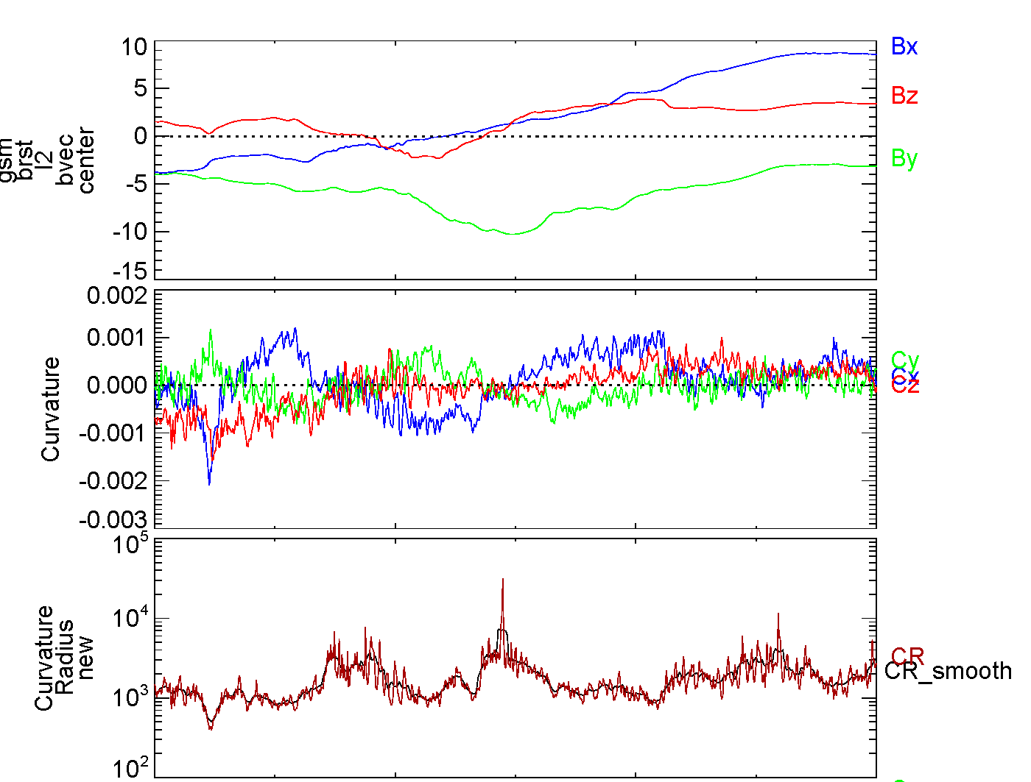
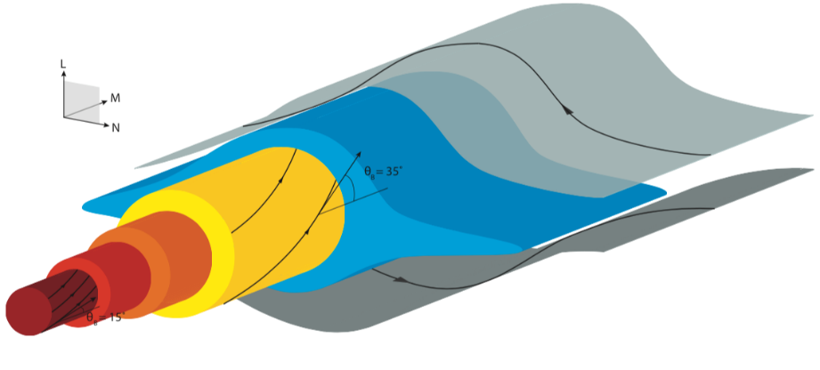

July-06 2017 flux rope: Magnetic curvature
[Akhavan‐Tafti et al., 2018, in preparation]
Curvature , where b is the unit magnetic vector.
Reversals in the X and Y components confirm the helical field structure.
Local maximum of the curvature radius in the center of the structure, low degree twist of field line.

Slide 7
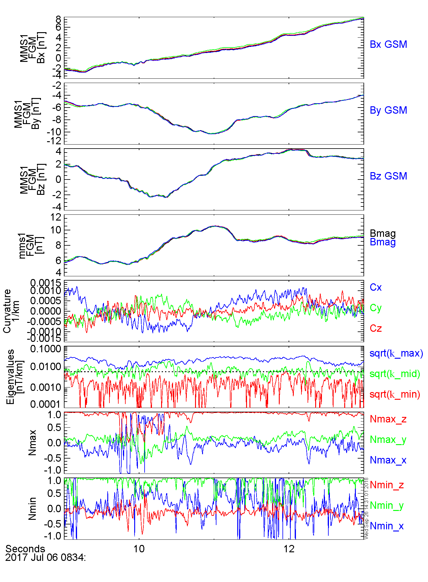
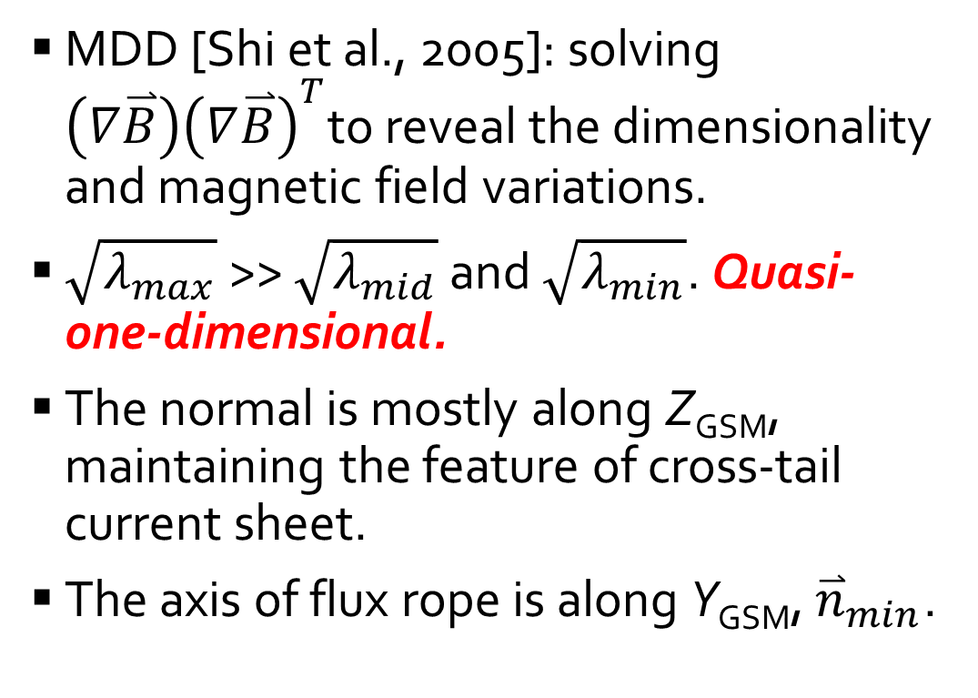
July-06 2017 flux rope: Magnetic field variations
MDD [Shi et al., 2005]: solving $\left(∇\overset{⃑}{B}\right){\left(∇\overset{⃑}{B}\right)}^{T}$to reveal the dimensionality and magnetic field variations.
$\sqrt{λ_{max}}$ >> $\sqrt{λ_{mid}}$ and $\sqrt{λ_{min}}$. Quasi-one-dimensional.
The normal is mostly along Z_{GSM}, maintaining the feature of cross-tail current sheet.
The axis of flux rope is along Y_{GSM}, ${\overset{⃑}{n}}_{min}$.

Slide 8
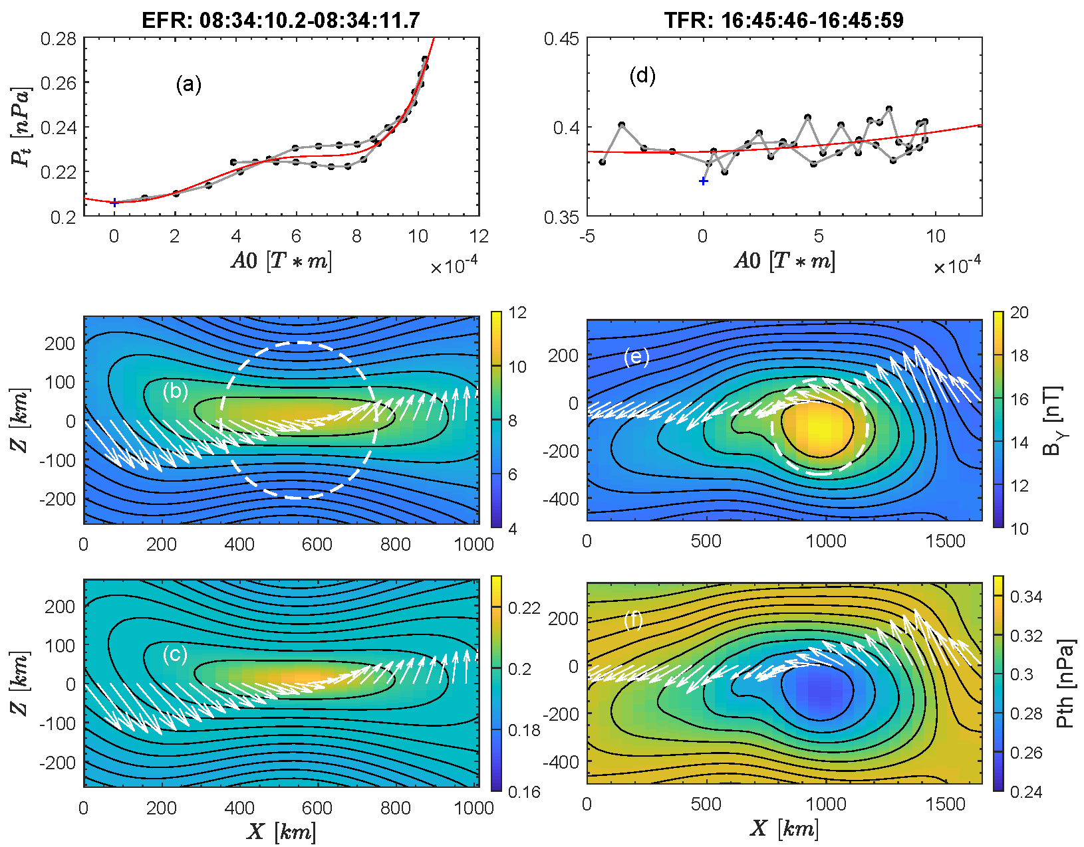
July-06 2017 flux rope
GS Reconstruction
Local coordinate from MDD:
  X = [-0.96, -0.29, 0.03];
  Y = [-0.30, 0.95, -0.11];
  Z = [0.00, 0.17, 0.99];
Vstr = [811, -24, -62] km/s.
Flatten feature, normal close to Z_{GSM}
Confirm quasi-1D feature from analysis of MDD
Magnetic field increase in the center;
Thermal pressure increase in the center.
Both are consistent with the observations.

Slide 9
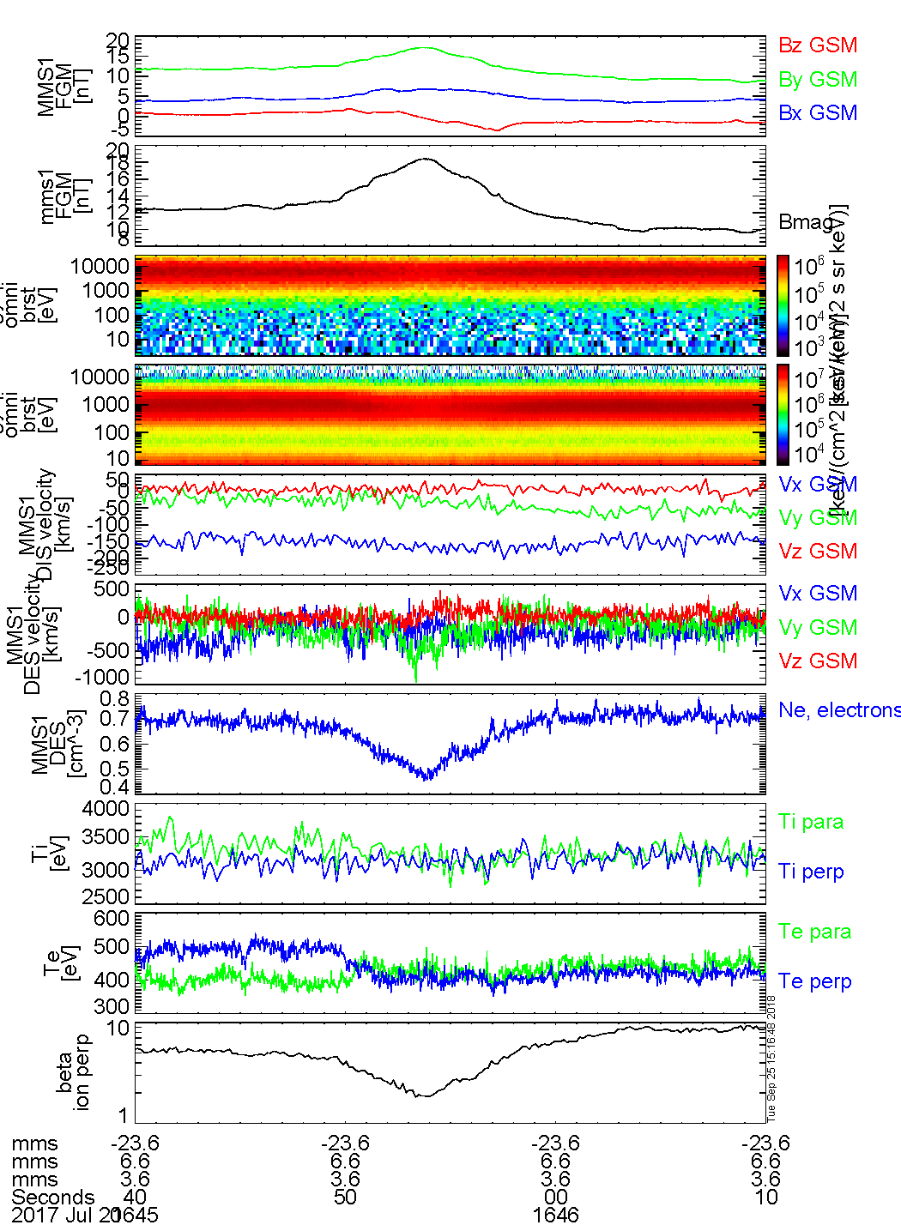
July-20 2017
Central plasma sheet: |B_{x}| < 5 nT, beta > 1
Guide field B_{y} ~ 12nT, B_{y}/B_{Lobe} ~0.37
Tailward flow of ~ -200 km/s
N_{e} shows clear decrease (~ - 36%)
Scale, 1,050 km, ~3.9 di

Slide 10
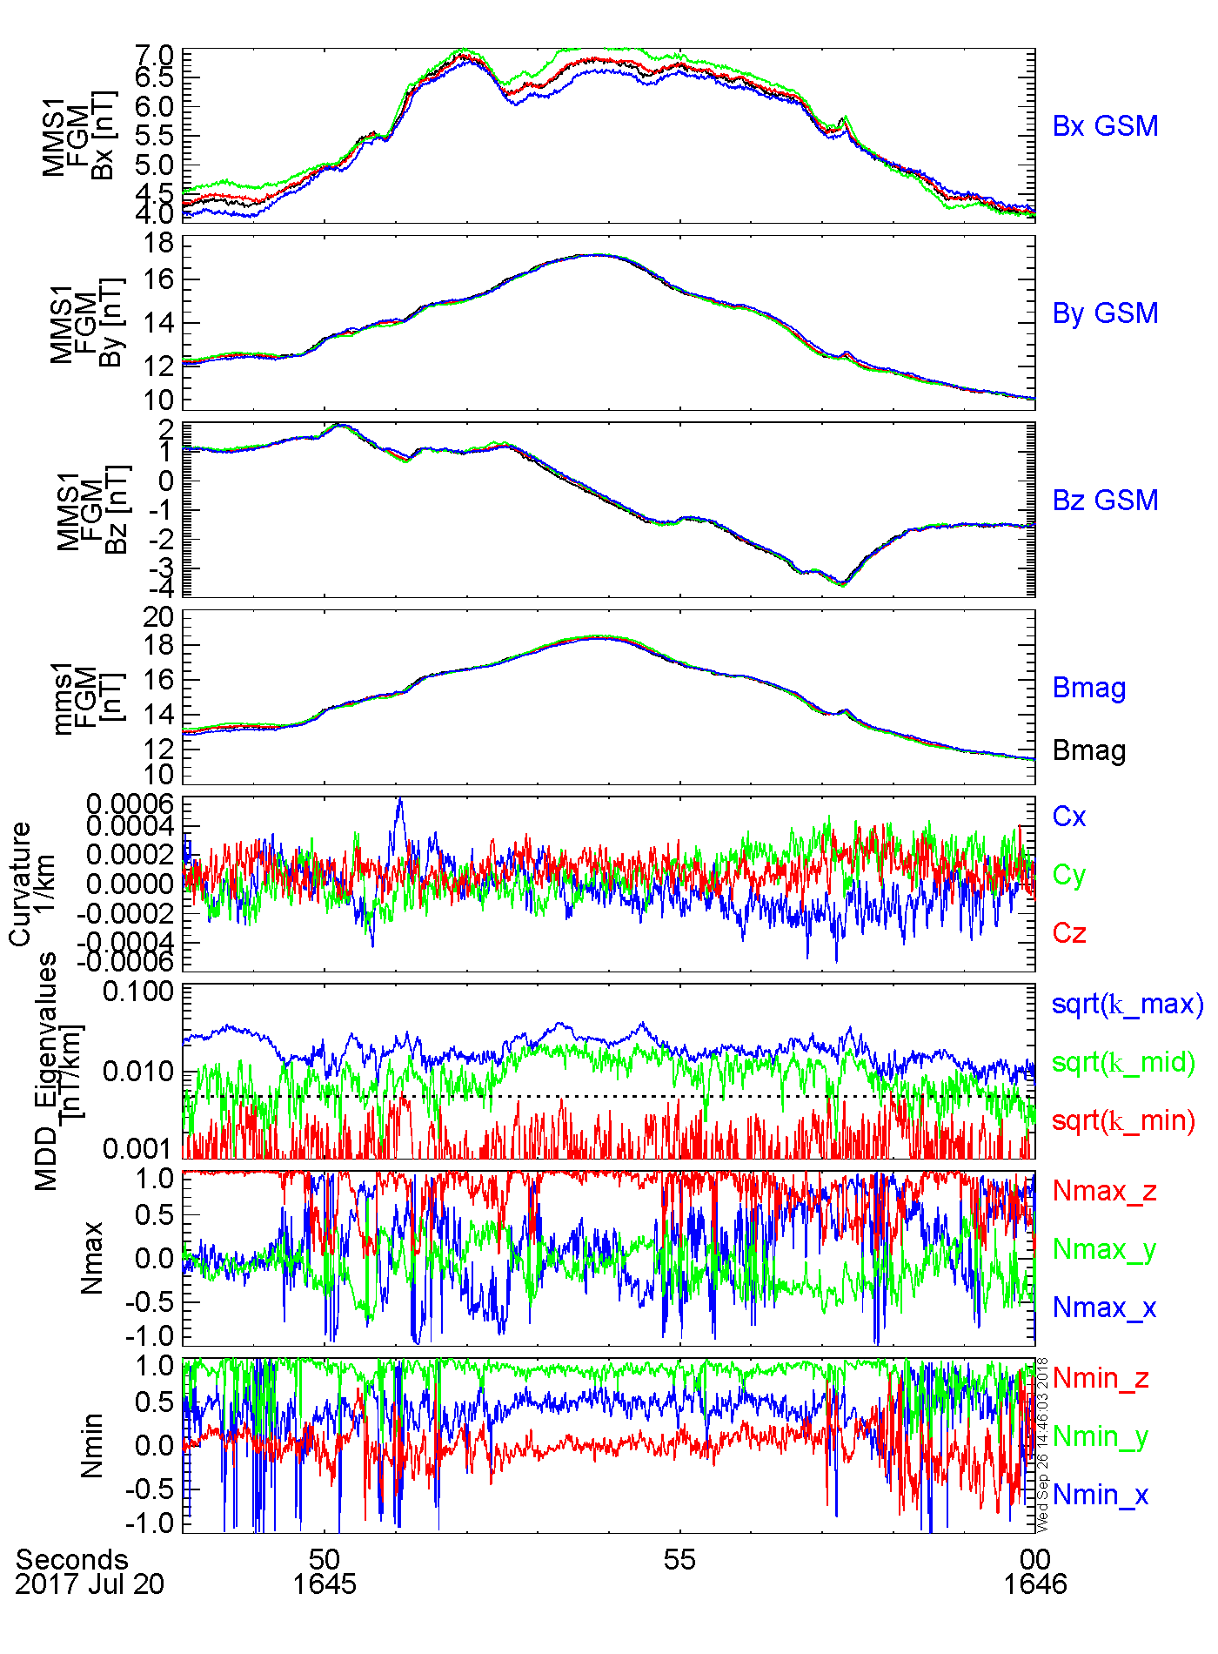
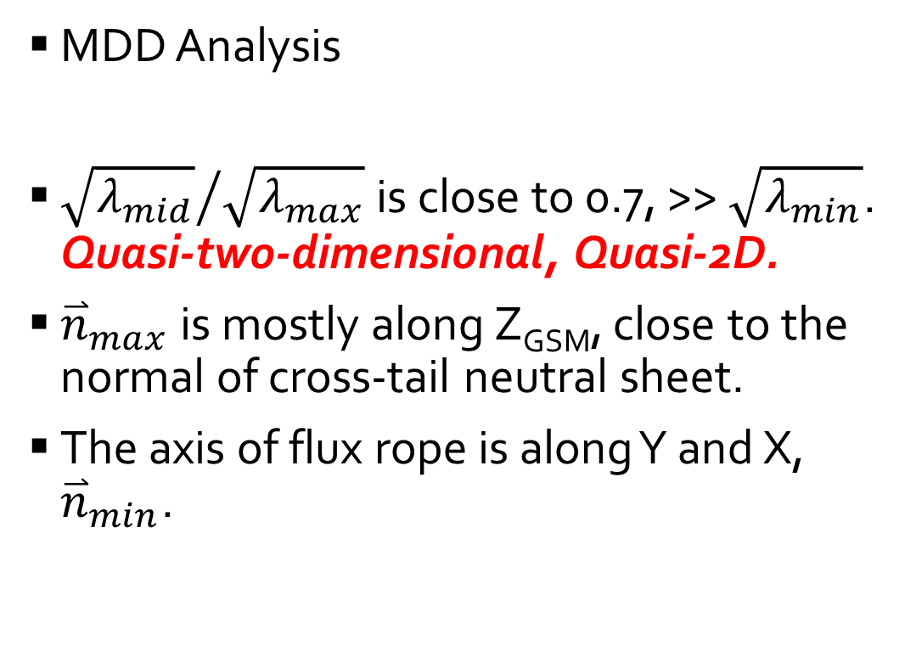
July-20 2017 flux rope: Magnetic field variations
MDD Analysis
${\sqrt{λ_{mid}}}/{\sqrt{λ_{max}}}$ is close to 0.7, >> $\sqrt{λ_{min}}$. Quasi-two-dimensional, Quasi-2D.
${\overset{⃑}{n}}_{max}$ is mostly along Z_{GSM}, close to the normal of cross-tail neutral sheet.
The axis of flux rope is along Y and X, ${\overset{⃑}{n}}_{min}$.

Slide 11
July-20 2017 flux rope
GS Reconstruction
Local coordinate from MDD:
  X = [0.87, -0.47, 0.11];
  Y = [0.47, 0.88, 0.02];
  Z = [0.10, -0.04, -0.99];
Vstr : [-116, 58, -3.0] km/s
Circular feature, normal close to Z_{GSM}
Confirm quasi-2D feature of the ion scale flux rope
Magnetic field increase in the center;
Thermal pressure decrease in the center (density depletion).
Both are consistent with the observations.

Slide 12
Summary of the Case Study
 | July-06 2017 | July-20 2017
Dimensionality | Quasi-1D | Quasi-2D
Guide Field | B_{y} ~ 5nT, B_{y}/B₀ ~0.23 | B_{y} ~ 12nT, B_{y}/B₀ ~0.37
Plasma Density | A small increase (~ 6%) | Clear decrease (~ - 36%)
Magnetic field structure

Slide 13
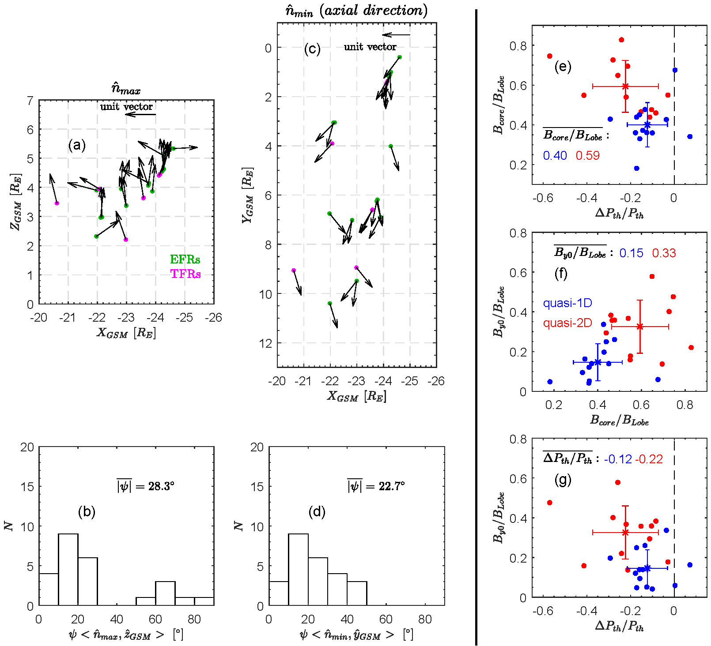
Statistical Results (1): Core Field, Guide Field, Thermal Pressure
Quasi-2D flux ropes (red dots) have larger core field (~ 0.59) than the quasi-1D flux ropes (blue dots, ~ 0.40);
Decrease of P_{th} inside quasi-2D flux ropes (~ -0.22) were more prominent than that of quasi-1D flux ropes (~ -0.12).
Quasi-2D flux ropes were observed in environments with relatively larger guide field (~ 0.33) than the quasi-1D flux ropes (~ 0.15).
Evolution from Flatten (1D) to Circular Cross-Section (2D)?

Slide 14
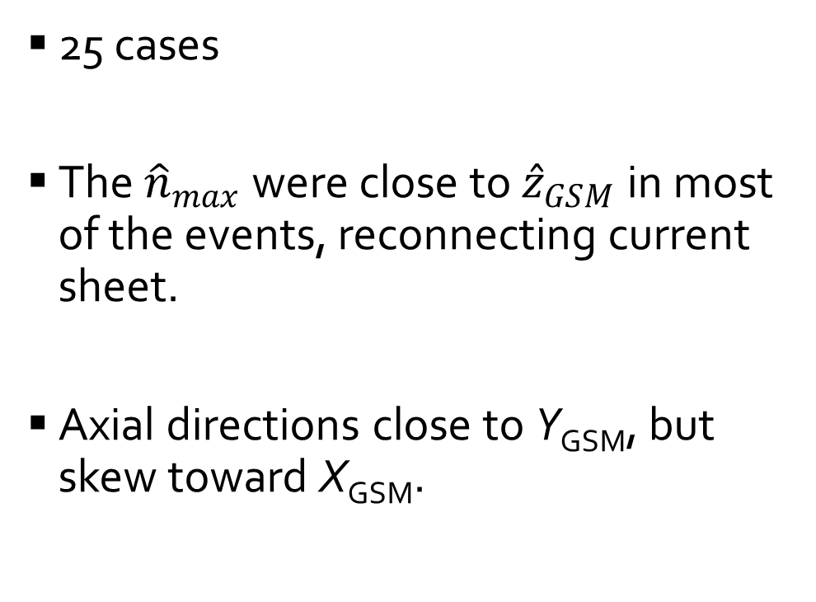
Statistical Results (2): Field Variations
25 cases
The ${\hat{n}}_{max}$ were close to ${\hat{z}}_{GSM}$ in most of the events, reconnecting current sheet.
Axial directions close to Y_{GSM}, but skew toward X_{GSM}.
[Nakamura et al., 2016; Teh et al., 2018]

Slide 15
Conclusion
Ion-scale flux ropes are observed to have either flattened or circular cross-sections.
Flux ropes with circular cross-sections have stronger core field and fewer particles than flattened flux ropes.
Flux ropes are expected to evolve from flattened to circular cross-sections as their internal plasma is depleted.

Slide 16
Thank you!

Slide 17
Outline
Introduction
MMS case studies
  Magnetic Field Variations
  Dimensionality
  Flux Rope Structure
Statistical Results
Conclusions

Slide 18
Methodology
Selection of ion-scale flux ropes
  B_{z} bipolar, B_{y}, B_{t} increase
  |B_{x}| < 5 nT,
  Scale < 10 di, ion inertial length
  Curvature analysis
Gives 25 events from Phase 2B of MMS.
Multi-spacecraft techniques
  Magnetic Curvature Analysis;
  Minimum Directional Derivative (MDD)
  GS reconstruction validates the results
[Shen et al., 2007]
  [Shi et al., 2005]
[Sonnerup and Guo, 1996; Hau and Sonnerup, 1999]

